Slide 1
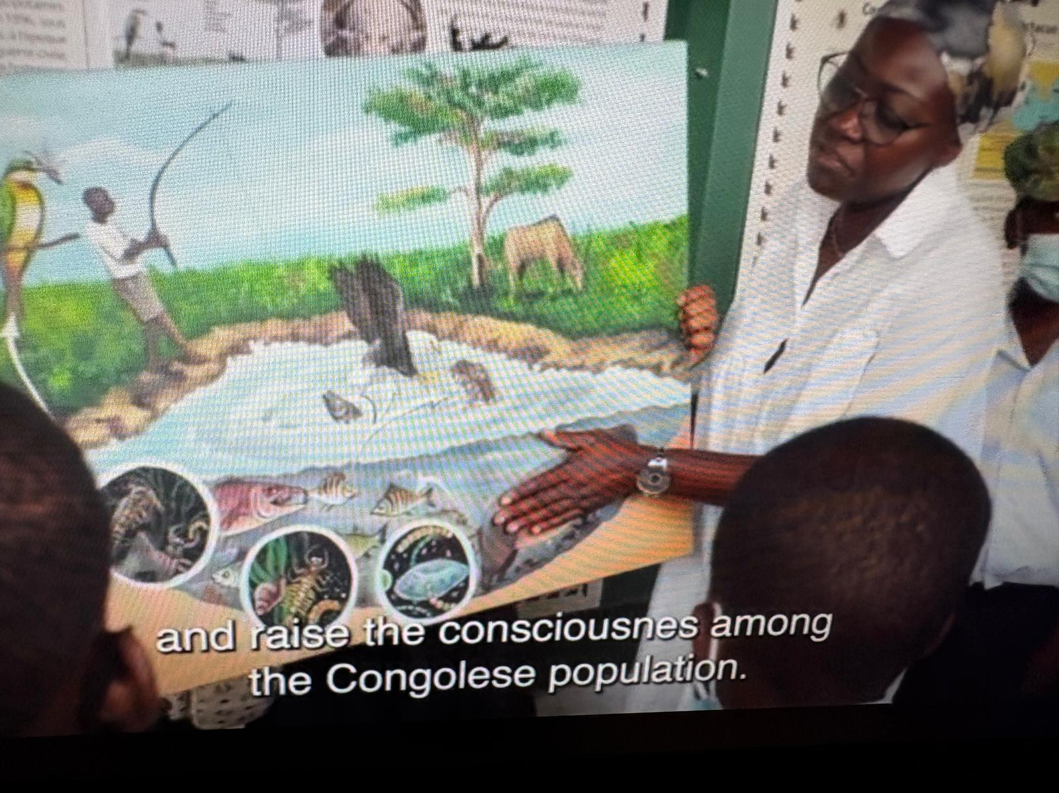
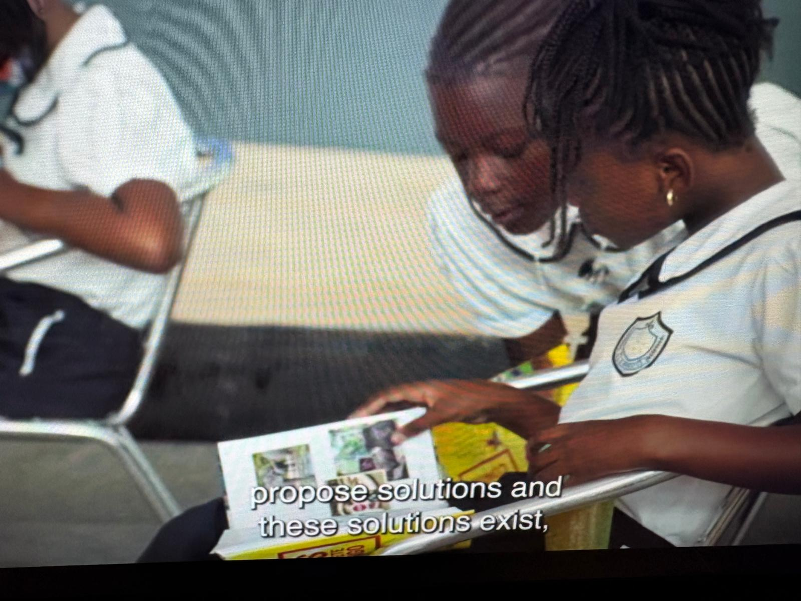
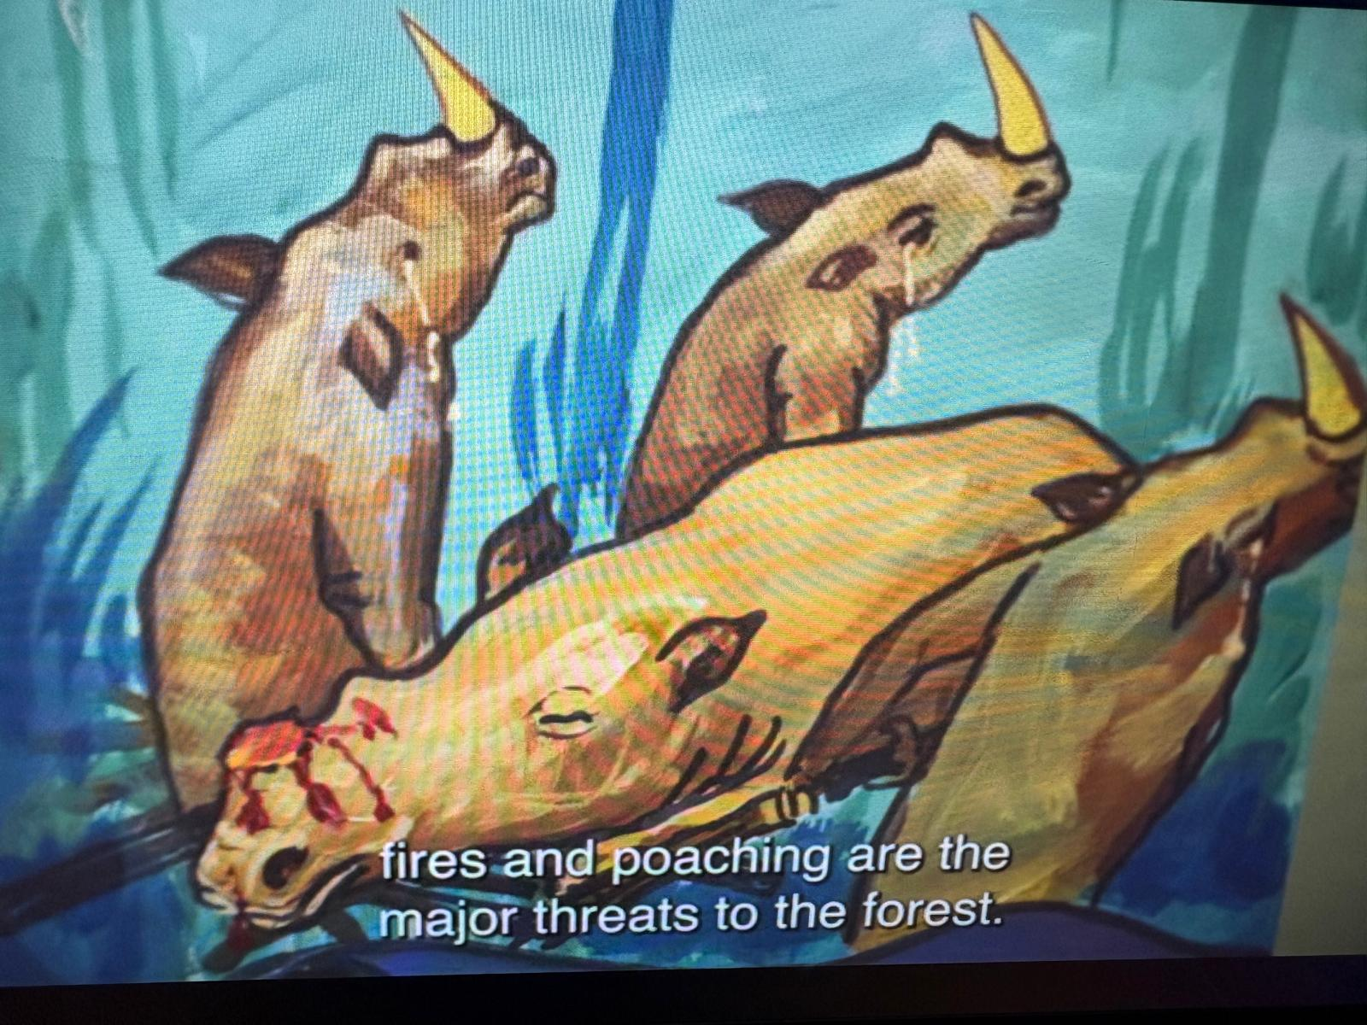
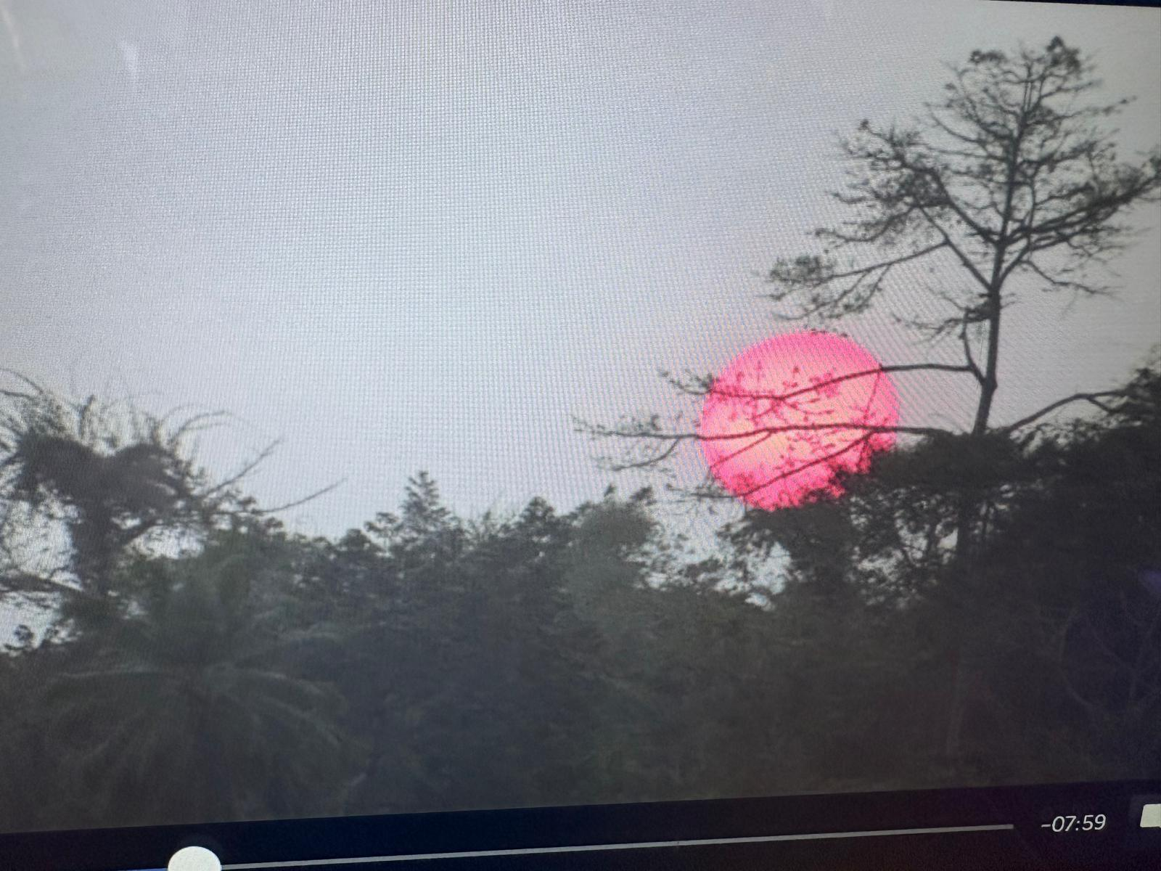
Session 7:
Greening Qualifications and
Harnessing AI for Future-Ready Skills
14th May 2026
Eduarda Castel-Branco
Green skills education

Slide 2

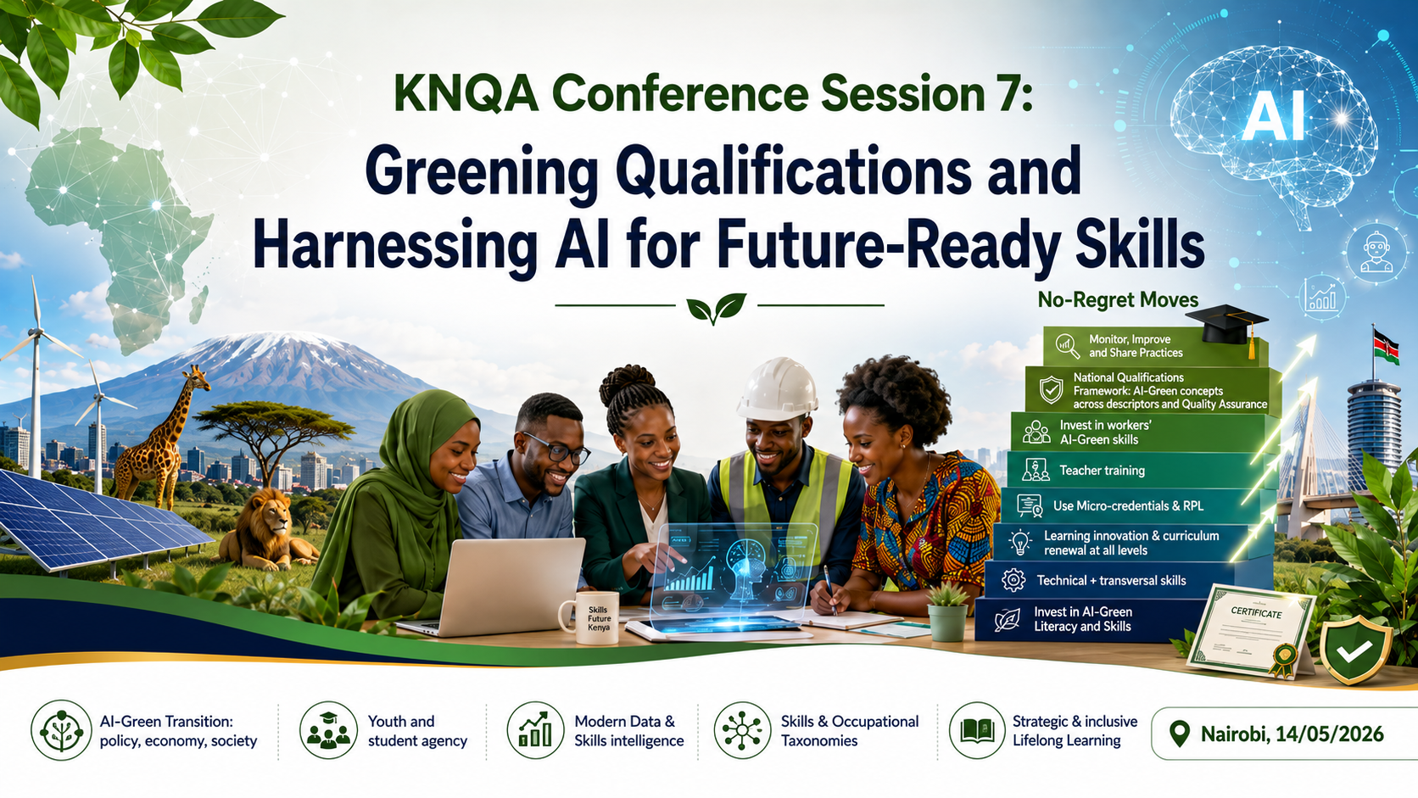
Twin transition Green-AI: No regret Moves

Slide 3
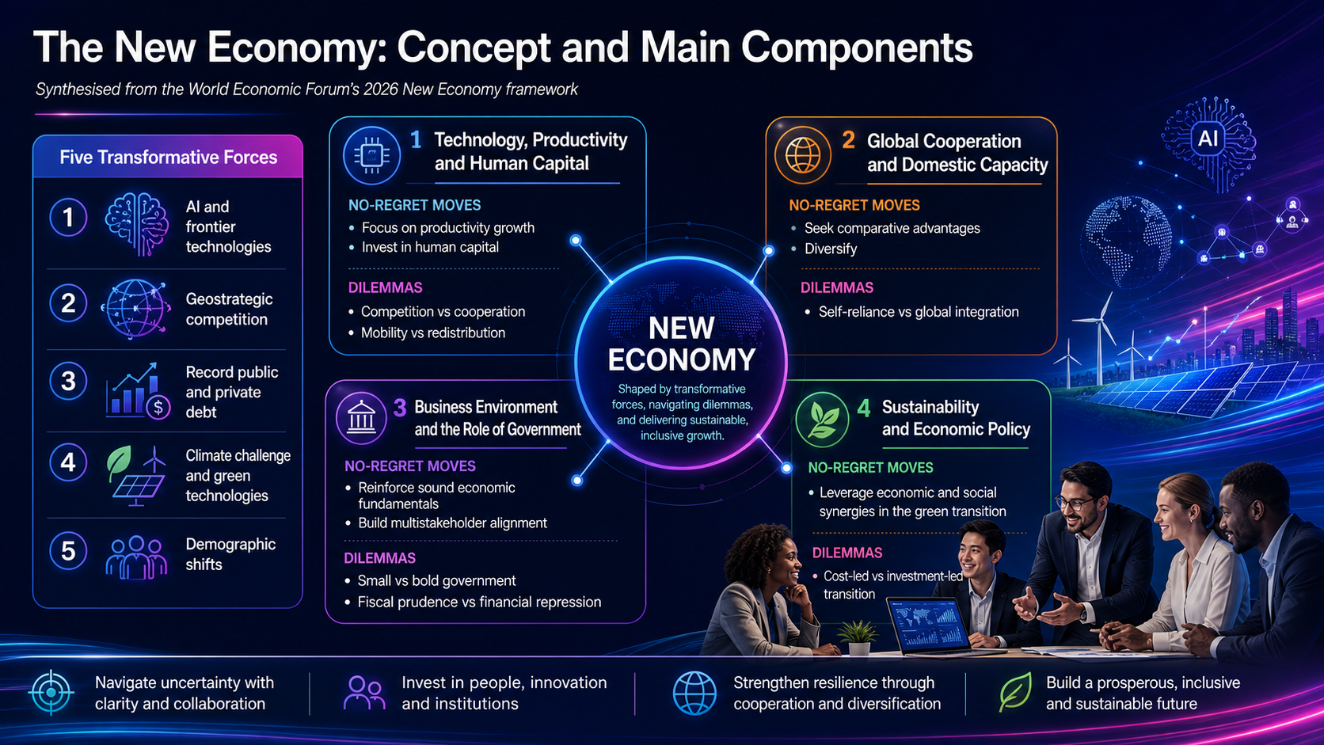

Slide 4
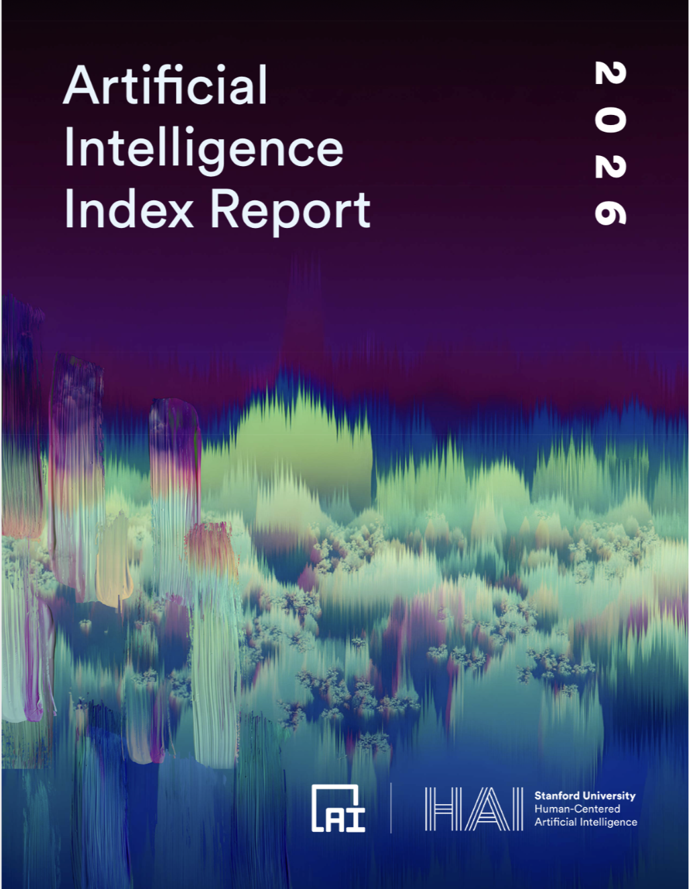
Trends and issues globally and by sector: NEW - AI Index by Stanford University Human Centered-AI
15 Takeaways, including
AI capability is not plateauing. It is accelerating and reaching more people than ever. Industry produced over 90% of notable frontier models in 2025, and several of those models now meet or exceed human baselines on PhD-level science questions, multimodal reasoning, and competition mathematics
Responsible AI is not keeping pace with AI capability, with safety benchmarks lagging and incidents rising sharply.
AI adoption – much faster spread that PC and Internet. AI spread- historic speed, and consumers are deriving value from tools they often access for free. Generative AI reached 53% population adoption within three years (2022-2025).
Formal education is lagging behind AI, but people are learning AI skills at every stage of life.
AI sovereignty is becoming a defining feature of national policy, but capabilities remain uneven, even as open-source development helps to redistribute who participates. National AI strategies expanding, esp. in developing countries.
Public trust: AI experts and the public have very different perspectives on the technology’s future, and global trust in institutions to manage AI is fragmented.
Themes of the AI Index
Research and Development
Technical Performance
Responsible AI
Economy
Science
Medicine
Education
Policy and Governance
Public Opinion

Slide 5
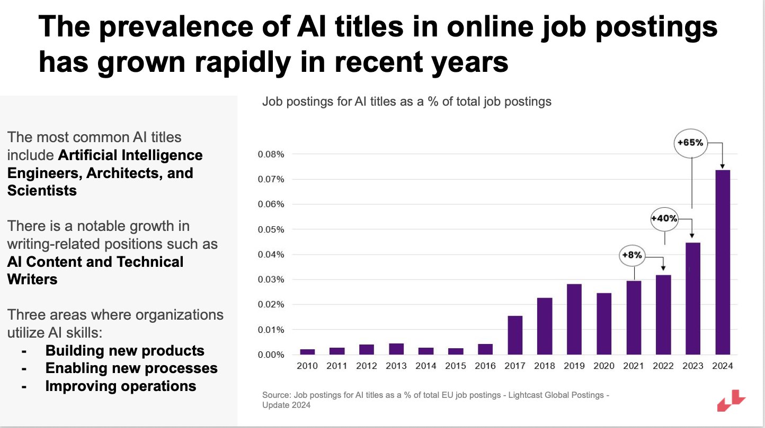
Demand for AI-linked roles and skills grows significantly

Slide 6
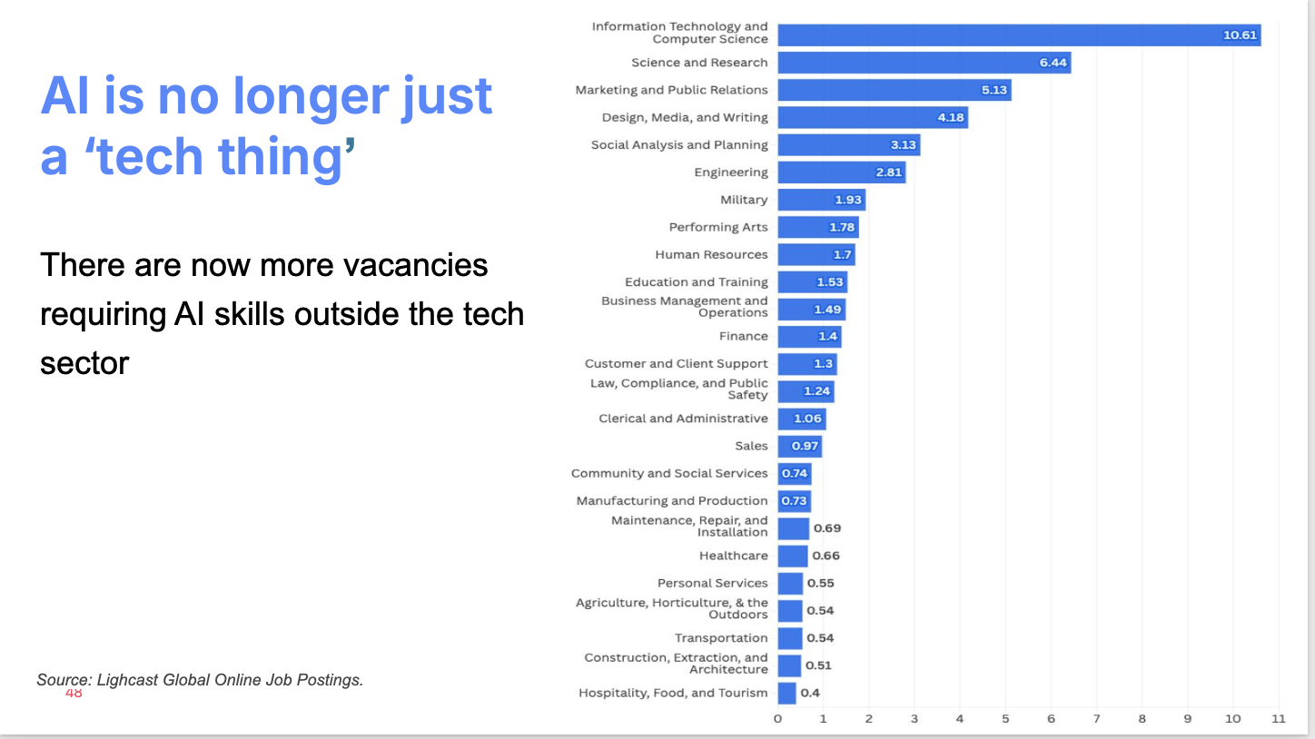
AI – in all occupations (beyond “Tech”)

Slide 7
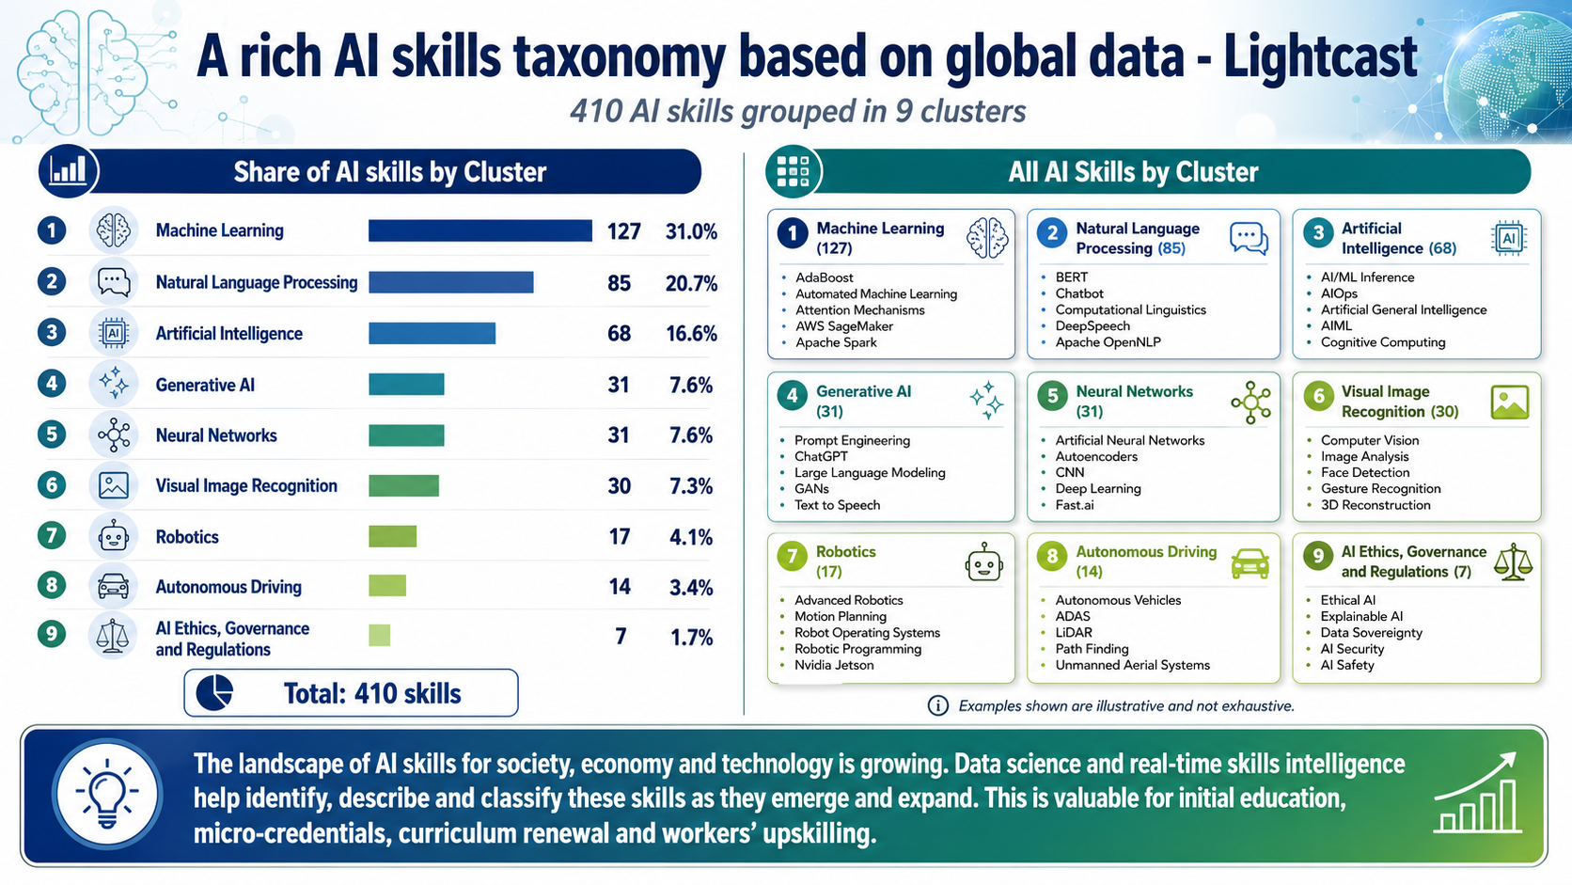

Slide 8
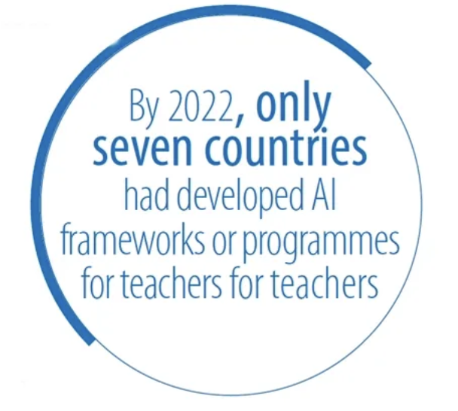
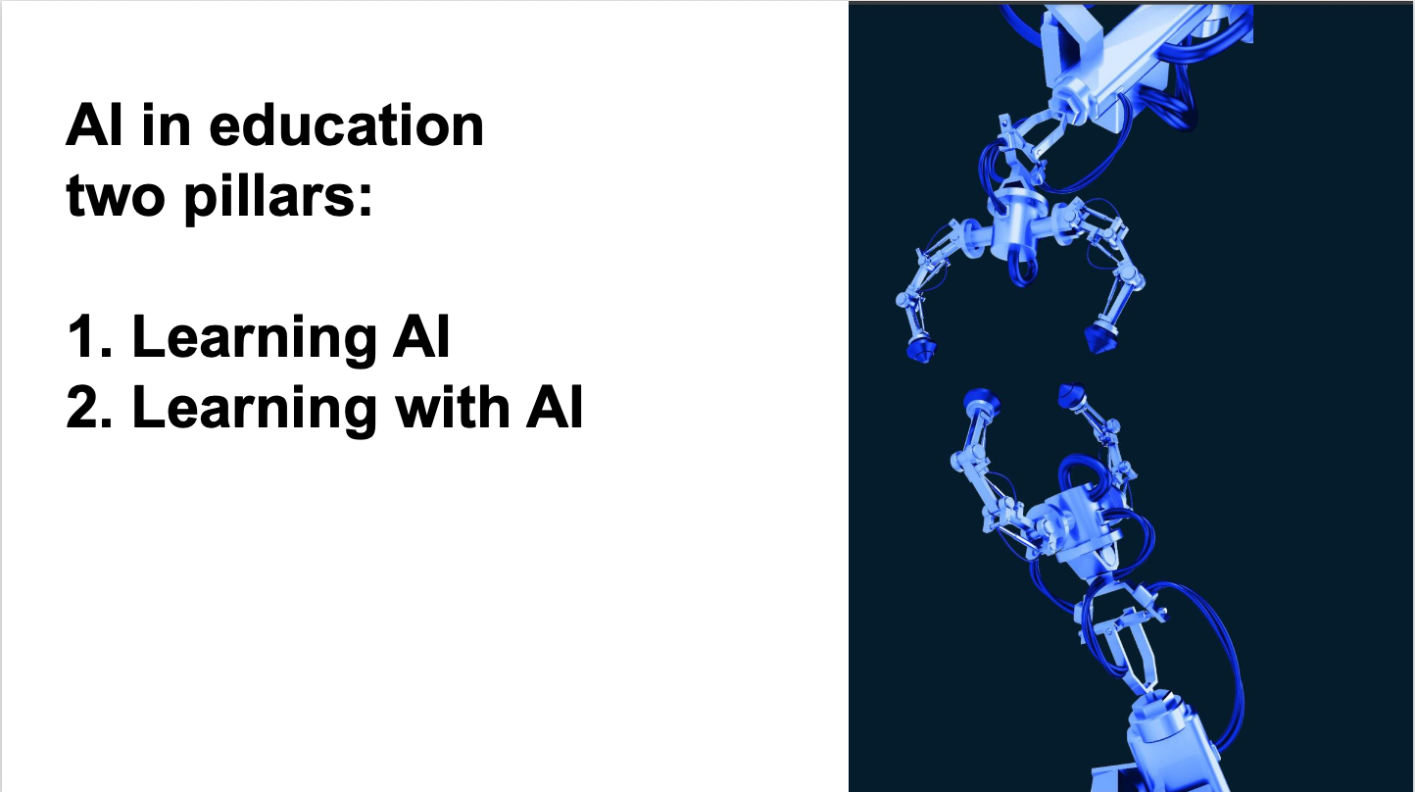
UNESCO

Slide 9
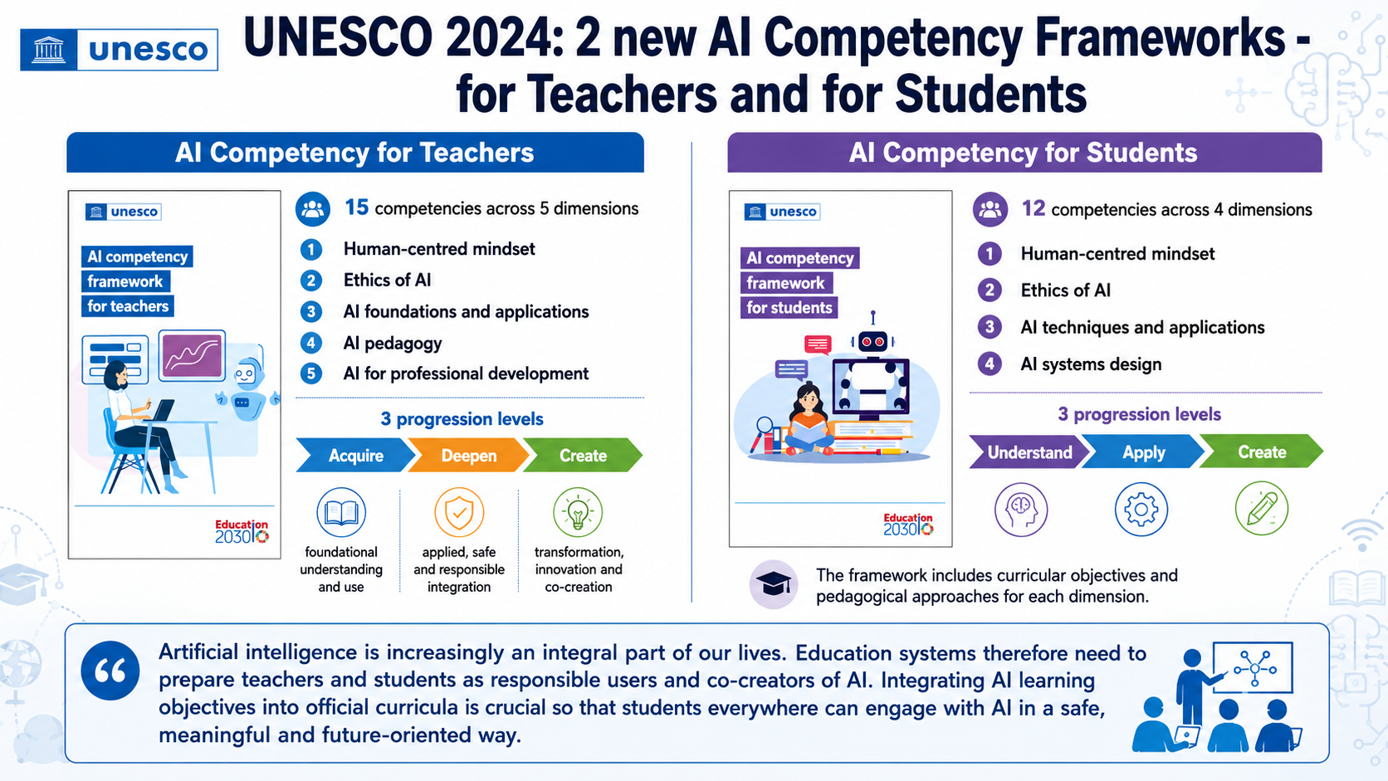

Slide 10
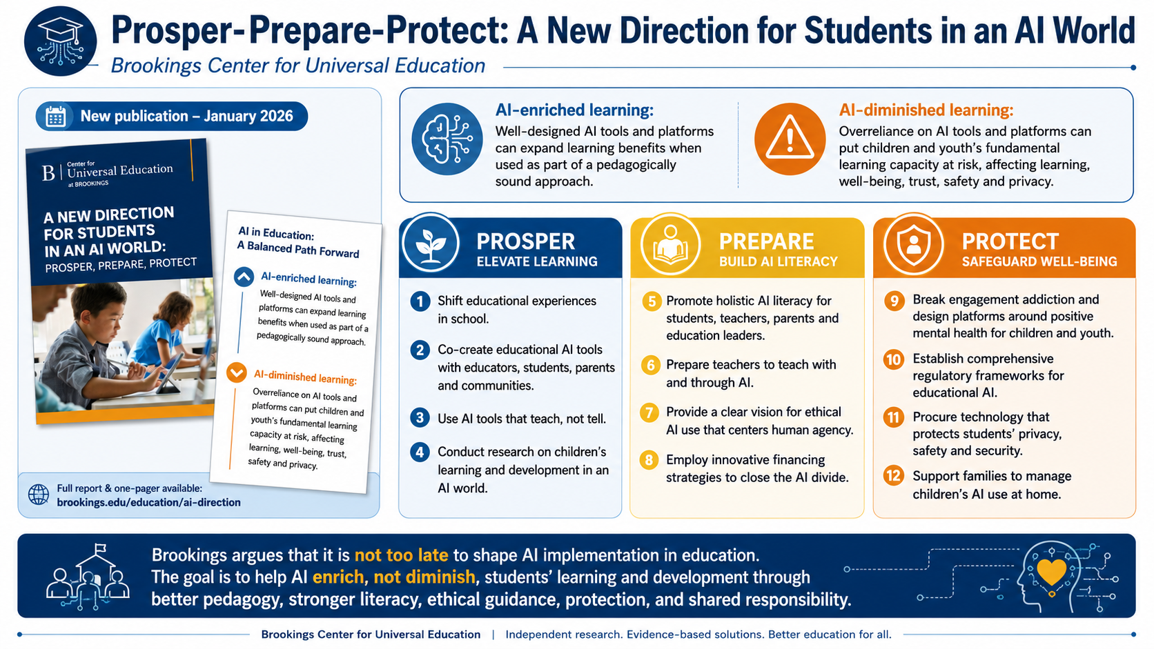

Slide 11
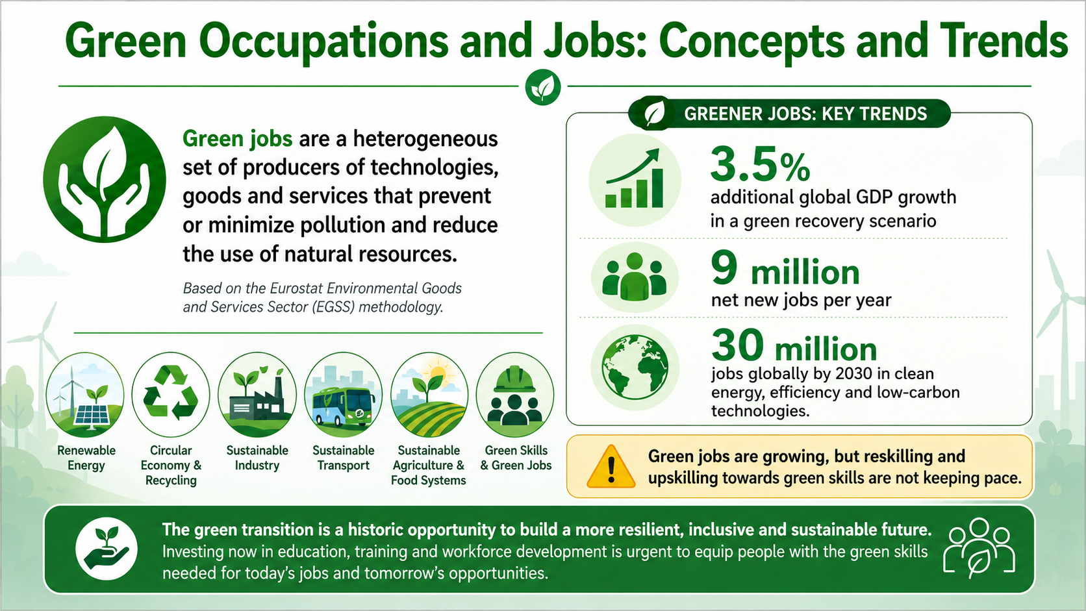

Slide 12
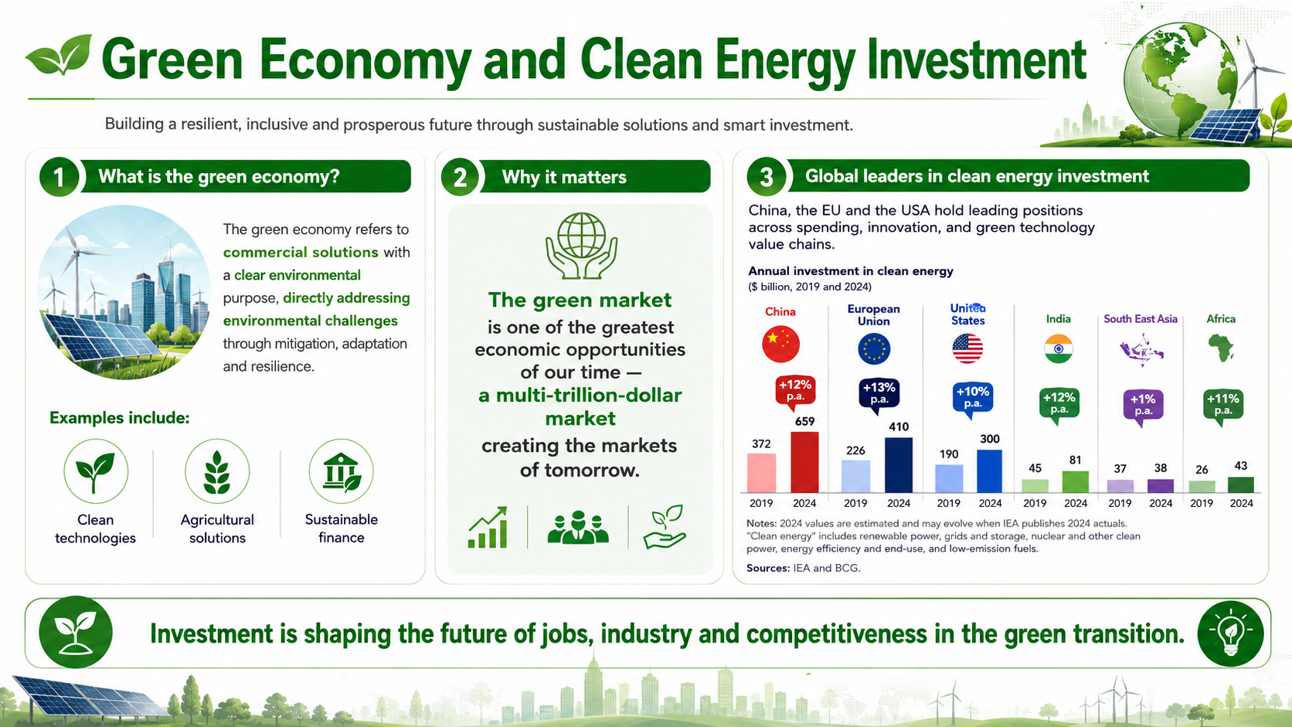

Slide 13
Taxononies of Green Skills and Competences
WEF: Green Skills
Environmental awareness
Sustainable and efficient resource usage
Adopting green technologies
Taxonomies | Skills
ESCO | 629 green
Lightcast | 13 categories – 279 skills
Greenskills map | 11 areas, 54 sub-areas, 243 green skills clusters
World Economic Forum | 3 skills

Slide 14
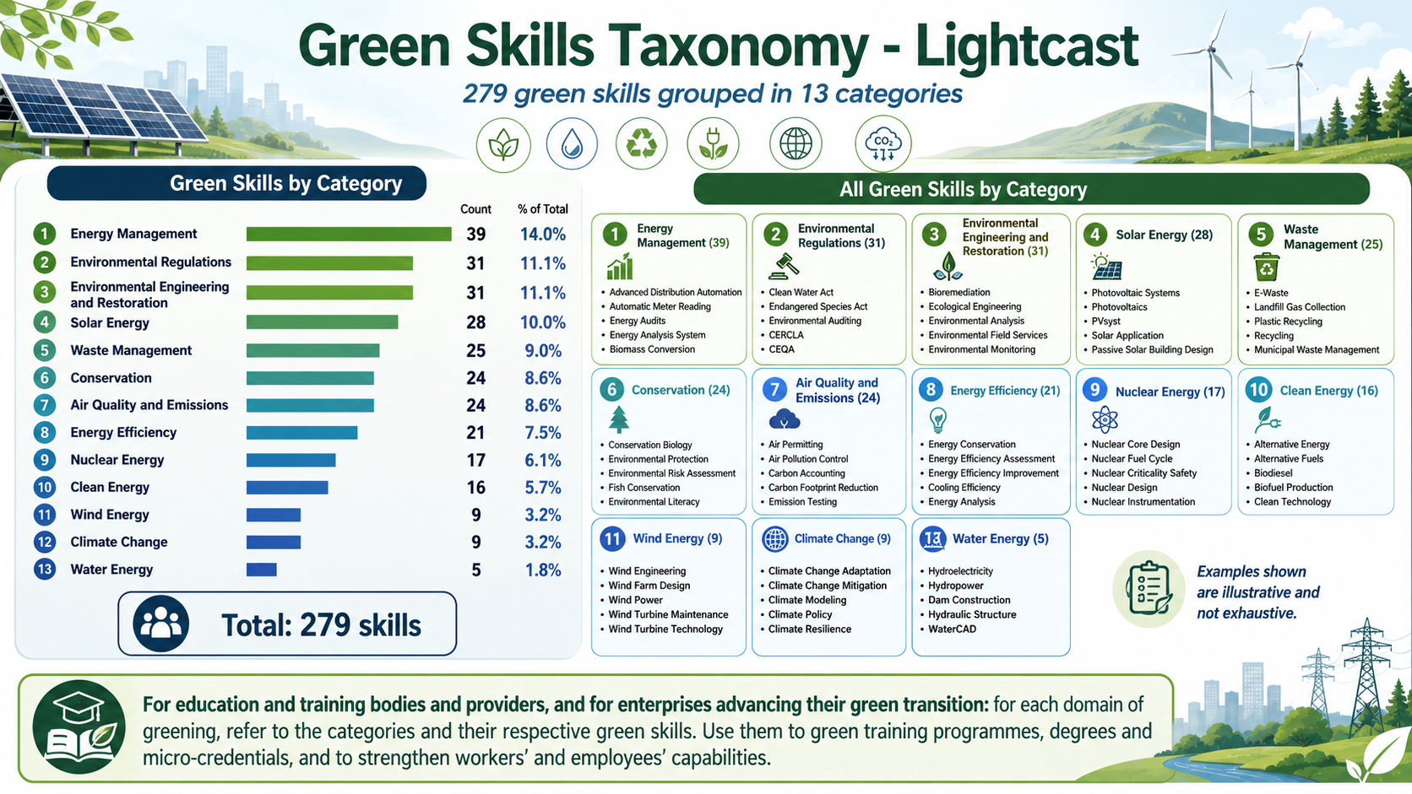

Slide 15
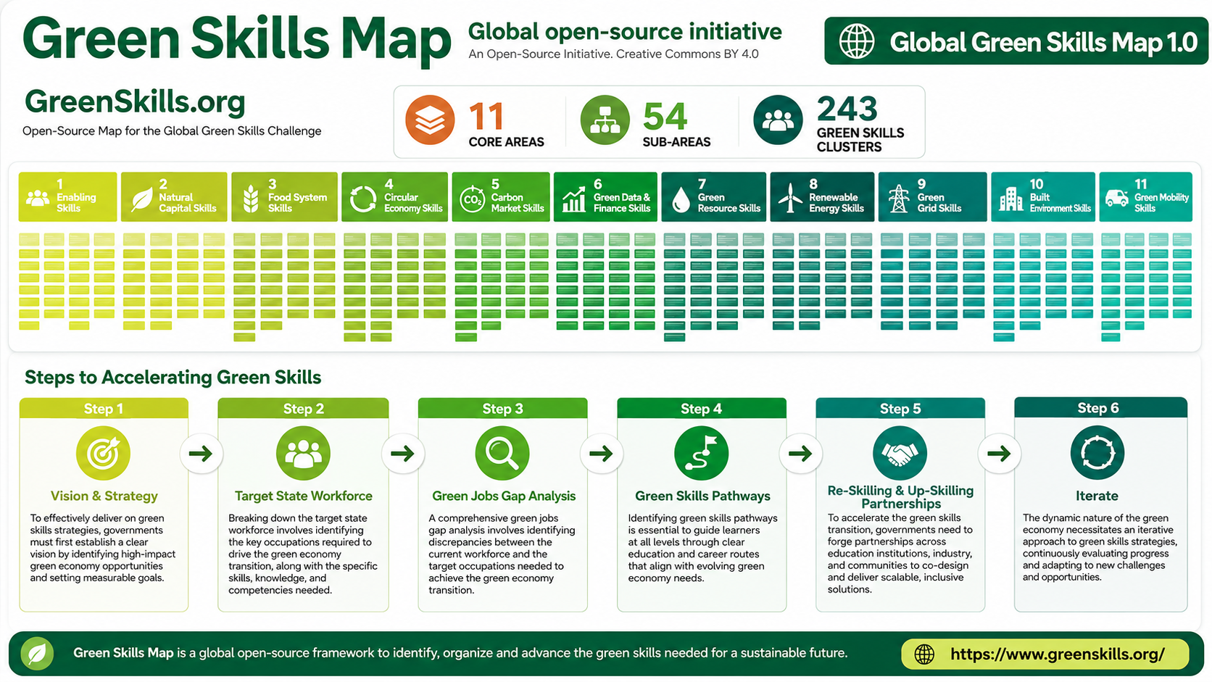

Slide 16
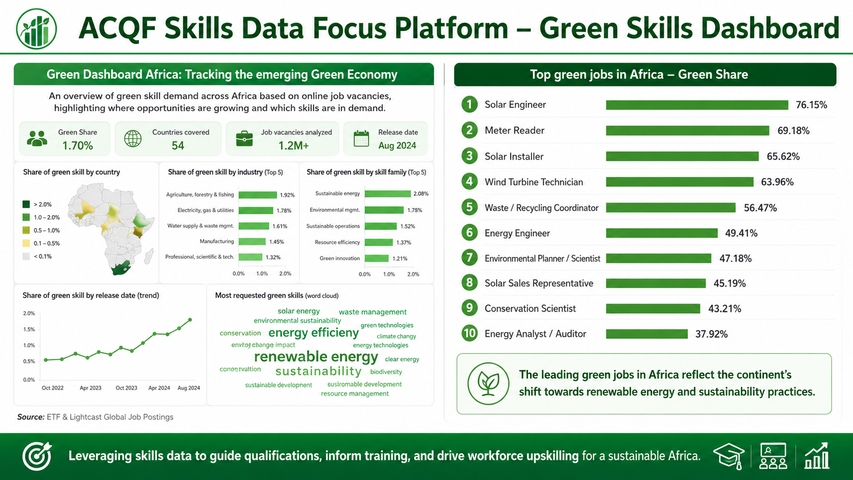
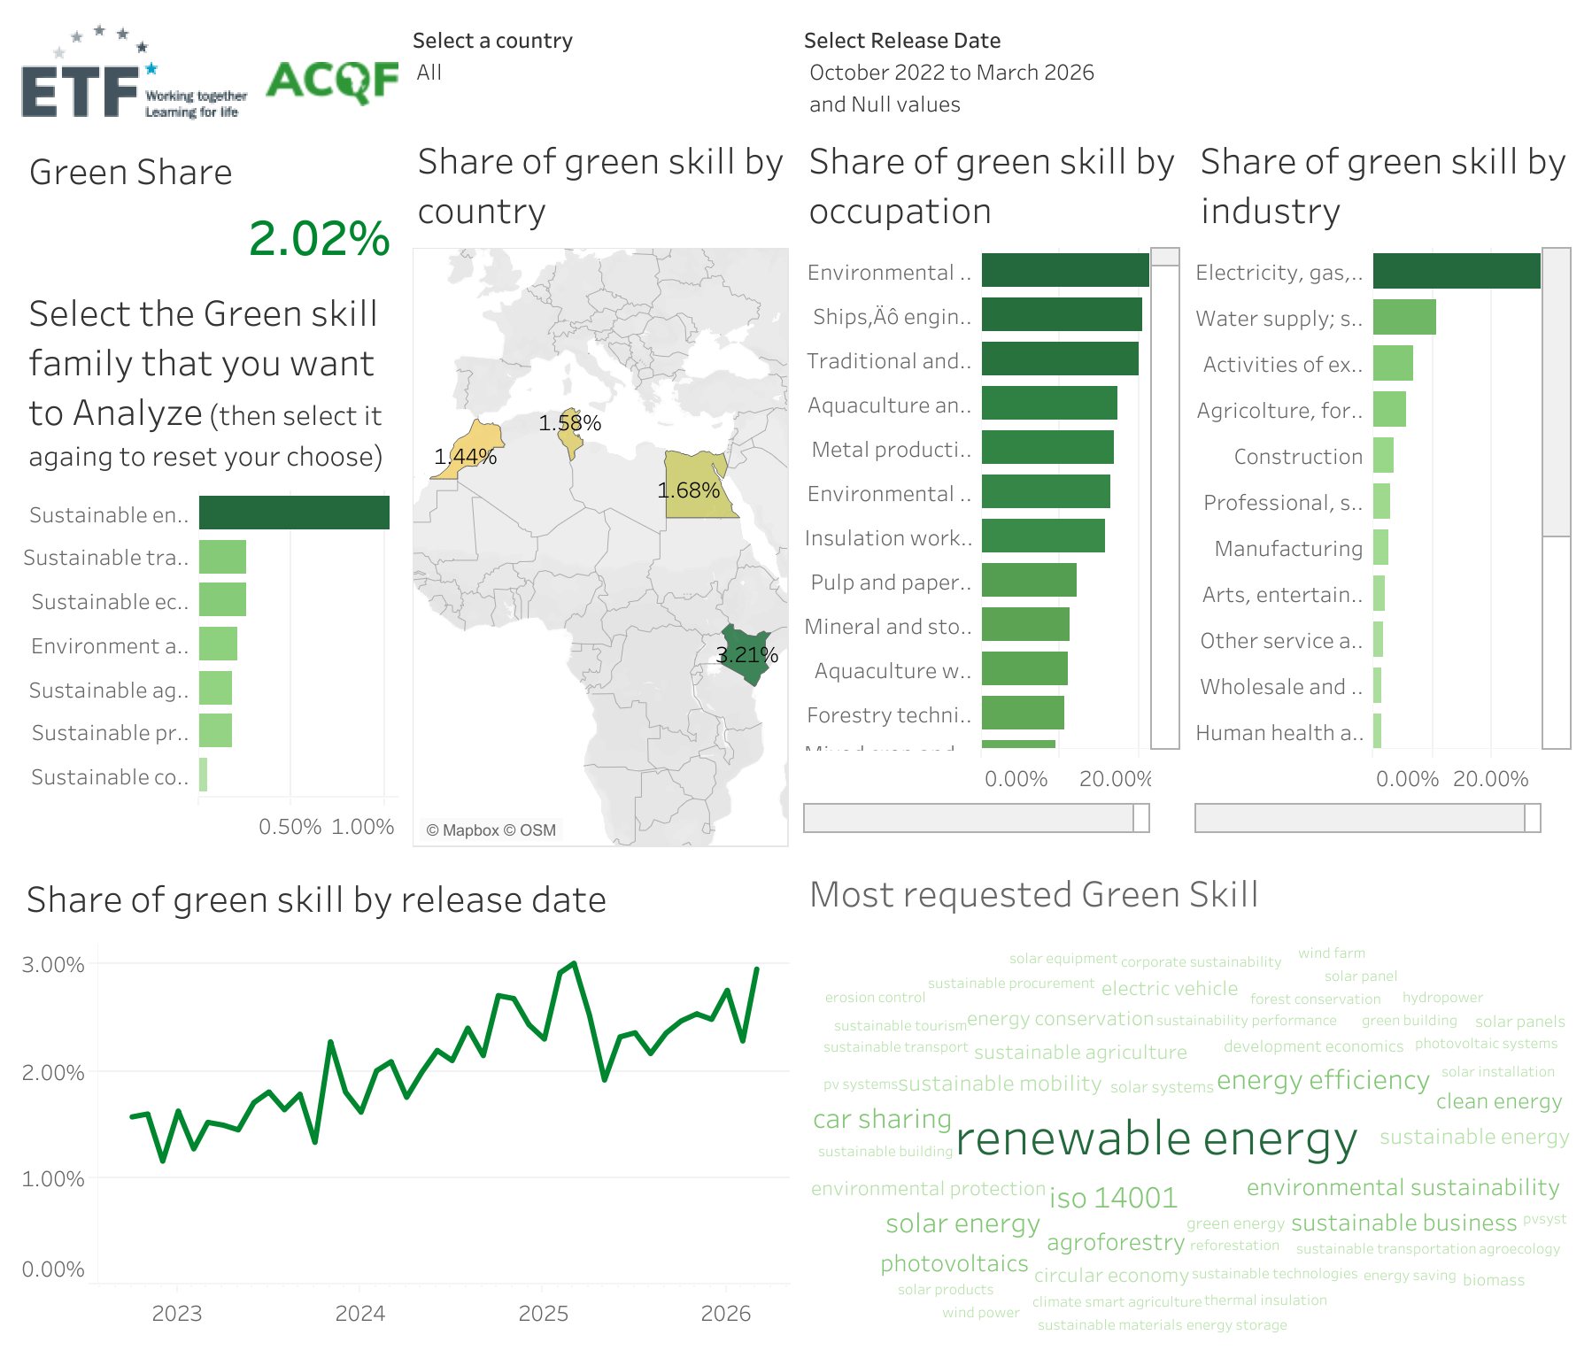

Slide 17
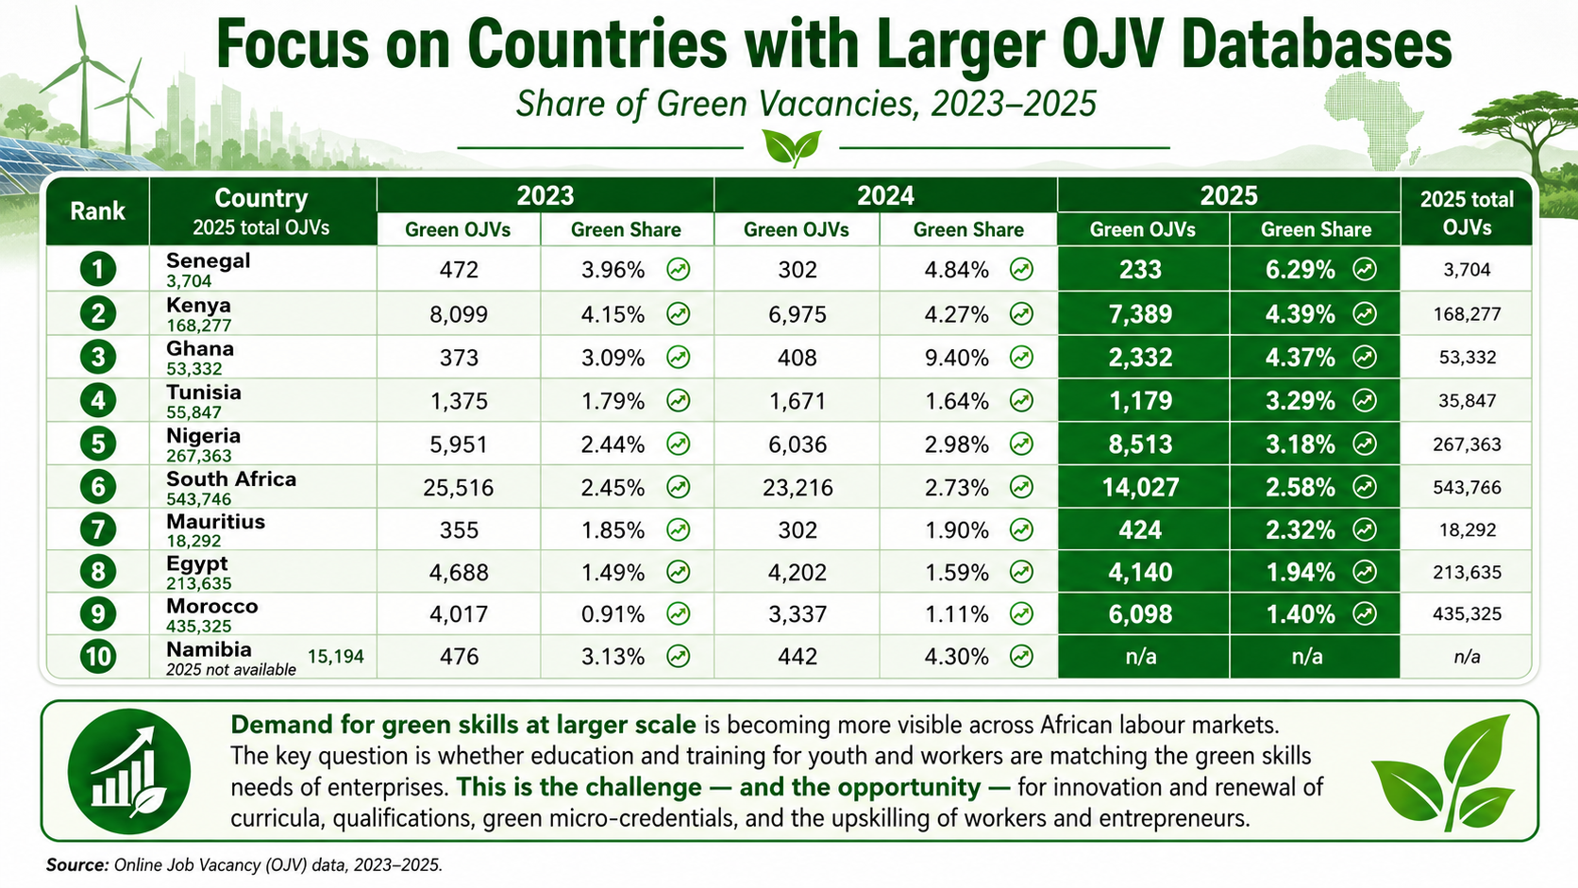

Slide 18
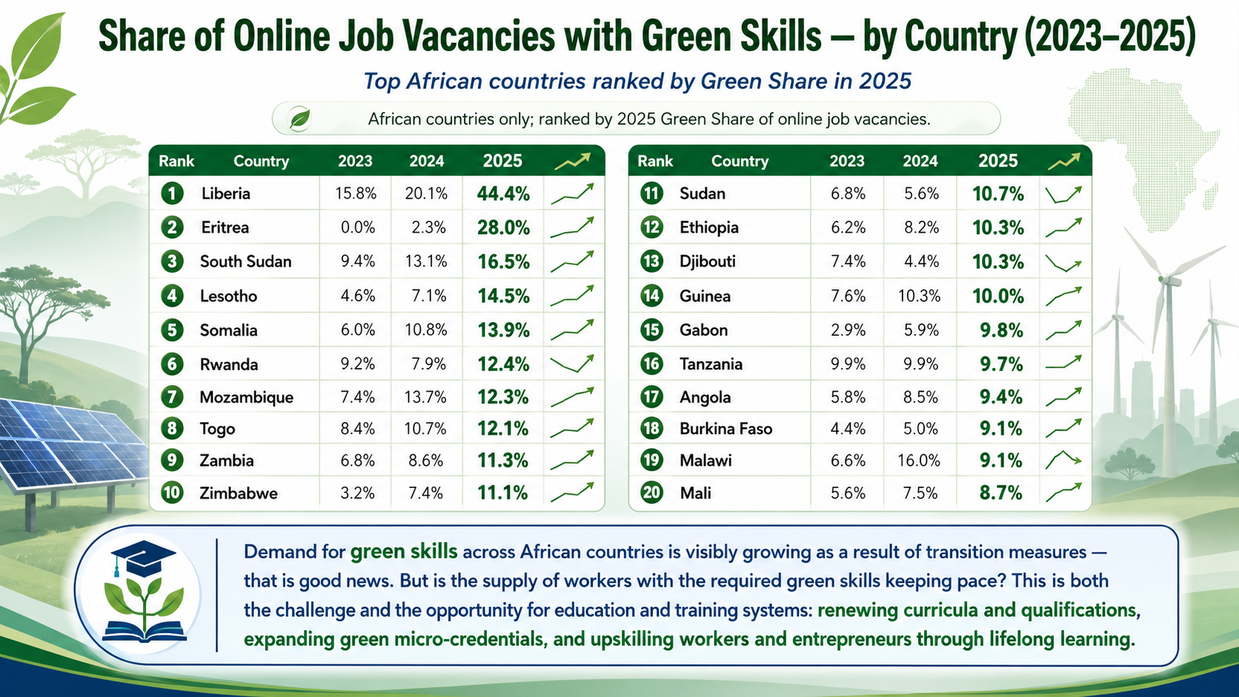

Slide 19
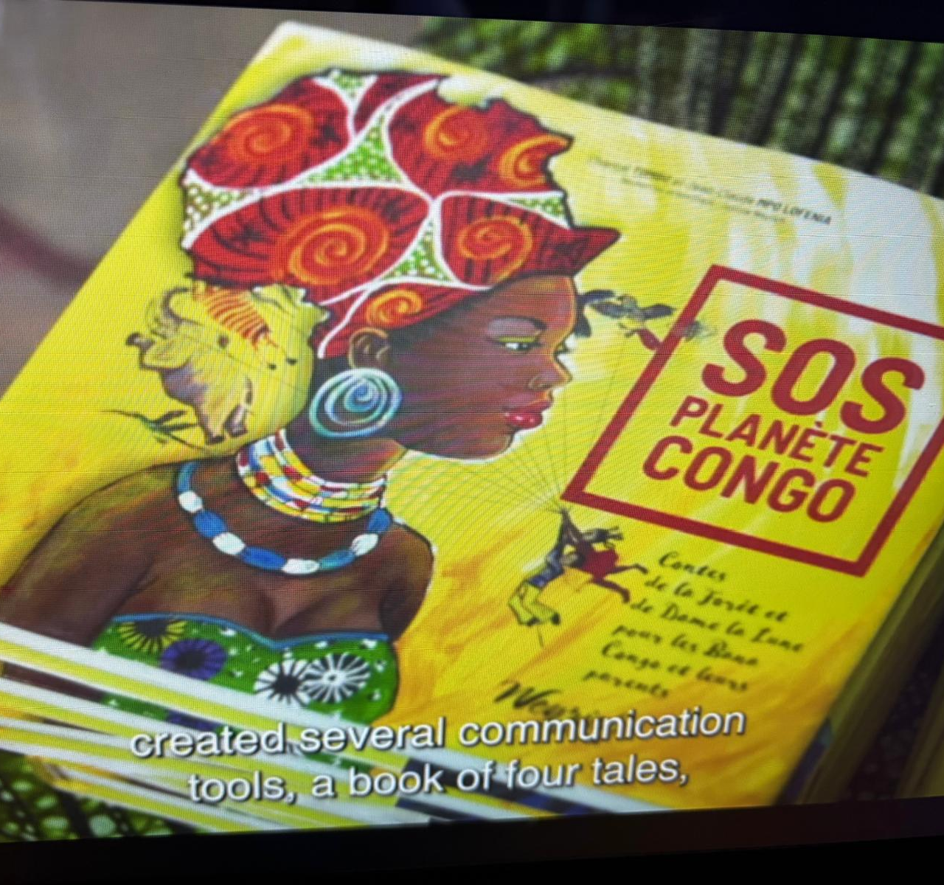
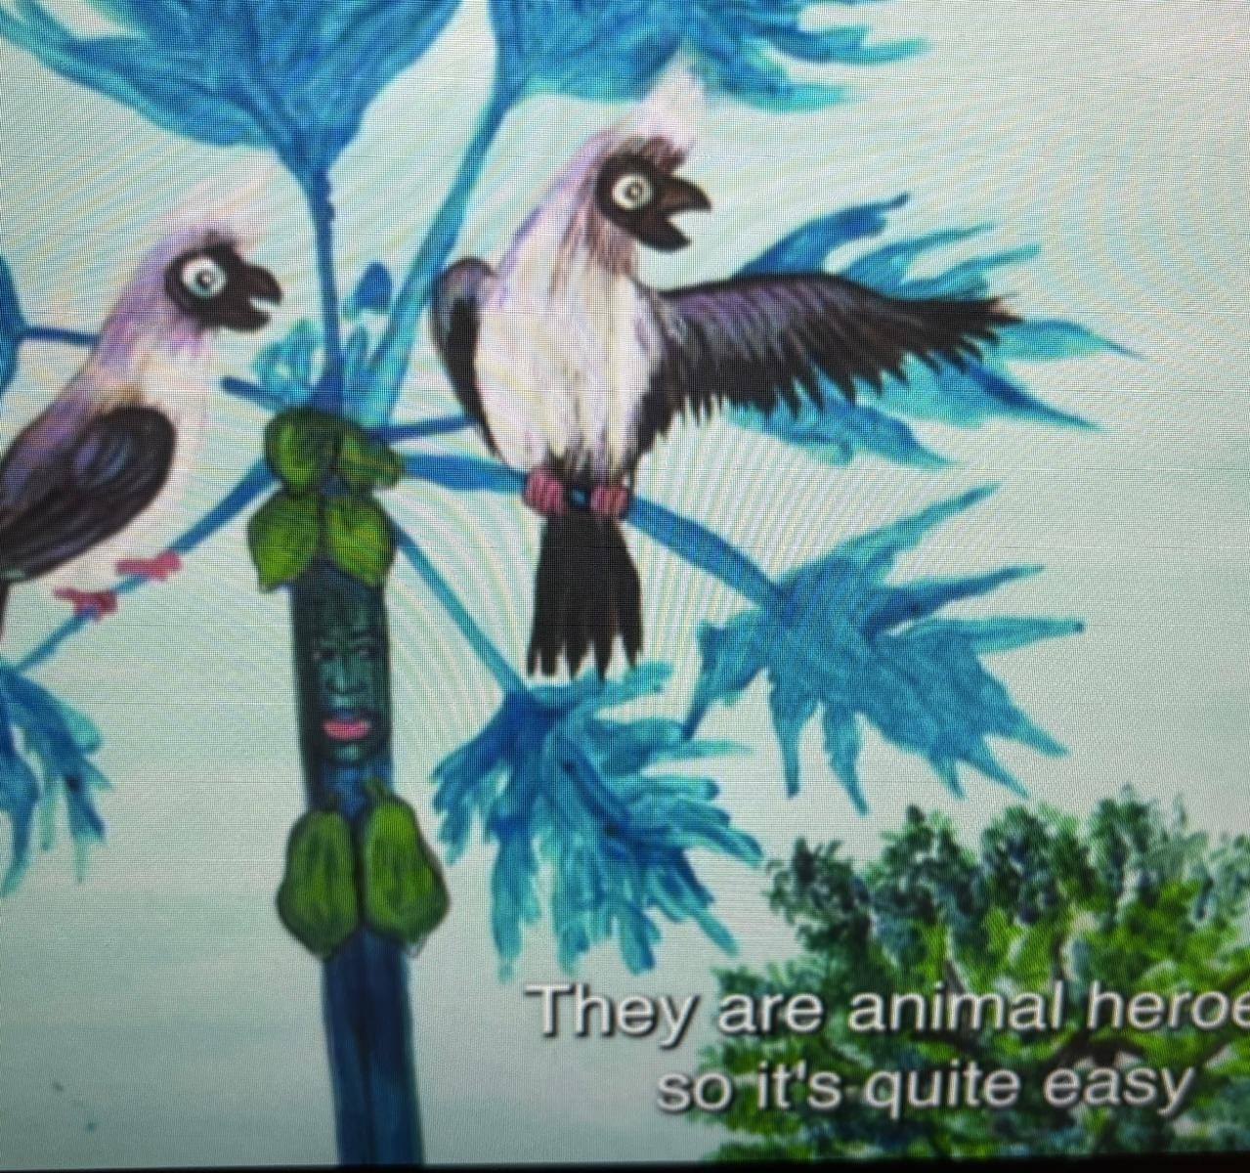
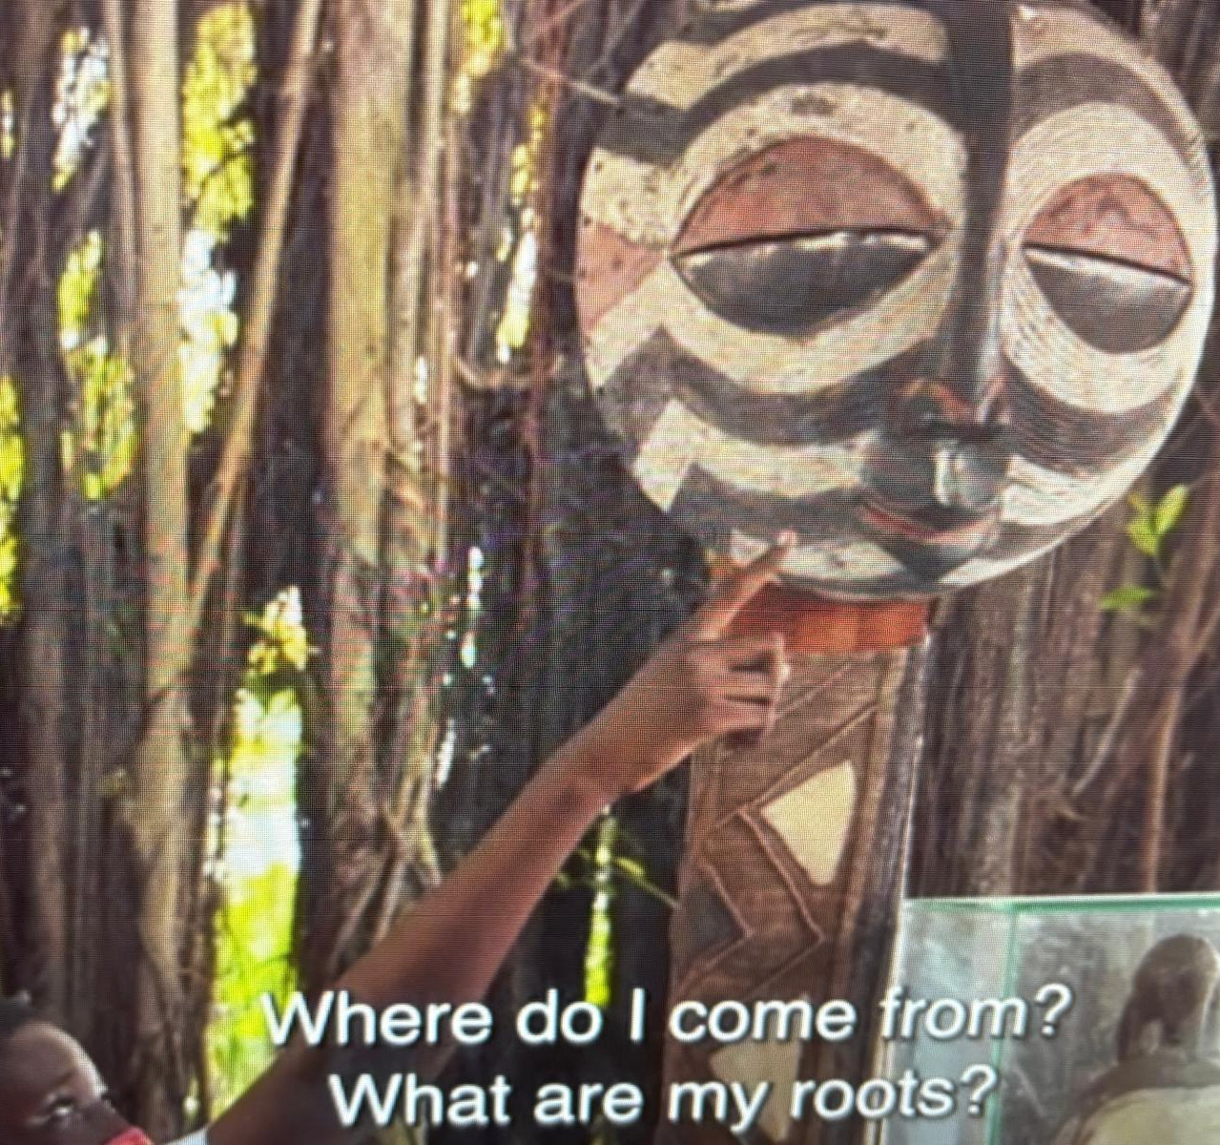
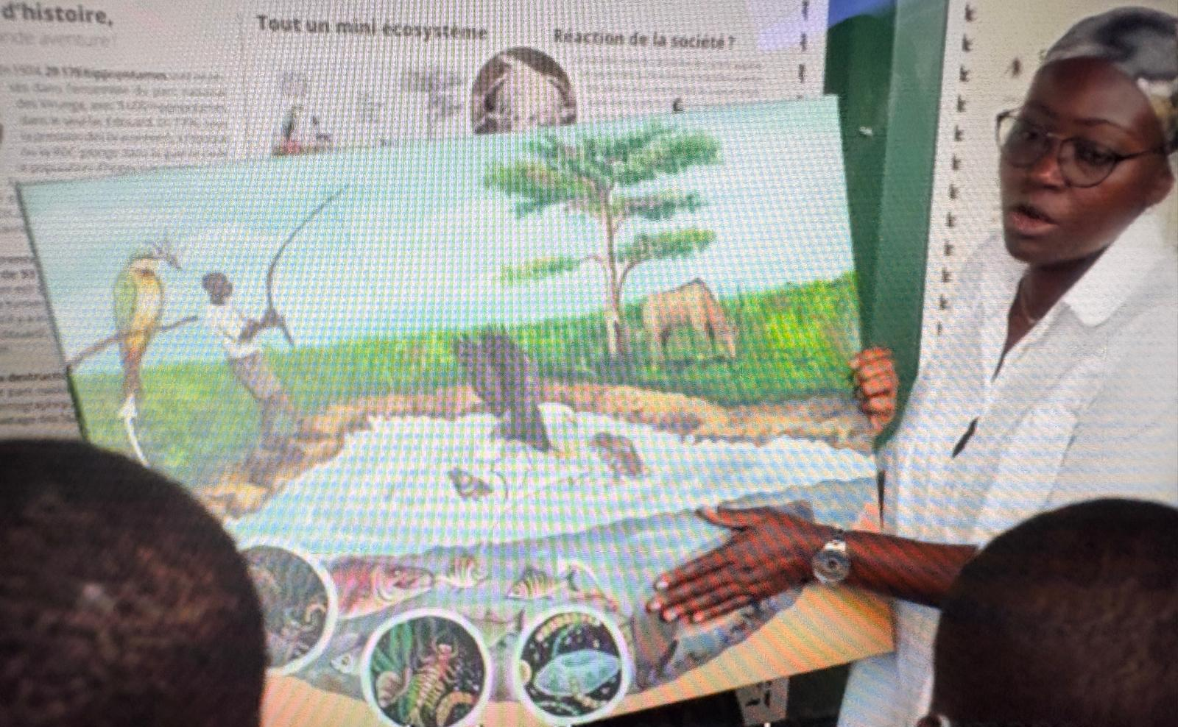

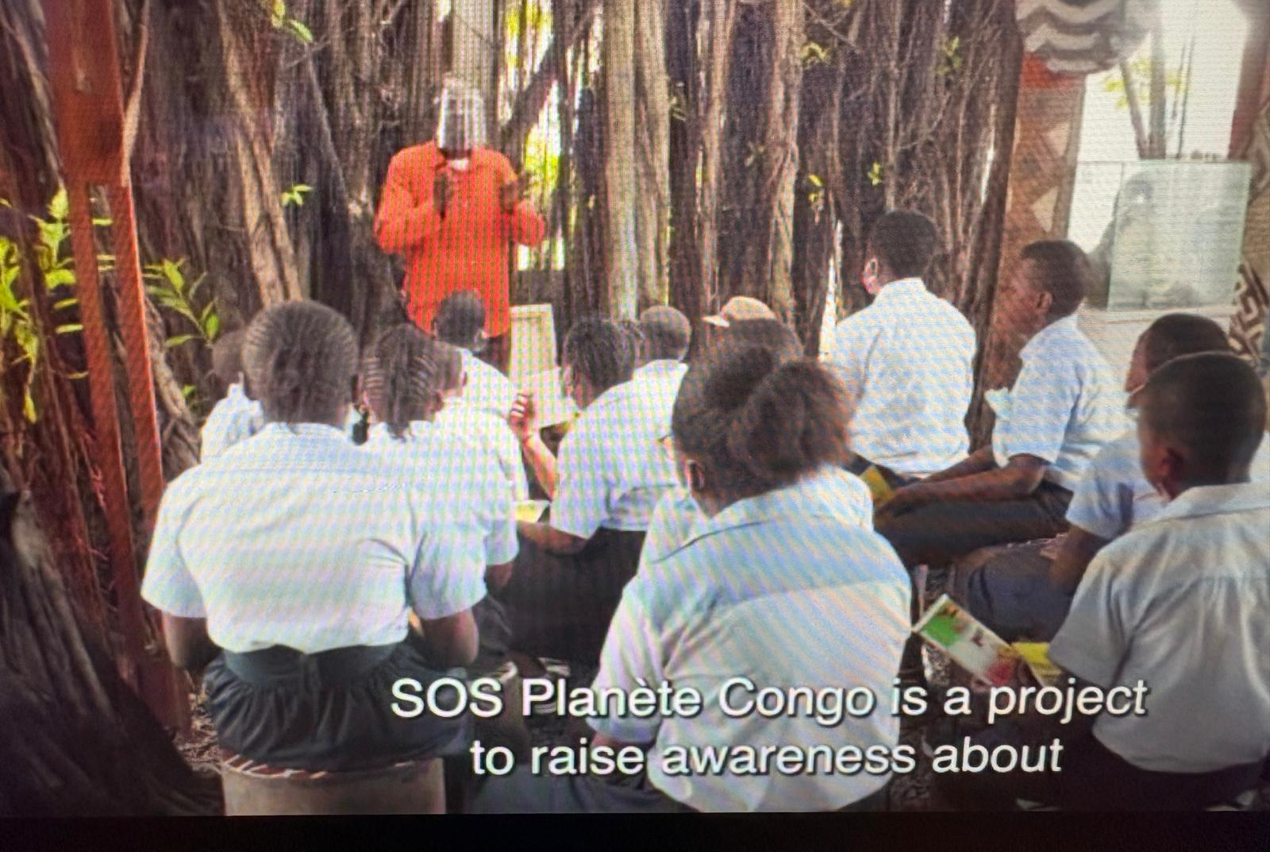
Green skills education: science, indigenous knowledge, culture, innovation, creativity, community, agency

Slide 20
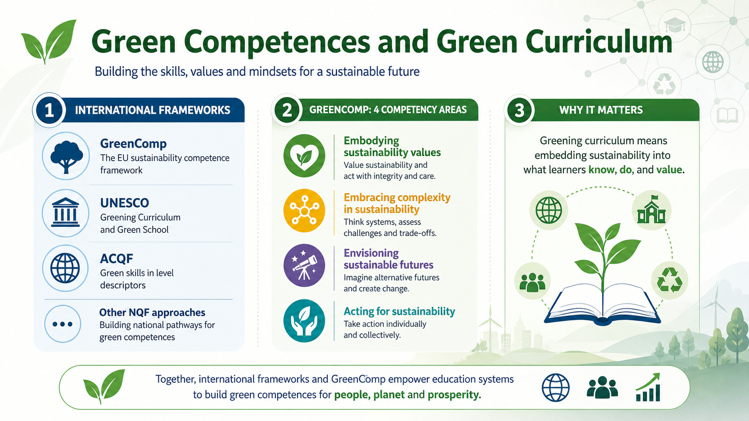

Slide 21
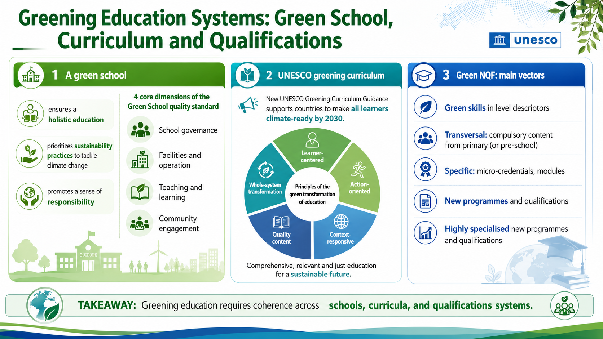

Slide 22
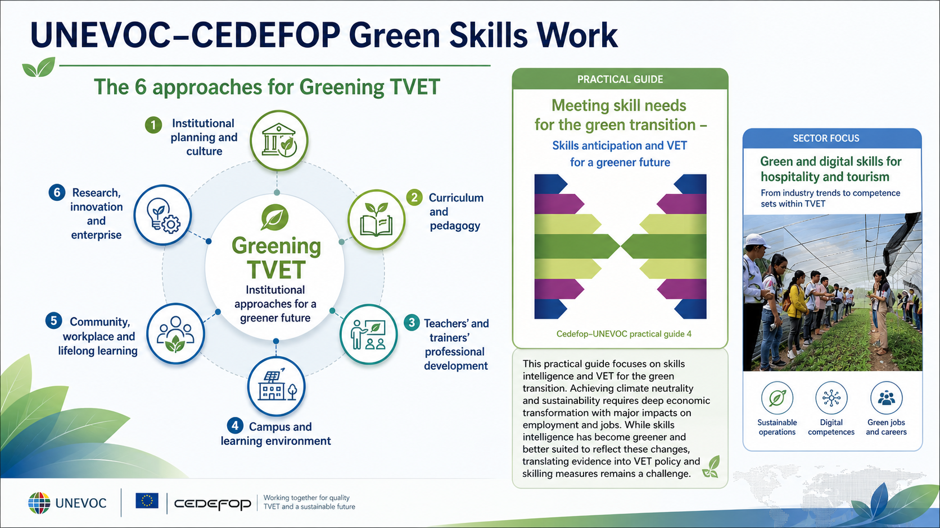

Slide 23
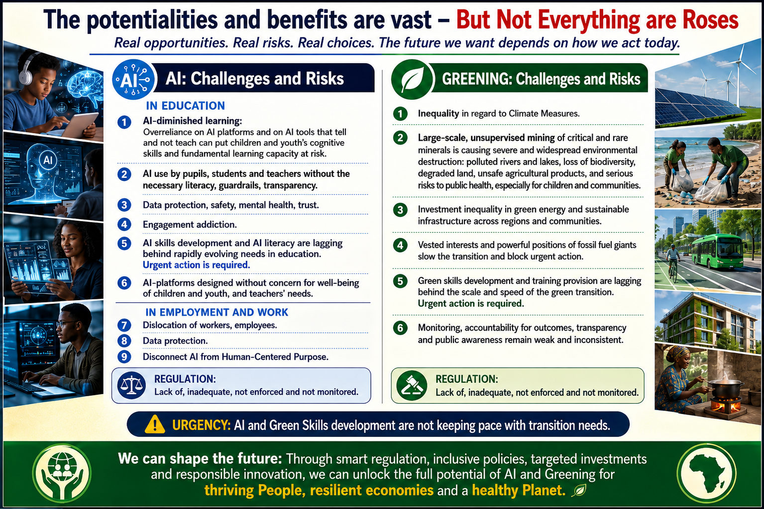

Slide 24
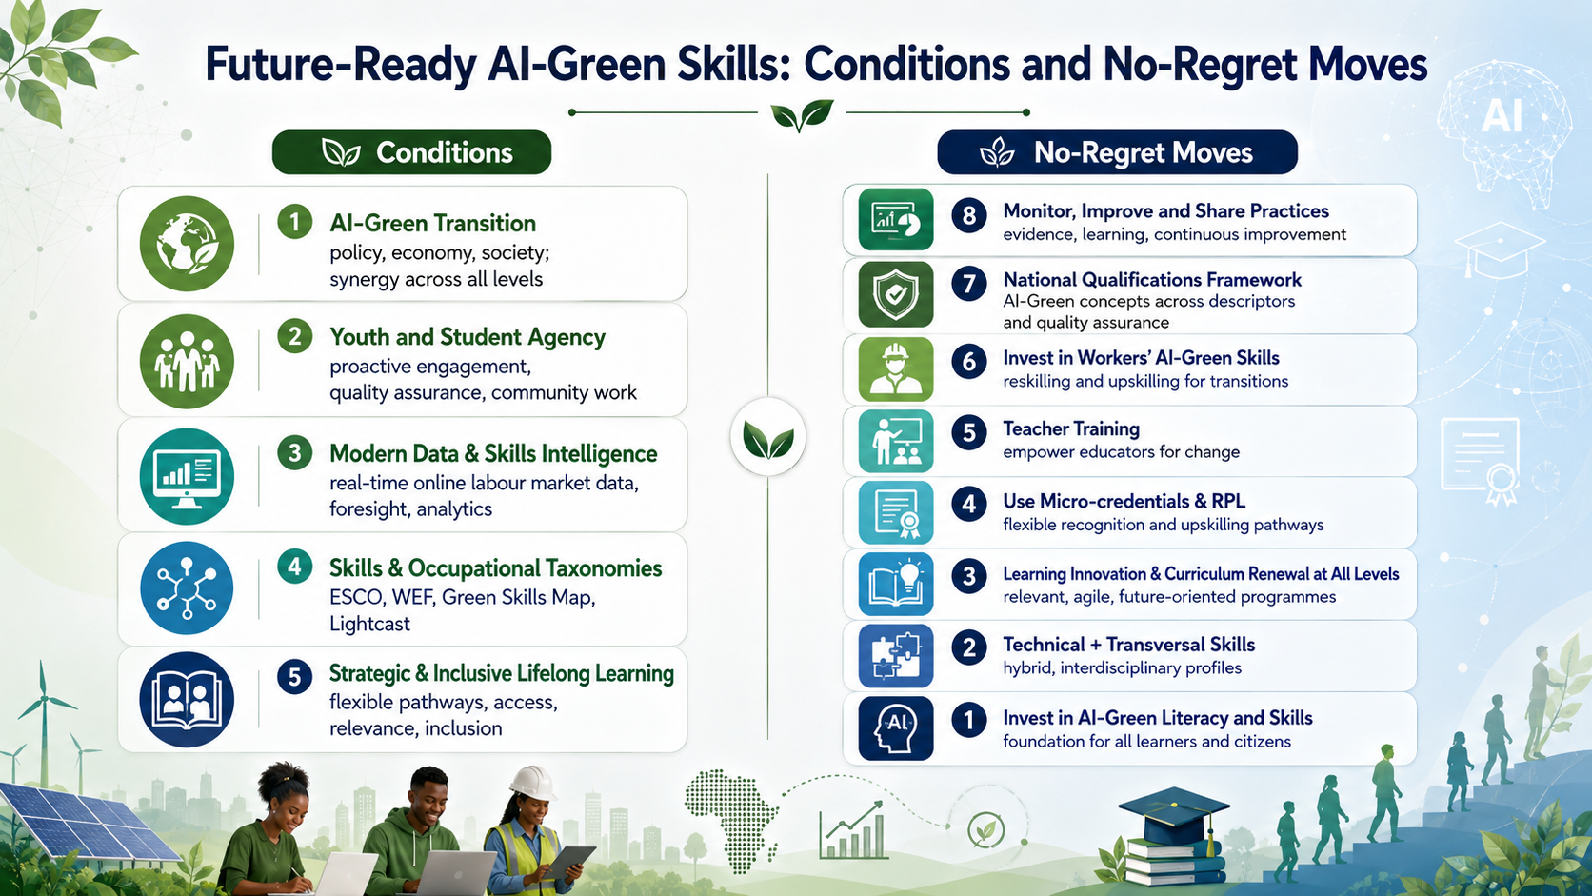

Slide 25
