Slide 1
Day 3 Break out Room 3 (Kifaru)

Slide 2
TOWARDS A NATIONAL DIGITAL CREDENTIAL & VERIFICATION ECOSYSTEM FOR KENYA- REDUCING REPEAT CHECKS THROUGH BLOCKCHAIN AND MULTIFACTOR AUTHENTICATION
PRESENTED BY: RONALD YEGO
THE ELDORET NATIONAL POLYTECHNIC

Slide 3


A Crisis of Trust
80% of Institutions Affected
Manual & Slow
Paper-based, single-factor checks are labor-intensive, prone to error, and can take weeks to complete.
About 80% of Kenyan universities have encountered fake academic credentials (Odhiambo & Oguk, 2025).
Systemic Vulnerability
Finance, employment, and education sectors all rely on fragmented, manual authentication workflows (Oguk & Juma, 2025).

Slide 4

The Cost of Broken Verification
What's at Stake
High transaction costs for institutions repeating manual checks per applicant
Delayed recruitment and admissions due to slow transcript comparisons and phone confirmations
Eroded public confidence in the value of Kenyan qualifications
Fraudulent intermediaries exploiting information asymmetries and legacy processes

Slide 5

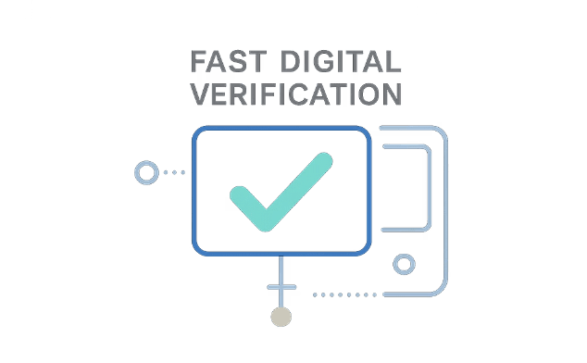
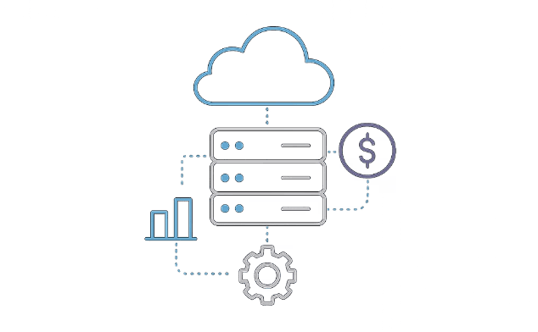
What the World Has Learned
International blockchain credential pilots offer a blueprint — but most remain
siloed and lack robust MFA.
Tamper-Evident Records
Seconds, Not Weeks
Hybrid Designs Lower Costs
Distributed ledgers provide immutable records of issuance, revocation, and updates (Said et al., 2025; Tariq et al., 2019).
Blockchain systems in low- and middle-income contexts cut verification from days to seconds (Cardenas-Quispe & Pacheco, 2025).
On-chain/off-chain models manage costs and support gradual migration from existing databases (Rustemi et al., 2023).

Slide 6

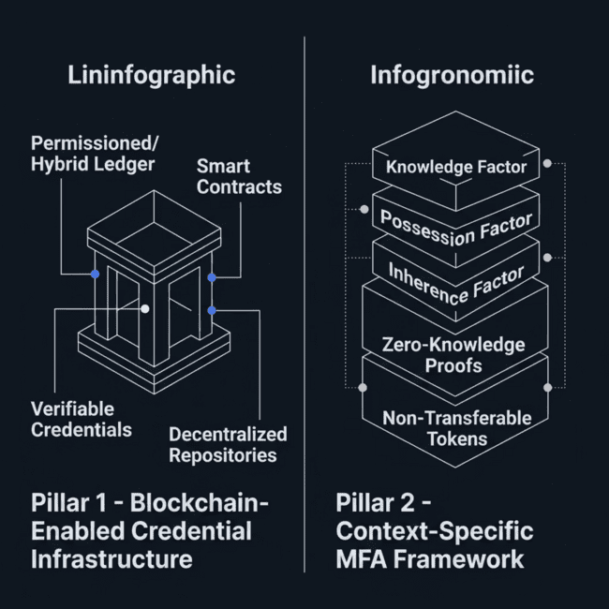

The Two Pillars of the Proposed
Ecosystem
KNQA-Anchored Vision
A one-stop, interoperable platform where all Kenyan qualifications are issued, managed, and verified once — then securely re-used by universities, TVETs, employers, regulators, and foreign recognition bodies.
Goal: Reduce repeated checks while strengthening trust across the entire credential lifecycle.

Slide 7
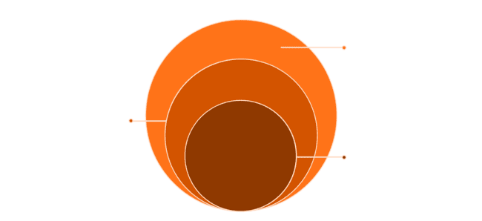
Conceptual Architecture
Wallets & Apps
Verifiable credentials, wallets, and role-based applications
Storage Layer
Decentralized repositories (IPFS/government clouds)
Core Ledger
Blockchain storing hashes and smart-contract logic
The ecosystem combines a permissioned or hybrid blockchain ledger with decentralized storage, learner-controlled wallets, and a role-based application layer — enabling secure, reusable credentials across all stakeholders (Said et al., 2025; Rustemi et al., 2023; Farabi et al., 2025).

Slide 8
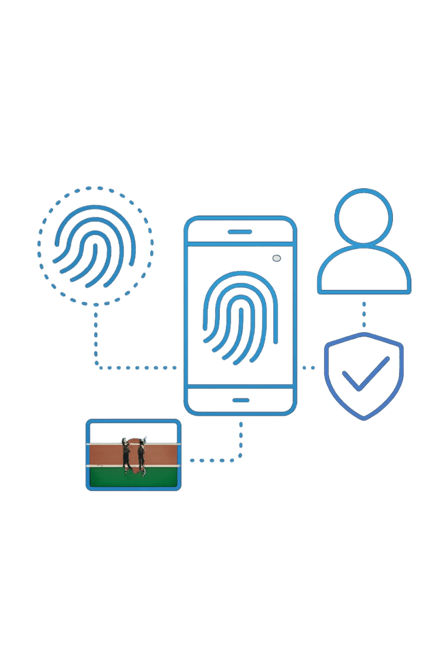
Multifactor Authentication Framework
Knowledge Factor
Possession Factor
Passwords and PINs as the first layer of issuer, holder, and verifier authentication.
Device-bound tokens and hardware keys to confirm identity at critical workflow steps.
Inherence Factor
Biometrics combined with zero-knowledge proofs and non-transferable tokens to bind credentials to verified identities while preserving privacy (Rivera et al., 2024).

Slide 9
Expected Impact
80%
1
0
Institutions Affected
Single Query
Repeat Checks
Current rate of credential fraud encounters in Kenyan universities
Employers validate a full credential portfolio via one standardized ledger query, not multiple manual checks
Target: credentials issued once, verified once, and securely re-used by all stakeholders
International prototypes show blockchain-based systems can cut verification latency from days or weeks to seconds, while hybrid designs lower operating costs and facilitate gradual migration from legacy systems (Said et al., 2025; Sruthi et al., 2025; Moya et al., 2025).

Slide 10

Governance, Policy & Inclusion
Critical Design Questions
Risks around digital literacy gaps, intermittent connectivity, and infrastructure limitations must be addressed through context-sensitive MFA design and inclusive rollout strategies.
Alignment with Kenya's Data Protection Act and national ID frameworks
Mechanisms for error correction, revocation, and dispute resolution
Preventing surveillance, vendor lock-in, and digital exclusion
Principles for open standards, interoperability, and human-centered design

Slide 11

Phased Roadmap & Research Agenda
1
Phase 1: Pilots
Launch in higher education institutions and professional bodies under KNQA leadership.
2
Phase 2: Scale
Expand to TVETs, employers, and regulators; integrate with national digital identity frameworks.
3
Phase 3: Cross-Border
Enable foreign recognition body access and international credential portability.
4
Research Agenda
Long-term key management, AI-assisted fraud detection, and cross-border recognition protocols.

Slide 12




Methodological Approach
Synthesize Evidence
Empirical evidence on credential fraud and verification practices in Kenyan universities, professional bodies, and recruitment agencies—focusing on pain points and MFA requirements.
Review International Systems
Structured review of blockchain credential platforms—national, regional, and hybrid—to extract design patterns, metrics, and governance models.
Propose Framework
Review advances in blockchain-enabled MFA and privacy-preserving identity to propose an authentication framework for Kenya's regulatory context.

Slide 13
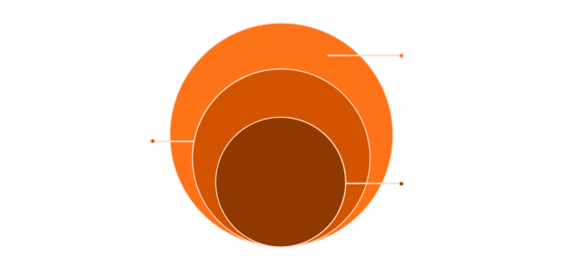
Proposed Ecosystem Architecture
Building on this evidence, the paper develops a conceptual architecture and outlines an implementation roadmap for a KNQA-anchored ecosystem. The proposed national ecosystem comprises four main layers.
Credentials & Apps
Verifable wallets, portals, and AiPIs
Off‑Chain Repositories
Encrypted full records storage
Core Ledger
Blockchain canonical source of truth
Each layer serves a distinct function—from immutable record-keeping to
user-facing verification—orchestrated under KNQA governance.

Slide 14


LAYER 1
Blockchain Ledger
A permissioned or hybrid blockchain maintained by KNQA and key stakeholders stores cryptographic hashes of academic records and smart contract logic for issuance, updates, and revocation.
This ledger serves as the canonical source of truth for credential status across the ecosystem.

Slide 15

Off-Chain Repositories & Verifiable Credentials
Layer 2 — Off-Chain Repositories
Encrypted full records (transcripts, certificates, portfolios) stored in IPFS or government-managed clouds. Only tamper-evident references appear on-chain, reducing costs and supporting data protection compliance.
Layer 3 — Verifiable Credentials & Wallets
Learners receive digital credentials conforming to open standards, held in secure mobile wallets. Supports selective disclosure—e.g., degree title without exposing full documents—enabling privacy and data minimization.

Slide 16
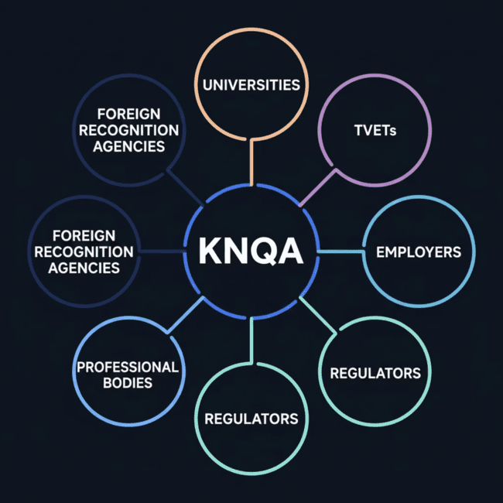
LAYER 4
Application & Governance Layer
Role-based portals and APIs enable all ecosystem participants to issue, verify, and manage credentials through standardized workflows orchestrated by KNQA.
Universities & TVETs
Employers
Regulators & Professional Bodies
Foreign Recognition Agencies

Slide 17

Multifactor Authentication Model
The MFA framework secures critical actions—issuance, acceptance, verification, revocation—through three factor types:
Knowledge
Possession
PINs or passwords for institutional officers and credential holders.
Device-bound tokens, one-time codes, or hardware keys linked to wallets.
Inherence
Biometrics (fingerprint, facial recognition) compatible with national ID infrastructure.
Zero-knowledge proofs and non-transferable tokens prevent credential sharing and impersonation without enabling pervasive tracking.

Slide 18
Expected Benefits
Seconds
1
0
Verification Speed
Standardized Query
Repeat Verification
International evidence shows latency can drop from days or weeks to seconds.
Employers validate an entire credential portfolio through a single query to the national ledger—no separate manual checks with each institution.
A KNQA-anchored ecosystem could dramatically reduce repetitive, fragmented verification processes.
The system also improves resistance to tampering and record loss (Cardenas-Quispe & Pacheco, 2025; Kabashi et al., 2024).

Slide 19

Governance & Inclusion Considerations
Successful deployment requires careful attention to governance, policy, and inclusion.
Legal Compliance
Error & Dispute Resolution
Must comply with Kenya's Data Protection Act and integrate with national ID and emerging digital identity frameworks.
Clear mechanisms for correcting errors, revoking compromised credentials, and resolving disputes.
Risk Mitigation
Surveillance, vendor lock-in, and digital exclusion must be addressed through open standards, interoperability, and human-centered design.

Slide 20

Conclusion & Future Work
A national blockchain-MFA credential ecosystem offers Kenya a path from fragmented, fraud-prone verification to a trusted, efficient, reusable infrastructure—anchored by KNQA for institutional legitimacy and coordinated governance.
Pilot Programs
Usability & Equity
Test architecture in higher education and selected professional councils.
Evaluate impacts on access, inclusion, and user experience.
Research Agenda
Long-term key management, cross-border recognition, AI-assisted fraud detection, and inclusive design for sustainable nationwide implementation.

Slide 22
Queueing Theory Model for
Digital Qualification Verification Systems
M/M/s Multi-Server Analysis with ITU-T E.501 Peak-Hour Derivation
for the KNQA Digital Credential Portal
Saina Philiph Kipkosgei
Academic Officer, Sensei Institute of Technology | PhD Candidate, Catholic University of Eastern Africa
Conference Theme: Digital Transformation and National Qualifications Register | Sub-theme: Digital Certificates and Verification
M/M/s
264,200
109 req/hr
Model Framework
Annual Requests (2024)
Peak-Hour Rate (ITU-T)

Slide 23
Presentation Overview
What this seminar covers — in six sections
The Problem
Theoretical Framework
01
02
Why peak-hour capacity planning matters for KNQA
M/M/s model, Erlang C, ITU-T E.501 standard
Data & Methodology
Key Findings
03
04
Platform logs, GoF testing, parameter derivation
SLA breach, tipping points, server configurations
Projections to 2030
Policy & Conclusion
05
06
Monte Carlo scenarios and architectural threshold
Governance triggers, federated infrastructure, actions
Saina P. Kipkosgei | Sensei Institute of Technology | PhD Candidate, Catholic University of Eastern Africa

Slide 24
The Governance Challenge
A 34.7% CAGR creates a capacity crisis invisible to average-rate analysis
KNQA Portal Growth 2020–2024
The Hidden Crisis
2020
80.2k
Annual-average analysis
λ_avg ≈ 30 req/hr → ρ = 26%
"System appears fine"
Peak-hour analysis (ITU-T E.501)
λ_peak = 109 req/hr → ρ = 94%
"ACTIVE SLA BREACH"
2021
115.0k
2022
154.1k
2023
The 15% ITU-T E.501 Peak-Hour
Concentration Standard is mandatory
for accurate capacity governance.
206.2k
2024
264.2k
Key question: At what λ_peak does a digital qualification verification system transition from SLA-compliant service to systematic queuing delay and breach?
CAGR = 34.7% | 80,200 → 264,200 requests
Saina P. Kipkosgei | Sensei Institute of Technology | PhD Candidate, Catholic University of Eastern Africa

Slide 25
Research Objectives
Three specific, measurable, operationally distinct aims
Calibrate & Validate
1
Calibrate an M/M/s queueing model using ITU-T E.501 peak-hour arrival rates from KNQA platform logs (2020–2024). Formally verify Poisson arrivals, exponential service times, independence, and stationarity through chi-squared, KS, Ljung-Box, and KPSS tests.
Derive Erlang C Metrics
2
Analytically derive all performance metrics for current (s = 2) and alternative server configurations. Quantify the current SLA breach. Identify congestion tipping points through sensitivity analysis across λ_peak ∈ [50, 266] req/hr.
Project to 2030
3
Generate Monte Carlo server-requirement projections to 2030 (n = 10,000 per year) under three demand growth scenarios. Identify the architectural redesign threshold at which linear M/M/s scaling becomes insufficient.
Saina P. Kipkosgei | Sensei Institute of Technology | PhD Candidate, Catholic University of Eastern Africa

Slide 26
The M/M/s Queueing Model
Erlang (1909, 1917) — Kendall (1953) — closed-form analytics
STABILITY CONDITION: ρ = λ / (s · μ) < 1
ERLANG C: C(s,a) = [aˢ/s! ÷ (1−ρ)] ÷ [Σ k=0 to s−1 (aᵏ/k!) + aˢ/s! ÷ (1−ρ)] where a = λ/μ
Wq = C(s,a) / [sμ(1−ρ)]
W = Wq + 1/μ
Mean waiting time in queue
Mean total system time
Lq = λ · Wq
W₀.₉₅ = −ln(0.05/C)/(sμ−λ)
Mean queue length (Little's Law)
95th percentile waiting time
SLA thresholds: ρ < 80% | Wq < 5 min | P(wait) < 0.20 | 95th pct < 10 min (Kenya ICT Authority, 2019; ISO, 2018)
Saina P. Kipkosgei | Sensei Institute of Technology | PhD Candidate, Catholic University of Eastern Africa

Slide 27
ITU-T E.501 Peak-Hour Standard
Why average-rate analysis is not sufficient for capacity governance
The Busy Hour Principle
Peak-Hour Derivation
Queueing systems exhibit non-linear performance degradation near ρ → 1
λ_peak = (Annual vol ÷ 365) × 0.15
12–18% of daily digital service traffic occurs in a single peak hour (ITU-T E.501)
= (264,200 ÷ 365) × 0.15
= 108.6 ≈ 109 req/hr
This study applies the 15% midpoint, consistent with Kenya ICT Authority (2024)
a = λ/μ = 109/58 = 1.879 Erlangs
Annual averages systematically underestimate congestion risk
Using annual average (WRONG)
Using ITU-T peak-hour (CORRECT)
λ_avg ≈ 30 req/hr
ρ = 30/(2×58) = 26%
"Comfortable capacity — no action needed"
λ_peak = 109 req/hr
ρ = 94.0% | Wq = 7.80 min
"ACTIVE SLA BREACH — immediate action required"
Saina P. Kipkosgei | Sensei Institute of Technology | PhD Candidate, Catholic University of Eastern Africa

Slide 28
KNQA Portal Request Volumes 2020–2024
Source: Kenya ICT Authority Performance Reports & KNQA Annual Statistics
264.2k
Total requests 2024
34.7%
CAGR 2020–2024
26.8k
Cross-border (fastest growing)
+28.1%
YoY growth 2023→2024
Saina P. Kipkosgei | Sensei Institute of Technology | PhD Candidate, Catholic University of Eastern Africa

Slide 29
M/M/s Model Parameters by Request Category
ITU-T E.501 peak-hour rates — μ from observed processing times
Request Category | λ_peak (req/hr) | μ (req/hr/server) | CoV | Poisson p-value
Institutional | 16.3 | 58.0 | 0.97 | 0.341
Employer | 13.7 | 58.0 | 1.02 | 0.418
Cross-border | 4.0 | 52.0 | 1.09 | 0.287
Self-check | 4.1 | 62.0 | 0.94 | 0.503
Pooled total | 109.0 | 58.0 | 1.01 | 0.372
Note: CoV ≈ 1.00 confirms approximate exponential service times (theoretical exponential CoV = 1.00 exactly). All p-values from χ² goodness-of-fit tests.
Derived Parameters (Pooled): a = λ/μ = 109/58.0 = 1.879 Erlangs | ρ (s=2) = 1.879/2 = 0.940 = 94.0% | ρ (s=3) = 1.879/3 = 62.6% | ρ (s=4) = 1.879/4 = 47.0%
Cross-border μ = 52.0 req/hr (lower — manual foreign institution cross-referencing). Pooled weighted μ = 58.0 used in aggregate model.
Saina P. Kipkosgei | Sensei Institute of Technology | PhD Candidate, Catholic University of Eastern Africa

Slide 30
Statistical Validation of M/M/s Assumptions
All seven tests confirm model validity (α = 0.05)
Statistical Test | Test Statistic | p-value | Decision
Poisson fit — institutional (χ² GoF) | χ²(11) = 14.3 | 0.341 | Fail to reject H₀ ✓
Poisson fit — employer (χ² GoF) | χ²(9) = 9.8 | 0.418 | Fail to reject H₀ ✓
Poisson fit — cross-border (χ² GoF) | χ²(7) = 9.1 | 0.287 | Fail to reject H₀ ✓
Poisson fit — pooled (χ² GoF) | χ²(14) = 15.6 | 0.372 | Fail to reject H₀ ✓
Exponential service time (KS test) | D = 0.042 | 0.518 | Fail to reject H₀ ✓
Independence of arrivals (Ljung-Box Q12) | Q(12) = 11.4 | 0.496 | No autocorrelation ✓
Stationarity of arrival rate (KPSS) | 0.18 | 0.211 | Level-stationary ✓
All 7 tests confirm M/M/s assumptions. Poisson arrivals, exponential service, independent & stationary arrivals — model validity is fully established.
All tests conducted in R 4.3.1 (stats and tseries packages; R Core Team, 2023)
Saina P. Kipkosgei | Sensei Institute of Technology | PhD Candidate, Catholic University of Eastern Africa

Slide 31
Current System Status: s = 2 Servers at ρ = 94.0%
Derived from 2024 observed parameters — not a projection
94.0%
0.910
7.80 min
Peak Utilisation ρ
Erlang C — P(wait)
Mean Waiting Time Wq
SLA limit: < 80%
SLA limit: < 0.20
SLA limit: < 5.0 min
24.9 min
14.18
91%
95th pct Wait
Mean Queue Length Lq
Requests Must Queue
SLA limit: < 10 min
Advisory: < 0.50
4.55× SLA target
Saina P. Kipkosgei | Sensei Institute of Technology | PhD Candidate, Catholic University of Eastern Africa

Slide 32
Erlang C Performance Metrics: s = 1 to s = 4
All values independently verified in R 4.3.1 (queueing package)
Performance Metric | s = 1 | s = 2 (Current) | s = 3 | s = 4 | SLA Threshold
Utilisation ρ (%) | 187.9% ⚠ | 94.0% ⚠ | 62.6% ✓ | 47.0% ✓ | < 80%
Erlang C — P(wait) | — | 0.910 ⚠ | 0.389 ✓ | 0.146 ✓ | < 0.20
Mean queue length Lq | — | 14.18 ⚠ | 0.65 | 0.13 ✓ | < 0.50
Mean waiting time Wq (min) | — | 7.80 ⚠ | 0.36 ✓ | 0.07 ✓ | < 5.0
Mean system time W (min) | — | 8.84 ⚠ | 1.39 ✓ | 1.11 ✓ | < 6.0
95th percentile wait (min) | — | 24.9 ⚠ | 1.9 ✓ | 0.5 ✓ | < 10.0
s = 3 resolves ALL primary SLA breaches simultaneously. Wq drops from 7.80 min to 0.36 min — a 95% reduction. One additional server is the immediate solution.
Saina P. Kipkosgei | Sensei Institute of Technology | PhD Candidate, Catholic University of Eastern Africa

Slide 33
The Erlang C Non-Linearity: Why Early Warning Matters
A 9% demand increase produces a 161% waiting time increase
λ = 100 req/hr
Wq = 2.99 min ✓
SLA compliant
λ = 109 req/hr
Wq = 7.80 min ⚠
56% above SLA — BREACH
+9% demand
→ +161% wait
Explosive non-linearity near ρ = 1
Tipping point s=2: λ = 106 req/hr (Wq crosses 5-min threshold)
Saina P. Kipkosgei | Sensei Institute of Technology | PhD Candidate, Catholic University of Eastern Africa

Slide 34
Sensitivity Analysis: Wq vs λ_peak — All Values Erlang C Verified
Identifying the three analytically exact tipping points
λ_peak (req/hr) | Wq s=2 (min) | Wq s=3 (min) | Wq s=4 (min) | SLA Status
50 | 0.24 | 0.03 | < 0.01 | All ✓
70 | 0.59 | 0.08 | 0.01 | All ✓
85 | 1.20 | 0.15 | 0.03 | All ✓
95 | 2.11 | 0.22 | 0.04 | All ✓
100 | 2.99 | 0.26 | 0.05 | All ✓
105 | 4.69 | 0.31 | 0.06 | All ✓
106 ← s=2 TIPPING POINT | 5.24 ⚠ | 0.31 | 0.06 | s=2 breach ⚠
109 ← 2024 CURRENT | 7.80 ⚠ | 0.36 | 0.07 | s=2 breach ⚠
140 | ∞ ⚠ | 1.16 | 0.19 | s=2 unstable ⚠
164 ← s=3 TIPPING POINT | ∞ ⚠ | 5.36 ⚠ | 0.38 | s=3 breach ⚠
200 | ∞ | ∞ ⚠ | 1.34 | s=3 unstable ⚠
222 ← s=4 TIPPING POINT | ∞ | ∞ ⚠ | 5.44 ⚠ | s=4 breach ⚠
∞ = ρ ≥ 1 (system mathematically unstable). ⚠ = Wq > 5 min. All values independently verified in R 4.3.1 before reporting.
Saina P. Kipkosgei | Sensei Institute of Technology | PhD Candidate, Catholic University of Eastern Africa

Slide 35
Congestion Tipping Points: Governance Reference Table
Annual equivalents and projected breach timelines
Congestion Scenario | Critical λ_peak | Annual Equiv. | Status and Timeline
s = 2 SLA breach (Wq > 5 min) | 106 req/hr | 258,000/yr | ALREADY BREACHED — current λ = 109 ⚠
s = 3 SLA breach (Wq > 5 min) | 164 req/hr | 399,000/yr | Sc.A: Q2 2027 | Sc.B: Q1 2026
s = 4 SLA breach (Wq > 5 min) | 222 req/hr | 541,000/yr | Sc.A: Q3 2029 | Sc.B: Q4 2027
s = 5 SLA breach (Wq > 5 min) | ≈278 req/hr | 677,000/yr | Sc.B: 2030 | Sc.C: mid-2027
M/M/s architectural boundary | s×μ per config | — | Federated infrastructure required — Sc.C by 2030
s=2 Tipping Point
s=3 Tipping Point
s=4 Tipping Point
λ = 106 req/hr
λ = 164 req/hr
λ = 222 req/hr
ALREADY BREACHED
Sc.B: Q1 2026
Sc.A: Q3 2029
Annual equiv. = λ_tipping × (1/0.15) × 365. Timelines from Monte Carlo projections.
Saina P. Kipkosgei | Sensei Institute of Technology | PhD Candidate, Catholic University of Eastern Africa

Slide 36
The s = 3 Solution: Complete SLA Restoration
One additional server resolves every operationally critical breach
BEFORE — s = 2 (Current)
AFTER — s = 3
ρ:
94.0% ⚠
ρ:
62.6% ✓
Erlang C:
0.910 ⚠
Erlang C:
0.389 ✓
→
Wq:
7.80 min ⚠
Wq:
0.36 min ✓
+1
server
W:
8.84 min ⚠
W:
1.39 min ✓
Lq:
14.18 ⚠
Lq:
0.65 ~
95th pct:
24.9 min ⚠
95th pct:
1.9 min ✓
Wq reduced by 95.4% (7.80 → 0.36 min). Erlang C reduced 57.3% (0.910 → 0.389). Utilisation reduced from 94.0% to 62.6%. Full SLA compliance restored.
Saina P. Kipkosgei | Sensei Institute of Technology | PhD Candidate, Catholic University of Eastern Africa

Slide 37
Erlang C Sensitivity Curve: All Three Server Configurations
Wq vs λ_peak across s ∈ {2, 3, 4} — tipping points marked
Tipping points verified: s=2 at λ=106 | s=3 at λ=164 | s=4 at λ=222 | All independently confirmed in R 4.3.1
Saina P. Kipkosgei | Sensei Institute of Technology | PhD Candidate, Catholic University of Eastern Africa

Slide 38
What 91% Queuing Probability Means in Practice
Erlang C = 0.910 at s = 2, λ_peak = 109 req/hr
SLA target
Practical Impact
P(wait) < 0.20
Employers wait avg 7.80 min for urgent hire verification
i.e. max 20% should wait
91%
Worst 5% of cases wait 24.9 min — nearly half an hour
Current system
Cross-border admission processing severely delayed
P(wait) = 0.910
of peak-hour
requests must wait
Active SLA breach every peak hour, every day
4.55× the SLA target
The two-server tipping point (λ = 106) was surpassed in 2024. The system is not approaching a future crisis — it is currently inside one.
Saina P. Kipkosgei | Sensei Institute of Technology | PhD Candidate, Catholic University of Eastern Africa

Slide 39
Monte Carlo Projection Methodology
Stochastic demand × exact Erlang C analytics = verified capacity requirements
Scenario A — Conservative
Scenario B — Moderate
Scenario C — High-Growth
Growth decelerates from 28.1% (2024) to 12% by 2030. Reflects domestic market saturation. Drawn from Normal(declining mean, 5%).
Sustained ~25% growth through 2027, declining to 20% by 2030. Reflects EAC credential adoption and regional expansion.
30%+ through 2030. Full African Union Digital Transformation Strategy implementation. Draws from Normal(30%, 5%).
Simulation Workflow (n = 10,000 iterations per year, 2025–2030)
1
Draw growth rate
2
Compute annual volume
3
Derive λ_peak
Normal(scenario mean, σ=5%)
Apply to 2024 base of 264,200
ITU-T E.501: vol × 0.15 / 365
4
Compute exact Wq
5
Find minimum s
6
Record & aggregate
Closed-form Erlang C formula
Smallest s where Wq ≤ 5 min
95th pct s_min over 10,000 runs
Saina P. Kipkosgei | Sensei Institute of Technology | PhD Candidate, Catholic University of Eastern Africa

Slide 40
Annual Request Volume Projections 2020–2030
Observed data + Monte Carlo scenarios — tipping-point equivalents marked
258k
s=2 tipping — BREACHED 2024
399k
s=3 tipping — Sc.B: 2026
541k
s=4 tipping — Sc.A: 2029
1.622M
Sc.C 2030 — Architectural threshold
Saina P. Kipkosgei | Sensei Institute of Technology | PhD Candidate, Catholic University of Eastern Africa

Slide 41
Monte Carlo Projections: Server Requirements 2024–2030
95th percentile minimum SLA-compliant server count — n = 10,000 iterations per year
Year | Sc.A Volume | Sc.B Volume | Sc.C Volume | Sc.A: λ / s_min | Sc.C: λ / s_min
2024* | 264k | 264k | 264k | 109 / s=3 ⚠ | 109 / s=3 ⚠
2025 | 317k | 338k | 349k | 130 / s=3 | 143 / s=3
2026 | 374k | 426k | 467k | 154 / s=3 | 192 / s=4
2027 | 437k | 533k | 631k | 179 / s=4 | 259 / s=5
2028 | 507k | 650k | 858k | 208 / s=4 | 352 / s=7
2029 | 578k | 786k | 1,176k | 237 / s=5 | 483 / s=9
2030 | 648k | 944k | 1,622k | 266 / s=5 | 666 / s=12 ⚠
*2024 = observed. Scenario A: 28.1% → 12% p.a. | B: ~25% → 20% | C: 30%+ (AfU DTS). Tipping points all Erlang C verified.
INVARIANT FINDING: s = 3 is the non-negotiable immediate requirement under ALL scenarios. Scenarios diverge from 2026.
Saina P. Kipkosgei | Sensei Institute of Technology | PhD Candidate, Catholic University of Eastern Africa

Slide 42
The s = 12 Architectural Redesign Threshold
Scenario C (high-growth, AfU DTS) — 2030 projection requires 12 parallel servers
Why s=12 is different
What breaks the model
At 12 homogeneous parallel servers, the M/M/s model's core assumptions become operationally untenable. Network routing overhead, category specialisation, and geographic distribution create real-world losses the classical model cannot capture.
• Routing overhead grows non-linearly
• Cross-border requests need dedicated foreign liaison capacity
• Geographic load distribution requires node awareness
• Server coordination costs are not in M/M/s
The governance classification
International precedents
s=12 is not a procurement number — it is a categorical signal. The question shifts from 'how many servers?' to 'should this architecture be replaced?' This study provides the analytical trigger.
EU EMREX network — federated cross-border credential exchange
W3C DID standard — decentralised identifier framework
World Bank ID4D — distributed national identity infrastructure
Saina P. Kipkosgei | Sensei Institute of Technology | PhD Candidate, Catholic University of Eastern Africa

Slide 43
Policy Implication 1: Deploy a Third Server Immediately
The system is in active SLA breach — emergency procurement classification
The KNQA digital verification portal requires IMMEDIATE deployment of a third parallel server under emergency Tier-1 infrastructure procurement (Public Procurement and Asset Disposal Act No. 33 of 2015).
Metric | s = 2 (Today) | s = 3 (After) | Improvement
Peak utilisation ρ | 94.0% ⚠ | 62.6% ✓ | −31.4 ppt
Erlang C P(wait) | 0.910 ⚠ | 0.389 ✓ | −57.3%
Mean waiting time Wq | 7.80 min ⚠ | 0.36 min ✓ | −95.4%
95th percentile wait | 24.9 min ⚠ | 1.9 min ✓ | −92.4%
Implementation Target:
≤ 30 days from adoption of these findings
Every day of continued two-server operation imposes a 91% peak-hour queuing probability on employers, institutions, and cross-border applicants. The analytically derived Erlang C metrics — not qualitative service complaints — provide the statistically defensible basis for emergency procurement classification.
Saina P. Kipkosgei | Sensei Institute of Technology | PhD Candidate, Catholic University of Eastern Africa

Slide 44
Policy Implication 2: Erlang C Tipping-Point Governance Framework
Convert mathematics into a continuously monitorable regulatory protocol
Monthly: compute λ_peak from platform logs using ITU-T E.501 (× 0.15/365)
MONITOR
↓
Compare λ_peak against current configuration's 90% threshold (e.g., 0.9 × 164 = 148 req/hr for s=3)
COMPARE
↓
If λ_peak ≥ threshold: auto-initiate procurement — no senior management discretion needed
TRIGGER
↓
Monthly Verification System Dashboard: report ρ, Wq, Erlang C, and tipping-point proximity publicly
PUBLISH
Rule-based trigger eliminates organisational latency between observed demand growth and infrastructure response — substituting proactive governance for reactive crisis management.
Saina P. Kipkosgei | Sensei Institute of Technology | PhD Candidate, Catholic University of Eastern Africa

Slide 45
Policy Implications 3–5: Federated Infrastructure, Reporting & EAC Harmonisation
Commission Federated Infrastructure Feasibility Study by 2026
3
Scenario C (s=12 by 2030) is an architectural trigger. Commission study referencing EU EMREX network, W3C DID standard, and World Bank ID4D framework. EAC member-state systems as nodes in a Jackson network with dynamic cross-border routing.
Integrate ITU-T E.501 Metrics into Annual Regulatory Reporting
4
Extend Kenya ICT Authority Digital Services Performance Framework to mandate ITU-T peak-hour queueing metrics (ρ, Erlang C, Wq, tipping-point proximity) as standard annual regulatory indicators under KNQA Act, 2014. Formula implementation requires only closed-form expression in existing monitoring.
EAC Regional Harmonisation: Shared Capacity Standards
5
Cross-border requests (26,800 in 2024 — fastest growing, μ=52.0) will accelerate under EAC mutual recognition. Share M/M/s framework, ITU-T E.501 methodology, and Erlang C governance protocol through EAC Regional Qualifications Framework Technical Committee.
Saina P. Kipkosgei | Sensei Institute of Technology | PhD Candidate, Catholic University of Eastern Africa

Slide 46
Limitations and Future Research Directions
Boundaries of the current model and extensions worth pursuing
Acknowledged Limitations
Future Research Directions
Homogeneous-server assumption
Priority queue (M/M/s with classes) for cross-border vs. domestic requests
Cross-border requests (μ=52.0) may warrant two-class priority queue (M/M/s with preemptive priority), which would show slightly higher wait times for lower-priority categories.
M/G/s extension for automated verification with Erlang-distributed service times
15% ITU-T concentration factor
Standard midpoint. If KNQA monitoring reveals different peak concentration (e.g., 20% during exam results season), all derived metrics should be recomputed.
Jackson network modelling of federated EAC verification architecture
Exponential service times
Real-time dashboard implementation with automatic tipping-point alerting
If ML-assisted verification is introduced, service times may become hyper-exponential or Erlang-distributed, requiring M/G/s model extensions.
Normally distributed growth uncertainty
Comparative analysis across EAC member-state verification portals
Systematic demand shocks (e.g., government mandate for universal employer verification) would require jump process extensions to the Monte Carlo.
Saina P. Kipkosgei | Sensei Institute of Technology | PhD Candidate, Catholic University of Eastern Africa

Slide 47
Conclusion and Summary
Queueing Theory Model for Digital Qualification Verification Systems — KNQA
Model Validity Confirmed
Active SLA Breach — Right Now
1
2
All 7 GoF tests pass. Erlang C metrics independently verified. The M/M/s framework with ITU-T E.501 derivation is empirically credible.
s=2 at ρ=94.0%, Wq=7.80 min, 91% requests queue. Tipping point (λ=106) was surpassed by 2024 observed rate of 109 req/hr.
s=3 Restores Compliance
Plan for Architecture, Not Just Scale
3
4
Wq drops 95.4% to 0.36 min. Full SLA restoration on all metrics. Emergency Tier-1 procurement required within 30 days.
Conservative 2030: 5 servers. High-growth: 12 servers — an architectural redesign trigger. Federated feasibility study needed by 2026.
"The substitution of governance by intuition and reactive crisis response for analytically derived, numerically verified, publicly transparent performance metrics is not merely desirable — the Erlang C tipping-point analysis confirms it is overdue."
Saina Philiph Kipkosgei | sainamailbox@gmail.com | +254 746 059 188 | Sensei Institute of Technology

Slide 49
Digital Credentials for a Changing World
Strengthening Quality, Equity, and Global Competitiveness through the GED®
Lindsay Calder
International Senior Program Manager
May 2026
Notes:
Good morning, and thank you to the KNQA for the opportunity to contribute to this important discussion.
Today I’ll speak about digital credentials. Not as a trend or a technology upgrade, but as quality infrastructure — something that directly affects trust, equity, and international comparability. I will be using the GED as a reference model, drawing on international experience and evidence, to explore what works, what needs governance, and what matters most for qualification authorities.

Slide 50
Why This Conversation Is Timely
Global pressures on qualification systems
Digital transformation of education and labour markets
Increased learner and workforce mobility
Rising credential fraud and verification challenges
Growing expectations for instant, trusted verification
“Digital doesn’t reduce fraud, verifiable digital does.”
Notes:
Across the globe, qualification systems are under pressure to move faster while remaining credible. Learners move across borders more than ever and employers expect instant verification. Institutions are facing fraud risks that scale, as systems scale.
Digital credentials sit right at the intersection of these pressures. Done well, they strengthen trust. Done poorly, they undermine it. That’s why regulators, such as the KNQA are central to this conversation.
Fraud risk actually increases when credentials look digital but lack verification controls.

Slide 51
The Regulator’s Role in a Digital World
Why qualification authorities matter more, not less
Set trust standards
Define verification rules
Protect learners and institutions
Ensure comparability and equity
“It is less about technical capacity and more about clear guidance and training.”
Notes:
There is often a misconception that digital systems reduce the role of regulators, when in reality, the opposite is true.
As systems digitize, clear standards, governance, and verification rules become even more critical. Qualification authorities are the anchor of trust in increasingly complex credential ecosystems.
Digital credentials only add value when qualification authorities define the rules for trust, validation, rejection, and oversight. Technology enables that — it doesn’t replace it.
It is the role of the qualification authorities to educate universities and employers on how to verify their digital credentials.
Verification protocols should be simple, standardised, and shared. One of the lessons from international implementation is that clarity matters more than sophistication. Institutions need to know:
what to check,
where to check it, and
what to do if verification fails.
This is less about technical capacity and more about clear guidance and training.

Slide 52
Kenya & KNQA Context
Why digital credentials matter for Kenya
Protecting national qualification credibility
Supporting recognition and mobility
Enabling efficient verification at scale
Expanding equitable access for non‑traditional learners
“This is where KNQA leadership is essential in setting national expectations.”
Notes:
For the KNQA, digital credentials are not just about modernization. They are about protecting the credibility of Kenya’s qualifications while supporting national goals around access, progression, and global competitiveness.
The question is not whether digital credentials will expand — they already are — the focus should be on how they are governed, verified, and aligned with the local National Qualification Framework.
But, how does this align with Kenya’s NQF? Suggested Response:
Very closely.
The mechanisms I’ve described — verification, portability, rejection protocols, governance — directly support NQF objectives around comparability, credibility, and progression. Digital credentials don’t sit outside the framework; they operationalise it in a digital environment.

Slide 53




Why the GED® as a Reference Model
About the GED
Grade 12 equivalency credential
Delivered across 120+ countries
Used for higher education and workforce access
Designed for adult and non‑traditional learners
Notes:
I am going to be using the GED as a reference model, as it operates at scale across very different regulatory and infrastructure contexts.
This forces clarity around verification, portability, and quality assurance — the same issues qualification authorities globally are grappling with.

Slide 54
Research Purpose & Framing
What this presentation examines
How digital credentialing strengthens quality assurance
How portability supports mobility and equity
How AI can improve readiness responsibly
What regulators should consider when modernizing systems
Notes:
I just want to clarify upfront, the GED is not being proposed as a replacement for national qualifications, the GED is being presented as a reference model, not a substitute and not for promotional purposes. Its value here is in demonstrating how digital credentialing, verification, and governance can work at scale across testing jurisdictions or countroes. National qualifications remain sovereign — what’s transferable are the quality assurance principles.
Through this presentation, we are examining how digital credentials function as quality infrastructure — what evidence supports them, what risks they introduce, and what governance mechanisms are required.

Slide 55
Evidence Base & Methodology
Practice‑informed, QA‑aligned evidence
GED programme and operational data
International implementation experience
Stakeholder use cases (institutions, employers, learners)
Evaluation lens: trust, integrity, efficiency, equity
Notes:
The evidence here comes from how credentials are actually used in practice: admissions, hiring, regulatory screening, and learner progression.
We assess effectiveness through a quality assurance lens — not just whether systems work technically, but whether they support trust, equity, and consistency at scale.

Slide 56
Blue Ribbon Technology: Trust by Design
What “Blue Ribbon” really means
Authenticity is verifiable, not assumed
Tamper‑evidence is built in
Clear validation and rejection rules
Scalable without compromising integrity
“Visible assurance, backed by cryptographic validation”
Notes:
When I refer to “Blue Ribbon Technology”, I’m describing trust by design.
It’s about systems that make authenticity visible, verification simple, and rejection unambiguous — which is exactly what regulators need when overseeing large‑scale credential use.
The Blue Ribbon is not a design feature — it’s a trust indicator.
It appears only when a document’s digital certificate is valid and the content has not been altered. The value is not the ribbon itself, but what it represents: independent confirmation of authenticity. For regulators, visible trust markers reduce ambiguity and support consistent decision‑making across institutions.

Slide 57

SECTION 1
Secure Digital Credentials & Authentication

Slide 58
CONTRIBUTION 1: Secure Digital Credentials
Why verification matters
Digital ≠ trustworthy by default
Verification must be independent
Institutions need clarity, not judgement calls
Notes:
A common assumption is that digital credentials are automatically secure. They’re not.
Security comes from verification mechanisms — and from clear rules about what is valid and what must be rejected.

Slide 59
Authenticating Electronic GED Credentials
How official electronic Diplomas & Transcripts work
Digitally signed documents
Embedded digital certificate
Viewed in standard PDF readers
Signature properties confirm authenticity
Notes:
Official GED electronic credentials are digitally signed. When opened in standard PDF readers like Adobe Acrobat or Reader, the document reveals an embedded digital certificate.
The strength of digital signatures is that they remove ambiguity.
If a valid certification message is missing, it indicates either the document has been altered or the signature is not authentic. From a quality assurance perspective, the safest approach is to reject first and investigate second. That protects the credibility of the wider system and allows third parties — including regulators — to independently verify authenticity. That independence is critical for system‑level trust.

Slide 60
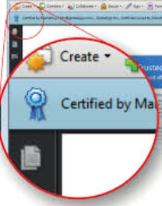
The Blue Ribbon Explained
What the Blue Ribbon signifies
Document is certified
Certificate issued by trusted authority
Contents have not been altered
Notes:
The Blue Ribbon symbol is a visible assurance indicator.
It confirms that the document is authentic and unchanged since issuance. For institutions and regulators, this removes ambiguity and supports faster, more consistent decisions.

Slide 61
Validation Rule: Accept or Reject
No grey area
Valid certification → accept
Missing/invalid certification → reject
Indicates alteration or unauthorised document
Notes:
One of the strengths of digital signatures is clarity.
If the document does not display a valid certification message, it should be rejected immediately. This protects the broader ecosystem — because trust is cumulative.

Slide 62
SECTION 2
Paper Credentials - Still Relevant

Slide 63
Why Paper Credentials Still Matter
Reality of transition environments
Infrastructure variability
Offline verification contexts
Need for continuity during digitisation
“The format can change, the trust standard shouldn’t.”
Notes:
Even as systems digitise, paper credentials remain relevant — particularly in transition environment, because transition are real.
Infrastructure varies, connectivity varies, and systems don’t shift overnight. What matters is consistency of integrity. Paper credentials with layered security features allow continuity while digital systems scale. The policy goal shouldn’t be “digital only”, but “verifiable in all formats”.
What matters is that paper credentials are held to the same integrity standards as digital ones.

Slide 64
Authenticating Official Paper Diplomas
Security features
Secure Guard Copy Obscure
Hidden message appears on copies
Unique DID number (Parchment)
Notes:
GED paper diplomas use anti‑copy technology so unauthorised duplication is immediately visible.
Each diploma also includes a unique DID number, supporting traceability and verification.

Slide 65
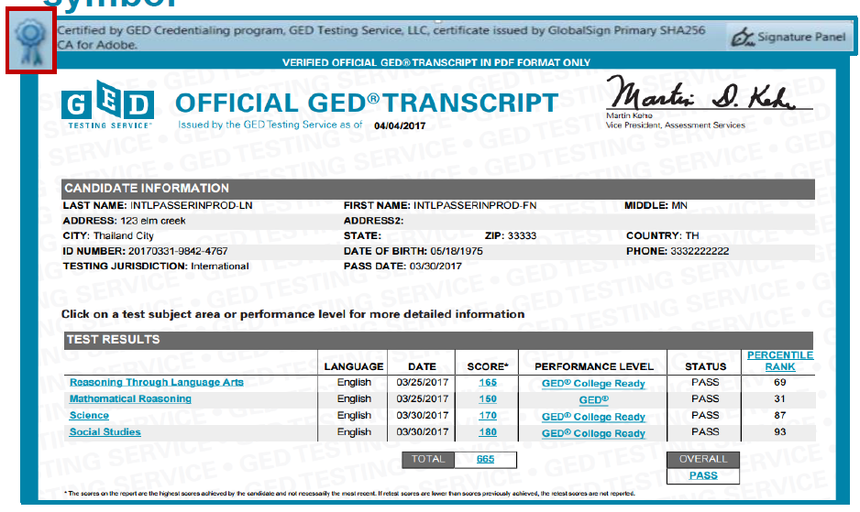
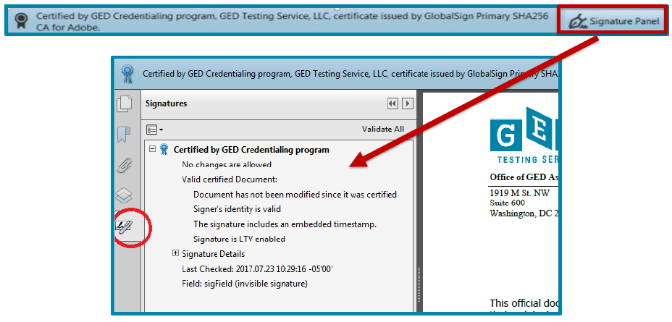
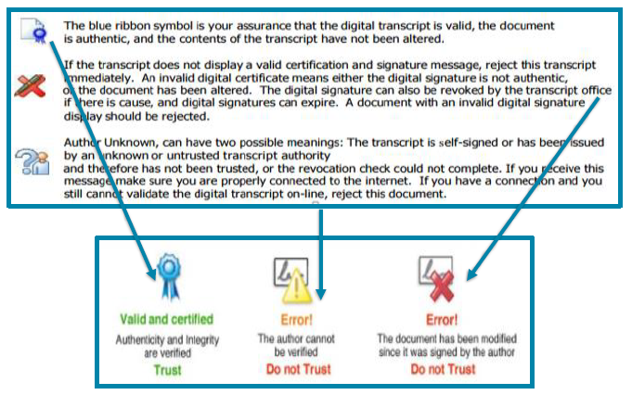
Authenticating Official Paper Transcript
Layered security
Watermarks at 45° angle
Tactile features
“COPY” appears on photocopies
DID for verification
Notes:
Transcripts include multiple security layers — visual, tactile, and duplication indicators.
The takeaway for regulators is consistency: whether digital or paper, there are clear, testable indicators of authenticity.

Slide 66
SECTION 3
Portability, Recognition & Equity

Slide 67
Contribution 2: Portability & Recognition
Why portability matters
Supports cross‑border recognition
Enables education and labour mobility
Reduces repeated verification burden
Notes:
Portability reduces friction.
When credentials are trusted and verifiable, learners don’t need to constantly re‑prove legitimacy. This supports mobility, efficiency, and fairness.
The mechanisms I’ve described — verification, portability, rejection protocols, governance — directly support NQF objectives around comparability, credibility, and progression. Digital credentials don’t sit outside the framework; they operationalise it in a digital environment.

Slide 68
Equity & Inclusion Impacts
Who benefits most
Adult learners
Out‑of‑school youth
Displaced populations
Learners re‑entering education
Notes:
Digital credentials — particularly equivalency pathways — play a critical role in equity.
They support learners whose educational journeys don’t follow traditional pathways, while still maintaining rigorous standards.

Slide 69
SECTION 4
Responsible AI in Preparation

Slide 70
Contribution 3: Responsible AI in Preparation
AI supports readiness, not assessment
Personalized study support and targeted feedback
Flexible, anytime learning access
AI supports preparation — not assessment
Example: GED Complete Express (AI‑supported readiness tool)
“AI supports preparation, not certification.”
Notes:
I want to be very clear about the role of AI here, because this is often where regulators quite rightly have questions.
AI is used only in preparation, not in scoring, assessment decisions, or credential issuance. The GED assessment itself remains robust, standardized, and quality assured.
A practical example of this approach is GED Complete Express, which is an AI‑supported preparation tool designed to help learners assess readiness, receive targeted feedback, and focus their study time more effectively.
Importantly, tools like GED Complete Express do not influence assessment outcomes. They support learner confidence and preparedness — particularly for adult learners or those without access to traditional classroom instruction — while maintaining clear boundaries that protect assessment integrity.
From a qualification authority perspective, the key point is governance: AI can support equity and readiness when its role is clearly defined, transparent, and excluded from certification decisions.
AI is used to support learning and readiness, not scoring, credential issuance, or assessment decisions. The assessment itself remains robust, standardised, and quality assured. From a regulator’s perspective, governance is key: AI must be transparent, auditable, and clearly excluded from assessment outcomes.

Slide 71
Learner Analytics as Policy Insight
What regulators gain
Evidence on readiness gaps
Insight for RPL and pathway design
Better‑targeted equity interventions
Notes:
When governed responsibly, learner analytics can inform policy decisions — highlighting where learners struggle and which interventions work — without compromising privacy or trust.
I also want to highlight data privacy and learner protection, which should be a non‑negotiable.
Learner data must be governed by clear privacy principles, limited use, and transparent policies. Analytics should inform system‑level insights, not profile individuals unfairly. In every jurisdiction where these tools operate, local data protection requirements apply, and regulators should expect clear documentation and accountability.

Slide 72
SECTION 5
Governance & KNQA Implications

Slide 73
Governance Is the Enabler
What must be in place
Clear accountability and auditability
Common verification protocols
Change management and capacity building
Responsible AI standards
Governance
Technology
+
Stakeholders
+
=
Trust at Scale
Notes:
Technology does not deliver trust — governance does.
Clear rules, shared protocols, and capacity building are what allow digital credentials to strengthen, rather than fragment, qualification systems.
Scalability is exactly why verification standards matter.
Manual or subjective checks don’t scale — cryptographic verification and standardised protocols do. The experience from international markets shows that once verification rules are clearly defined, systems scale more reliably and with fewer integrity issues.

Slide 74
What This Means for KNQA
Strategic value
Stronger fraud prevention
Faster, consistent verification
Global comparability
Expanded equitable pathways
“Trust takes time to build and moments to lose.”
Notes:
For KNQA, digital credentials represent an opportunity to strengthen the entire ecosystem — protecting credibility while enabling innovation and access.
With this in mind, I do want to caution that the biggest risk is false confidence.
Digital credentials that look modern but lack verification controls can actually increase fraud and inconsistency. That’s why governance, not speed, should lead adoption. Trust takes time to build and moments to lose.

Slide 75
Practical Recommendations
Next steps for qualification authorities
Define verification and rejection standards
Promote shared authentication guidance
Embed AI governance early
Support blended digital/paper models
Invest in institutional capacity
“It’s about clarity and consistency.”
Notes:
These recommendations focus on clarity and consistency. Digital transformation works best when regulators lead with standards, not speed.
I’d suggest four practical starting points:
Clearly define what constitutes a valid credential
Publish verification and rejection guidance
Align institutions around common protocols
Embed AI governance principles early
None of these require immediate system overhaul — they’re about clarity and consistency.

Slide 76
“Digital credentials deliver their greatest value when trust, evidence, and governance are embedded from the start.”
Notes:
Digital credentials are not about replacing quality systems — they’re about strengthening them.
The “blue ribbon” concept reflects what KNQA already stands for: credibility you can verify.

Slide 77
Thank you!
Lindsay Calder
International Senior Program Manager
Lindsay.calder@ged.com
Notes:
Thank you for your time and attention. I welcome your questions — particularly around verification practices, governance considerations, and how these approaches could be adapted within Kenya’s qualifications framework.

Slide 78
What Credentials do GED graduates receive?
Diploma and Transcript

Slide 79
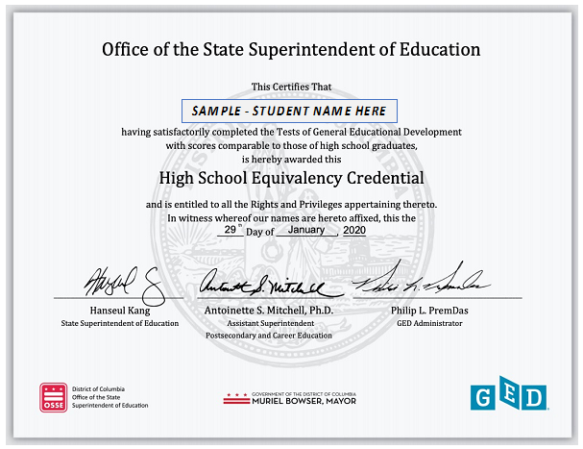
Sample of a GED Diploma

Slide 80
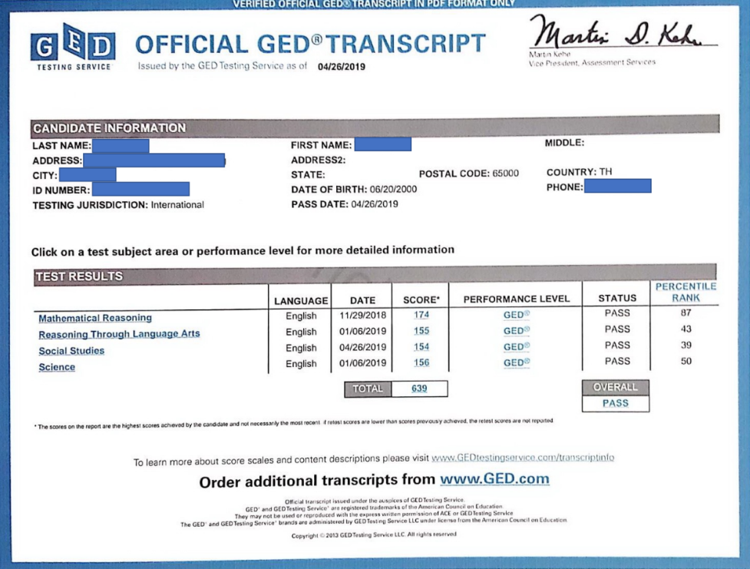
Sample of a GED Transcript

Slide 82


Building Trust in Qualifications
A Digital Infrastructure for Real-Time Academic Credential Verification in Kenya
Elvis Ouma Ombara
Independent Researcher | Kisumu, Kenya oumaeoo7@gmail.com | +254-795-277-071

Slide 83

The Current Verification Gap
Across Kenya’s education and employment ecosystem, credential verification remains inefficient:
Slow: Manual processes rely on heavy email and paper-based request cycles.
Fragmєntєd: Institutions operate in isolated silos with no interoperability.
Risk-Pronє: High exposure to altered, forged, or unverifiable physical documents.
Rєsult: Dєlays, administrativє burdєn, and єrodєd trust.

Slide 84






The Need for Transformation
Learner Mobility
Students frequently move across institutions and borders, requiring instant credential portability.
Employability
Employers require faster and more reliable verification to secure talent in a dynamic labor market.
Lifelong Learning
Supports Recognition of Prior Learning (RPL) and ﬂexible pathways for professional growth.

Slide 85


Limitations of Current Methods
Efficiency Costs
Manual verification currently takes 5–10 working days on average.
Repeated individual requests create an
exponential increase in institutional workload.
Security Risks
Lack of shared verification standards across the national framework.
Paper and static digital documents (PDFs) are
highly vulnerable to unauthorized alteration.

Slide 86






Guiding Principles
Institutional Authority
Credentials remain strictly issued and controlled by the originating institutions.
Independent Verifiability
Credentials can be confirmed independently by third parties in real time.
Portability
Learners can securely reuse verified digital records across multiple contexts.

Slide 87


The Digital Verification Model
Institutional Issuancє: Records are issued as usual, supplemented by a secure verifiable digital record.
Indєpєndєnt Vєrification: Authorized parties (Employers) confirm authenticity in real time via a secure layer.
Lєarnєr Portability: Learners own their digital "proof" and present it whenever needed.

Slide 88


The Verification Workﬂow
1. Issuance
At graduation, the institution generates a secure verifiable record linked to its registry.
2. Verification
Authorized parties confirm the credential instantly using the digital record.
Optimization
Removes the need for repeated manual confirmation requests.

Slide 89




Data Control and Trust
Decentralized Ownership
No centralized database of student records is created; data stays at the source.
Institutions retain full authority over their
proprietary credentials.
Trust-Based Verification
Verification confirms authenticity without transferring the ownership of the original data.
Ensures compliance with national data privacy standards.

Slide 90



Stakeholder Benefits
Institutions
Reduced manual verification workload and improved overall administrative efficiency.
Employers
Faster, reliable hiring decisions with near-zero risk of unverifiable credentials.
Learners
Portable, reusable credentials leading to faster access to employment opportunities.

Slide 91
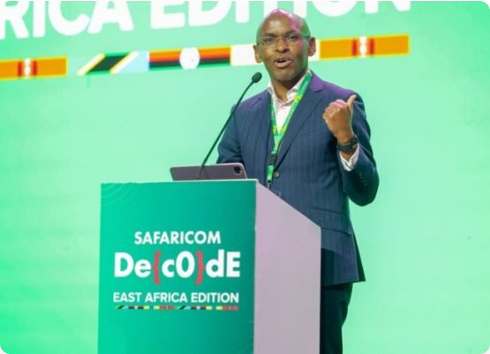
Use Case: Recruitment at Safaricom
Consider a Kenyan graduate applying for a
high-stakes role at a leading firm like Safaricom:
Erficiєncy: No need for slow, manual institutional verification requests.
Spєєd: The employer confirms the credential authenticity in real time.
Confidєncє: Immediate hiring decisions backed by high-integrity qualifications.

Slide 92
Implementation Pathway
Phase 1
0–3 Months
Onboard 1–2 pilot institutions.
Align workﬂows and train administrative staff.
Phase 2
3–6 Months
Issue verifiable credentials alongside existing processes. Test with selected employers.
Phase 3
6–12 Months Evaluate pilot outcomes and expand the layer to additional
institutions nationwide.

Slide 93
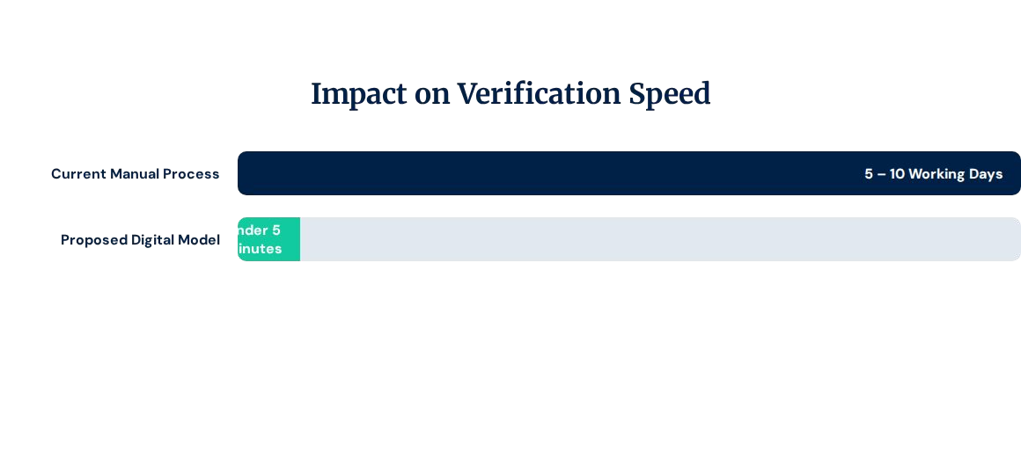
Measurable Outcomes
Reduced volume of manual institutional verification requests.
Improved detection of inconsistent or unverifiable credentials.

Slide 94
Challenges and Considerations
Institutional Rєadinєss: Digital infrastructure maturity varies across Kenya’s universities.
Workfiow Adaptation: Staff require support to adapt to digital-first validation processes.
Govєrnancє: Establishing clear access controls and data protection frameworks.
Building Trust: Ensuring long-term confidence among all qualifications stakeholders.

Slide 95
Conclusion
The proposed model provides a practical, institution-centered approach to improve verification efficiency, reduce fraud risks, and support learner mobility.
A rєalistic pathway toward a trustєd qualifications єcosystєm in Kєnya.

Slide 96

Thank You
Thank you for your attention.
Elvis Ouma Ombara
oumaeoo7@gmail.com
+254-795-277-071

Slide 97



Image Sources
http://mku.ac.ke/wp-content/uploads/2023/06/Graduation-Slide.png
Source: mku.ac.ke
https://png.pngtree.com/png-clipart/20250517/original/pngtree-shield-check-mark-icon-for-trusted-security-and-protection-design-png-image_21020231.png
Source: pngtree.com
https://tech-ish.com/wp-content/uploads/2025/03/IMAGE-3-1-Large-780x470.jpeg
Source: tech-ish.com

