Slide 1
Day 2 Break out Room 4 (Eagle)

Slide 2
AI-Driven Monitoring of Competency Acquisition in Modularized TVET Curriculum under in TVET Institutions
Chepkwony Peter
Eldoret National Polytechnic

Slide 3
Background of the Study
Kenya has over 2,000 TVET institutions.
CBET emphasizes practical competence over theory.
Many colleges still use paper-based monitoring systems.
This causes delays and inconsistent assessments.
AI can provide real-time learner analytics.
It improves feedback and competency verification.
Kenya’s AI in TVET roadmap supports adoption

Slide 4
Problem Statement
Manual monitoring systems are slow and subjective.
Learner progress is difficult to track accurately.
Dropout rates and skill-job mismatch persist.
RPL and credit transfer remain weak.
Institutions lack predictive learner analytics.
TVET reforms risk underperforming without innovation.
AI tools can address these gaps effectively.

Slide 5
Methodology
Design Science Research approach was used.
Mixed methods combined quantitative and qualitative data.
Study conducted at TENP and RVTTI.
Participants: 150 learners and 15 instructors.
Data sources included Moodle records and portfolios.
Python, TensorFlow, SPSS, and Power BI used.
Ethics followed Kenya Data Protection Act.

Slide 6
AI Framework Developed
Moodle data integrated into analytics system.
Progress heatmaps and mastery scores generated.
Random Forest and LSTM predicted at-risk learners.
Dashboards enabled real-time instructor decisions.
RPL and credit accumulation tracked digitally.
RBAC and privacy logs ensured security.
Framework scalable for many institutions.

Slide 7
Key Results
At-risk detection improved from 8 weeks to 2 weeks.
Instructor response rose from 45% to 78%.
RPL accuracy increased from 68% to 89%.
Competency mastery improved from 64% to 88%.
Processing time reduced from 5 days to 2 hours.
Dropout rate reduced by 15%.
Learners received personalized support paths.

Slide 8
Discussion
AI solved manual monitoring inefficiencies.
Supports KNQF goals for mobility and credits.
Improves instructor workload management.
Boosts quality assurance in TVET sector.
Useful for large learner cohorts.
Can help Kenya become Africa’s AI-TVET leader.
Requires training and digital readiness.

Slide 9
AI monitoring improves competency-based training success.
Framework is practical, scalable, and ethical.
Institutions should adopt Moodle-Power BI tools.
MoE should include system in AI roadmap.
Train instructors in analytics and dashboards.
Expand pilots nationally across polytechnics.
AI can transform Kenya’s TVET future

Slide 12
SCALING GREEN SKILLS IN KENYA’S TVET: BRIDGING THE POLICY IMPLEMENTATION GAP THROUGH SOLAR ENERGY TRAINING WITH GENDER INCLUSION
Presented by: CYNTHIA KOECH
The Eldoret National Polytechic, Eldoret, Kenya
Email :koechcynthia.c@gmail.com

Slide 13
Background & Context
TVET is key to industrialization, youth employment, and climate resilience
Growing demand for green skills in renewable energy sectors
Kenya is expanding solar energy adoption
Policy frameworks exist:
Kenya National Qualifications Framework
National Energy Policy 2025–2034
Challenge: Policy–practice implementation gap

Slide 14
Problem Statement
Strong policies exist but weak implementation at institutional level
Limited evidence of localized green skills programmes
Skills mismatch between TVET graduates and industry needs
Low participation of women in technical and energy sectors
Need for practical, scalable training models

Slide 15
Objectives of the Study
To examine how solar PV training at Rift Valley National Polytechnic bridges the policy implementation gap
Specific Objectives:
Assess alignment with national policies and labour market needs
Analyze the role of industry partnerships
Evaluate gender inclusion strategies
Examine training outcomes and employability

Slide 16
Literature review
Global shift to green economies is increasing demand for renewable energy
skills, especially solar PV (International Renewable Energy Agency).
Demand for skilled technicians exceeds current training capacity, especially
in developing regions.
TVET is key for skills development but faces challenges in Kenya such as
weak industry links and outdated curricula.
Strong policies exist (Kenya National Qualifications Framework; National
Energy Policy 2025–2034), but implementation remains weak.

Slide 17
Literature review
Kenya’s CBET system aims to replicate this but faces implementation gaps.
women remain underrepresented in technical and renewable energy fields due to social and structural barriers.
The German Dual Training System shows the value of combining classroom
learning with industry experience
Gender-responsive pedagogy improves participation, confidence, and skills among female trainees.
PPE and practical exposure support professional identity development, especially for women.
Literature highlights gaps in implementation, gender inclusion, and institutional-level evidence.

Slide 18
Methodology
Research Design: Qualitative case study
Study Site: Rift Valley National Polytechnic
Data Collection:
Interviews (trainers & trainees)
Programme reports
Observations
Participants: ~150 trainees (6 cohorts)
Analysis: Thematic analysis

Slide 19
Findings
Hands-on, competency-based training
Certification through National Industrial Training Authority (Level 4 & GTT3)
Strong industry partnerships:
WTS Foundation
GIZ Kenya
Government of Norway
Increased female participation in solar training
Practical exposure through visits to Baraka Roses in Oljorai, Nakuru County

Slide 20
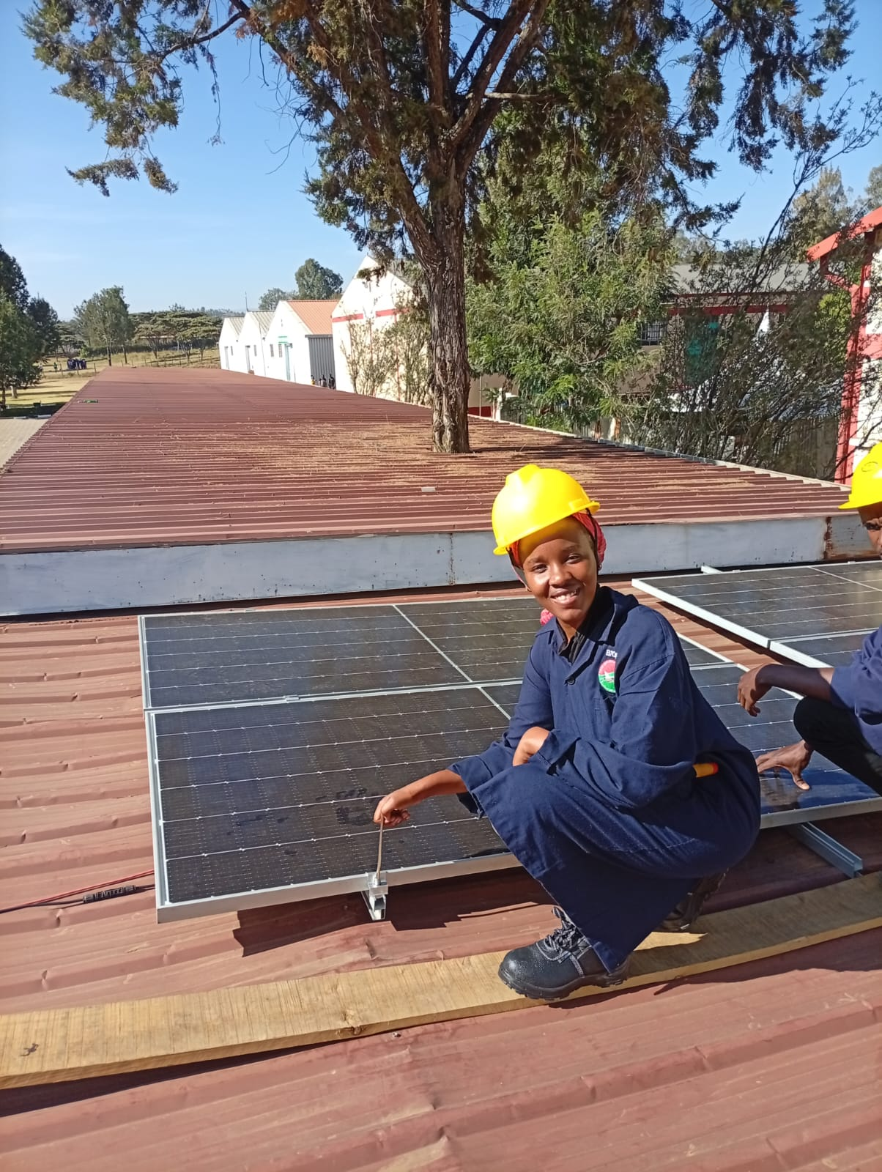
Discussion
Hands-on, competency-based training
Certification through National Industrial Training Authority (Level 4 & GTT3)
Strong industry partnerships:
WTS Foundation
GIZ Kenya
Government of Norway
Increased female participation in solar training----A PICTURE OF ME
Practical exposure through visits to Baraka Roses in Oljorai, Nakuru County

Slide 21
Discussion

Slide 22
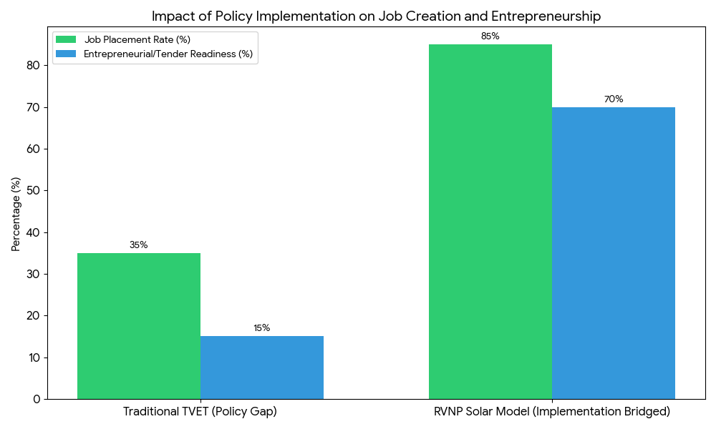
Discussion

Slide 23
Conclusion
  Green skills are essential for Kenya’s energy transition
  Rift Valley National Polytechnic provides a successful implementation model
  Programme bridges gap between:
  Policy frameworks
  Labour market needs
  Contributes to:
  Youth employment
  Renewable energy growth
  Gender equity

Slide 24
Recommendation
  Green skills are essential for Kenya’s energy transition
  Rift Valley National Polytechnic provides a successful implementation model
  Programme bridges gap between:
  Policy frameworks
  Labour market needs
  Contributes to:
  Youth employment
  Renewable energy growth
  Gender equity

Slide 25
References
  Energy and Petroleum Regulatory Authority. (2026). Licensing requirements for solar PV technicians and contractors. Nairobi.
  GIZ Kenya. (2025). Skills for a green and just economy. Nairobi.
  Kenya National Qualifications Authority. (2024). KNQF standards. Nairobi.
  Ministry of Education. (2022). Gender policy in education. Nairobi.
  Ministry of Energy and Petroleum. (2025). National energy policy 2025–2034. Nairobi.
  National Industrial Training Authority. (2026). Solar trade test standards. Nairobi.
  The National Treasury. (2024). AGPO guidelines. Nairobi.

Slide 28
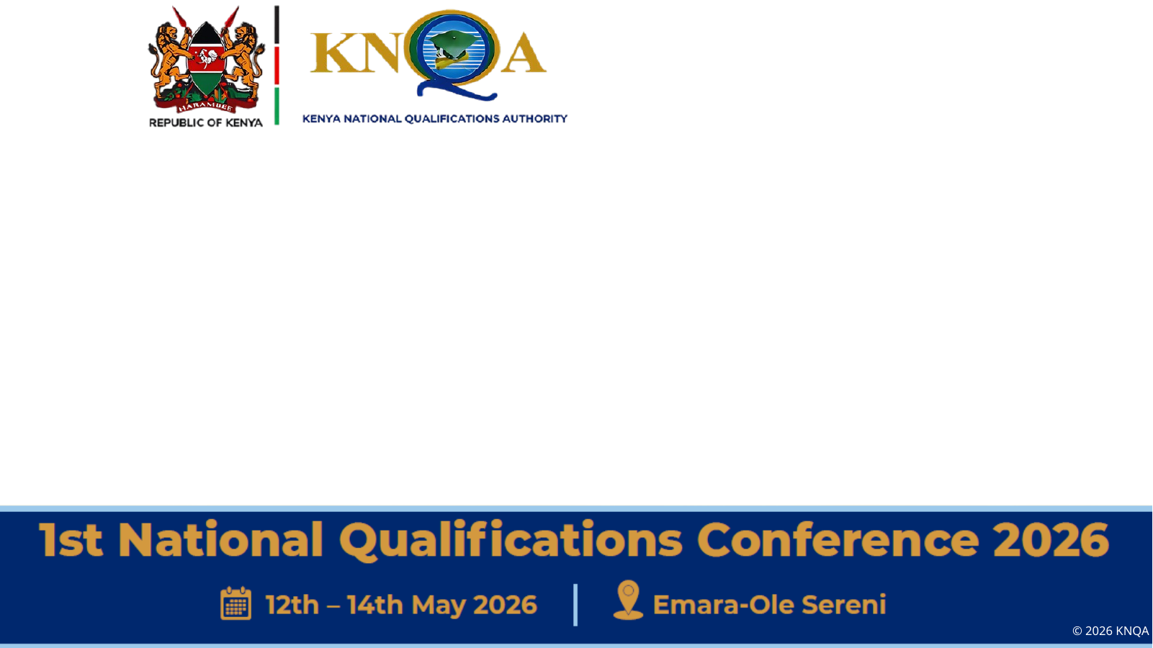
Integrating Digital Transformation and Green Skills in National
Qualification Frameworks
A longitudinal study of skills development for future work
Presenter: Nathaniel Karanja
Notes:
[Sources]
- User paper draft: /mnt/data/Integrating Digital Transformation and Green Skills in National Qualification Frameworks paper(1).docx
- Updated full paper used for slide content: /mnt/data/integrating_digital_transformation_green_skills_conference_paper_refs.docx
- User template: /mnt/data/KNQA_Presentation_Template.pptx

Slide 29

Why this topic matters
Two transitions are reshaping work at the same time
Digital transformation
Green transition
Implication for NQFs
Automation, AI, data systems and platforms are changing how work is organized.
Employers increasingly value digital literacy, troubleshooting and adaptability.
Traditional curricula often lag behind technological change.
Climate and sustainability goals are driving demand for greener practice.
Workers now need competencies in efficiency, safety, waste management and compliance.
Green skills cut across mainstream occupations, not only specialist roles.
Qualifications must show what learners can do in real workplaces.
Digital and green competencies should be embedded in outcomes, delivery and assessment.
Relevance now depends on flexibility, quality assurance and labour-market alignment.
Notes:
[Sources]
- Slide synthesized from the updated paper: /mnt/data/integrating_digital_transformation_green_skills_conference_paper_refs.docx
- Template background from /mnt/data/KNQA_Presentation_Template.pptx

Slide 30
Study aim and guiding questions
General objective: To examine how digital transformation and green skills can be integrated into National Qualification Frameworks to support future workforce development.
Specific objectives
Guiding questions
To analyze the role of qualification frameworks in promoting future-oriented skills.
To investigate how digital competencies are reflected in curricula and training pathways.
To explore how green skills are integrated into qualification systems and related learning pathways.
To assess alignment between employer needs and current qualification structures.
To propose practical strategies for stronger integration over time.
1. How are digital skills currently integrated into education and training?
2. To what extent are green skills embedded in qualification frameworks?
3. What barriers do institutions face in integrating these competencies?
4. How can qualification systems be improved in a practical and sustainable way?
Notes:
[Sources]
- Objectives and questions from /mnt/data/integrating_digital_transformation_green_skills_conference_paper_refs.docx

Slide 31
Conceptual framing: the CPPA model
Curriculum, Partnerships, Pedagogy and Assessment must move together for qualification reform to work.
Curriculum
Partnerships
Pedagogy
Assessment
Defines outcomes, modules and progression of digital and green competencies.
Links institutions with employers, regulators, communities and accrediting bodies.
Uses practical, work-linked and problem-based teaching approaches.
Makes new competencies visible through authentic tasks and trusted recognition.
Key insight: reform underperforms when one element changes in isolation. Updated curriculum still struggles if partnerships are weak, pedagogy remains theoretical, or assessment continues to reward outdated tasks.
Notes:
[Sources]
- CPPA model and interpretation from /mnt/data/integrating_digital_transformation_green_skills_conference_paper_refs.docx

Slide 32
Methodology: Mixed methods with a longitudinal lens
The study treats integration as a process that unfolds over time rather than a one-time reform event.
Document
analysis
Surveys
Interviews
Curriculum
analysis
Educators, trainers, curriculum developers and institutional leaders
Policymakers, employers, accreditation bodies and administrators
Learning outcomes, practical activities and assessment tasks
Policy papers, framework guidelines, accreditation criteria and curriculum documents
Analysis strategy: descriptive statistics for survey patterns + thematic analysis for interviews and documents, allowing triangulation across multiple evidence sources.
Notes:
[Sources]
- Methodology section from /mnt/data/integrating_digital_transformation_green_skills_conference_paper_refs.docx

Slide 33
Why integration matters in practice
Outdated qualification systems create risks for learners, employers and institutions.
For learners
For employers
For institutions
It becomes harder to interpret what qualifications actually signal, especially when work now combines technical, digital and sustainability tasks.
Graduates may hold recognised credentials but still lack the competencies linked to emerging jobs and changing workplaces.
Programmes risk losing credibility if they are seen as disconnected from industry change, innovation needs and environmental priorities.
Meaningful integration is not adding a few modern topics. It is redefining competence so that technology use, sustainability, safety and adaptability become part of occupational practice.
Notes:
[Sources]
- Discussion section from /mnt/data/integrating_digital_transformation_green_skills_conference_paper_refs.docx

Slide 34
A phased roadmap for implementation
The paper argues for piloting, learning, monitoring and gradual scaling rather than attempting full reform at once.
1. Needs assessment
2. Pilot modules
3. Infrastructure
4. Scale and refine
Map trainer competence, equipment, readiness and local industry demand.
Test priority modules such as Solar PV while beginning trainer upskilling.
Develop labs, equipment and partnerships for attachments, internships and access.
Use pilot evidence to improve curriculum, accreditation alignment and expansion.
Why this matters: a phased approach reduces institutional risk, builds ownership, and creates space for evidence-based learning before large-scale rollout.
Notes:
[Sources]
- Roadmap section from /mnt/data/integrating_digital_transformation_green_skills_conference_paper_refs.docx

Slide 35
Assessment reform and employability signals
Assessment systems should capture what future-ready work actually requires.
Move beyond traditional tasks
Strengthen employability and recognition
Solar system sizing and commissioning
Energy auditing and efficiency checks
Battery handling and safety compliance
E-waste management and responsible disposal
Authentic practical tasks tied to occupational standards
Introduce micro-credentials or skill badges for specific green competencies.
Give employers clearer signals about what graduates can do in practice.
Align new assessment approaches with accreditation and certification structures.
Use assessment reform to make new competencies visible and trusted.
Notes:
[Sources]
- Assessment reform discussion from /mnt/data/integrating_digital_transformation_green_skills_conference_paper_refs.docx

Slide 36
Strategic recommendations
1
Update NQF standards so digital and green competencies are explicit across levels.
2
Invest in trainer professional development and short certification pathways.
3
Support infrastructure for practical delivery, especially demonstration and simulation environments.
4
Build sustained partnerships with employers for curriculum review, attachments and equipment access.
5
Adopt flexible assessment models, including competency-based practical tasks and micro-credentials.
6
Monitor outcomes over time, including employability, entrepreneurship and institutional learning.
Notes:
[Sources]
- Recommendations synthesized from /mnt/data/integrating_digital_transformation_green_skills_conference_paper_refs.docx

Slide 37
Conclusion and selected references
Closing message
Selected references
Future-ready qualifications are not only about keeping pace with change. They are about preparing people to participate meaningfully in a more digital, greener and more uncertain world.
National Qualification Frameworks can become a powerful bridge between policy ambition, institutional practice and labour-market needs when reform is practical, phased and evidence-based.
• Cedefop (2021)
• ETF (2023)
• ILO (2019)
• IRENA & ILO (2024)
• OECD (2018, 2020)
• UNESCO (2017)
• UNESCO-UNEVOC (2017, 2020)
• World Bank (2025)
Notes:
[Sources]
- Conclusion and references from /mnt/data/integrating_digital_transformation_green_skills_conference_paper_refs.docx

Slide 38
THANK YOU
Notes:
[Sources]
- Conclusion and references from /mnt/data/integrating_digital_transformation_green_skills_conference_paper_refs.docx

Slide 41
Micro-Credentials, Digital Badges & the Disruption of Qualifications Awarding Systems: Policy Implications for the Kenya National Qualifications Framework (KNQF)
Sub-Theme: Emerging Trends in the Qualifications Awarding System
Dr. Mercy Maina
College of Career Guidance and Development, Nairobi, Kenya
mercy@careerguidancecollege.co.ke | +254 722 792726
Margaret Waithaka
Career Guidance Institute, Nairobi, Kenya
Maggie.waithaka@gmail.com | +254 722 791351

Slide 42
Presentation Roadmap
Setting the Scene: Why micro-credentials matter for Kenya right now
Purpose & Research Questions: What this paper investigates
Theoretical Lenses: 4 frameworks explaining the disruption
Global Institutional Voices: UNESCO, ILO, OECD, UNICEF, World Bank & more
Comparative Frameworks: EQF, AQF, ACQF — what works
East African Evidence: Kenya, Uganda, Eastern & Southern Africa
The KNQF Gap Analysis: Where the framework falls short
Key Findings: What the research reveals
The Policy Framework: 5 pillars for KNQA action
Conclusions & Recommendations: The way forward

Slide 43
Setting the Scene
The Kenyan Context — Why This, Why Now
83%
650K+
2025
Kenya's workforce in the informal economy
Credential offerings globally — growing 14% annually
Kenya's KNQF consolidation — a critical moment
The Central Tension:
Micro-credentials offer a transformative opportunity for informal workers, gig economy participants, and youth who cannot access long formal programmes — but without governance, they risk fragmenting the KNQF and deepening credential inequality.
Sources: Ministry of Labour & Social Protection (2023); OECD (2021); KNQA (2024)
KNQA National Qualifications Conference 2026 | Nairobi, Kenya | Dr. Mercy Maina & Margaret Waithaka

Slide 44
Purpose & Research Questions
5 Aligned Questions — From Theory to Policy
Overarching Aim: To develop a comprehensive, theoretically grounded policy framework for the structured integration of micro-credentials into the KNQF.
RQ1
How are micro-credentials disrupting qualifications systems — and what theoretical frameworks explain this?
RQ2
What best practices have UNESCO, ILO, OECD, World Bank, ETF, COL and others advanced?
RQ3
How have EQF, AQF and African frameworks adapted their architectures for micro-credentials?
RQ4
Does the current KNQF provide an adequate basis to recognise, regulate and integrate micro-credentials?
RQ5
What tiered, equity-centred framework should the KNQA adopt in alignment with Kenya's Skills Policy 2023?
KNQA National Qualifications Conference 2026 | Nairobi, Kenya | Dr. Mercy Maina & Margaret Waithaka

Slide 45




Theoretical Framework
Four Lenses — One Coherent Analytical Architecture
Disruptive Innovation
Lifelong Learning Theory
Christensen (1997)
Jarvis (2004); Delors (1996)
Explains HOW micro-credentials are disrupting qualifications systems, starting with under-served learners and moving to challenge established institutions
Explains WHY learners need micro-credentials, the Gikomba trader, the boda boda operator, the stacking graduate: learning across the whole life course
Human Capital Theory
Social Reproduction Theory
Becker (1964); Schultz (1961)
Bourdieu (1986)
Explains WHY employers and economies value micro-credentials, skills investment drives productivity, aligning with Kenya's Vision 2030 & government agenda
Asks WHO benefits but warns that without equity-centred policy, micro-credentials deepen existing inequalities rather than democratising access
KNQA National Qualifications Conference 2026 | Nairobi, Kenya | Dr. Mercy Maina & Margaret Waithaka

Slide 46
International Institutional Voices
Global Best Practices — What the World's Leading Bodies Say
TIER 1 — Global Multilateral Bodies
TIER 2 — Regional & Technical Bodies
UNESCO-IIEP
CEDEFOP
Universal definition + 7 policy recommendations (2023)
Labour market value; VET quality assurance standards (2023)
ETF
ILO & UNICEF
Guide for developing & transition economies — Namibia model (2023)
Tripartite governance; micro-credentials for youth & work (2025)
Commonwealth of Learning (COL)
World Bank
Commonwealth Micro-credential Framework — East Africa input (2025)
Human Capital Index; Skill Crisis Report — Kenya HCI (2025)
ACQF
Africa Micro-Credentials Handbook — most proximate to Kenya (2024)
OECD
Implementation Project; Public Policies Compendium (2023)
GIZ
Platform gig work credentials — piloted in Kenya & Ghana (2023)
KNQA National Qualifications Conference 2026 | Nairobi, Kenya | Dr. Mercy Maina & Margaret Waithaka

Slide 47
Comparative Frameworks
EQF, AQF & African Regional Frameworks — Lessons for Kenya
🇪🇺 EQF (European)
🌍 ACQF (African)
EU 2022 Council Recommendation
2024 Micro-Credentials Handbook
Common definition, quality criteria, credit transfer across 27 member states. Erasmus+ European Digital Credentials; portable, verifiable badges.
First continental guidance specifically for African NQFs. Acknowledges African terminological diversity. Most contextually proximate to Kenya.
🇦🇺 AQF (Australian)
🤝 COL Commonwealth
National Micro-credentials Framework
Commonwealth MC Framework (2025)
National register, sector credit frameworks, ASQA/TEQSA quality audit roles. Most referenced template globally. Addresses stacking and articulation.
Developed with East African input. Emphasises portability, RPL, learner-centred approach. Directly applicable to Kenya as a Commonwealth member.
KNQA National Qualifications Conference 2026 | Nairobi, Kenya | Dr. Mercy Maina & Margaret Waithaka

Slide 48
East African & Kenyan Evidence
Grounding Global Best Practices in Regional Reality
This paper draws on the first generation of Kenya-specific and East African empirical research on micro-credentials
Vundi (2026) — Kenya TVET
Martin & Gianchandani / GIZ (2023) — Gig Economy, Kenya & Ghana
First Kenya-focused study on micro-credentials. TVET trainers recognise potential but cite: absence of national regulatory framework, quality assurance capacity gaps, and low institutional awareness.
Micro-credentials offer gig workers affordable, verifiable pathways. But without national recognition frameworks, their portability and utility is severely limited. Piloted in Kenya.
Mudza (2024) — ACQF Kenya Forum
Kalabuki & Uzorka (2026) — Uganda (East Africa)
Identifies 3 primary barriers in Kenya: no national definition, no recognition framework, no digital infrastructure for verifiable badges.
Micro-credentials support job-relevant skill acquisition in digital, technical, entrepreneurial areas. However, absence of accreditation standards limits broader recognition — a direct warning for Kenya.
Keevy & Paterson / UNICEF (2024) — Eastern & Southern Africa
Maina et al. (2022) — EPICA / East African Universities
Young people do not complete formal education. Skills acquired informally are rarely recognised. Key success factors: employer collaboration + integration into NQFs.
Tested at 3 East African universities. Demonstrates that structured micro-credentialling fosters pedagogical innovation and visibility of employability skills, but only within a coherent policy framework.
KNQA National Qualifications Conference 2026 | Nairobi, Kenya | Dr. Mercy Maina & Margaret Waithaka

Slide 49

KNQF Gap Analysis
Where the Framework Currently Falls Short
The KNQF, under Legal Notice 94, is not yet adequately equipped to govern the micro-credentials ecosystem
No National Definition
No Digital Infrastructure
Kenya has no agreed definition of a micro-credential. Different actors — platforms, TVET, universities, employers — use different standards and terminology.
No national register of recognised micro-credentials. No verifiable digital badge standard. No interoperability with international badge systems.
No QA Architecture
3 Unregulated Ecosystems
The KNQA Quality Assurance Framework does not include provisions for platform-issued, employer-endorsed, or gig economy credentials.
Platform credentials (Coursera, Google), HEI partnerships, and employer-issued badges all operate entirely outside KNQA oversight.
KeCCATs Not Operational
Equity Risk
Kenya Credit Accumulation and Transfer System (KeCCATs) exists in principle but has no guidance on assigning credit values or stacking micro-credentials toward KNQF qualifications.
Without deliberate equity provisions, micro-credentials risk deepening the digital divide — benefiting already-advantaged learners while leaving informal workers behind.
KNQA National Qualifications Conference 2026 | Nairobi, Kenya | Dr. Mercy Maina & Margaret Waithaka

Slide 50

Different Types of Learners
Lifelong Learning Theory (Jarvis, 2004; Delors, 1996) reminds us that learning is not confined to classrooms.
The Gikomba Market Trader
A working mother running a business in Nairobi's Gikomba market. She has acquired real financial management, digital payment, and business skills — but cannot sit in a classroom for three years. Her learning is invisible to the KNQF.
The Boda Boda Operator
A rider who completes a road safety and digital financial literacy badge through a platform. His skills are real and economically significant — but unrecognised by any national framework. He deserves a pathway.
The Stacking Graduate
A young graduate stacking Google, Coursera, and LinkedIn Learning credentials while working. She wants them to count toward her professional development pathway — but the KNQF has no mechanism to recognise them.
KNQA National Qualifications Conference 2026 | Nairobi, Kenya | Dr. Mercy Maina & Margaret Waithaka

Slide 51
Key Findings
What the Research Reveals — Across 4 Dimensions
Scale of Disruption
Credit Transfer Vacuum
F1
650K+ credential offerings globally. In Kenya, Coursera, Google, LinkedIn Learning have significant traction — entirely outside KNQA oversight. Three distinct unregulated ecosystems exist.
F3
KeCCATs has no micro-credentials guidance. Learners, employers and providers face uncertainty about how micro-credentials can stack toward KNQF qualifications.
Quality Assurance Gap
The Equity Risk Is Real
F2
KNQA's current QA framework — centred on institutional accreditation — cannot accommodate platform-issued or employer-endorsed credentials. A significant regulatory lacuna is widening.
F4
The most valued micro-credentials require digital access, financial resources, and cultural capital that are unevenly distributed. Without intervention, the 'micro-credentials divide' will deepen.
KNQA National Qualifications Conference 2026 | Nairobi, Kenya | Dr. Mercy Maina & Margaret Waithaka

Slide 52
The Proposed Policy Framework for KNQA
A Tiered, Equity-Centred Architecture — 5 Pillars for KNQA Action
National Definition
& Classification
Develop Kenya's own definition of micro-credentials through multi-stakeholder consultation.
Tiered Quality
Assurance Framework
Tier 1: KNQF-accredited institutions.
Operationalize
KeCCATs
Issue guidance on credit values, stacking rules, and articulation pathways for micro-credentials toward KNQF qualifications.
Specify minimum standards for volume of learning, learning outcomes, assessment rigour, and issuer credibility.
Tier 2: Quality-audited non-accredited bodies.
Tier 3: Unrecognized providers. Only Tier 1 & 2 eligible for KNQF recognition.
RPL provisions for informal learning.
National Digital Credentials Infrastructure
Equity as Core Design Principle
National register of recognized micro-credentials. Adopt Open Badges 3.0 standard.
Interoperability with ACQF and Commonwealth frameworks.
Targeted outreach to informal & rural learners.
Digital literacy integration. Monitoring equity outcomes systematically.
Subsidized access for low-income learners.
KNQA National Qualifications Conference 2026 | Nairobi, Kenya | Dr. Mercy Maina & Margaret Waithaka

Slide 53

Methodology
Qualitative, Interpretivist — Documentary & Comparative Policy Analysis
Research Design
Comparative Framework
Qualitative, interpretivist approach. Documentary analysis + comparative policy analysis. Critical policy studies perspective (Ball, 1993; Gale, 2001).
Bray & Thomas (1995) multi-level model. 4 analytical dimensions across 5 jurisdictions: EU/EQF, Australia/AQF, SADC, EAC, Kenya/KNQF. Definition, QA, credit, equity.
Documentary Corpus
Limitations
Two sources: (1) National/regional policy instruments — KNQA Act, LN 94, EQF, AQF, ACQF. (2) Institutional documents — UNESCO, ILO, OECD, ETF, COL, GIZ, CEDEFOP, Erasmus+, ENQA.
Reliance on published documentation may not capture informal governance dynamics. Kenya-specific empirical research remains nascent — this paper contributes to addressing that gap.
KNQA National Qualifications Conference 2026 | Nairobi, Kenya | Dr. Mercy Maina & Margaret Waithaka

Slide 54





Discussion
5 Principles Guiding the KNQA's Response
The KNQA's response must be simultaneously RESTRICTIVE and ENABLING — governing without stifling, regulating without excluding.
1. Quality Assurance Centrality
Standards must be rigorous enough to protect public trust but flexible enough to accommodate diverse issuing contexts.
2. Equity-by-Design
Equity is not an afterthought; must be embedded in every policy instrument from recognition criteria to governance structures.
3. Stakeholder Co-Governance
Government, employers, workers, universities, TVET, platforms must jointly design and validate the credential system.
4. Digital Infrastructure Investment
No recognition system works without verifiable, portable, interoperable digital credentials. Infrastructure must precede recognition.
5. National Human Capital Development Alignment
Every micro-credential policy decision must advance Kenya's National Skills Development Policy 2023 and Vision 2030 objectives.
KNQA National Qualifications Conference 2026 | Nairobi, Kenya | Dr. Mercy Maina & Margaret Waithaka

Slide 55
Recommendations for the KNQA
5 Pillars — Concrete, Actionable, Sequenced
IMMEDIATE
(0–12 months)
SHORT TERM
(1–2 years)
MEDIUM TERM
(2–5 years)
1
Commission national micro-credentials definitional consultation
1
Establish tiered QA framework (Tier 1/2/3)
1
Operationalize Open Badges 3.0 national standard
2
Gazette formal recognition of KNQA's role in MC governance
2
Issue KeCCATs guidance specifically for micro-credentials
2
Establish multi-stakeholder MC governance council
3
Publish interim quality criteria aligned with UNESCO/ACQF definitions
3
Launch national digital credentials register pilot
3
Integrate equity monitoring into annual KNQF reporting
KNQA National Qualifications Conference 2026 | Nairobi, Kenya | Dr. Mercy Maina & Margaret Waithaka

Slide 56

Conclusion
The Inflection Point — What the KNQA Must Do
WITHOUT
Policy Intervention
WITH
Deliberate Integration
Fragmented qualifications landscape
Expanded access for marginalised learners
Deepening credential inequality
Recognised informal & gig economy skills
Eroded public trust in the KNQF
Coherent, trusted credentials ecosystem
Invisible informal sector learning
Kenya Human Capital Development priorities advanced
Unregulated gig economy credentials
KNQF alignment with global best practice
KNQA National Qualifications Conference 2026 | Nairobi, Kenya | Dr. Mercy Maina & Margaret Waithaka

Slide 57
Select Key References
A Comprehensive Evidence Base — 40+ Sources Across 4 Categories
International Organisations
UNESCO-IIEP (2023) • ILO & UNICEF (2025) • World Bank (2022, 2025) • OECD (2021, 2023) • CEDEFOP (2020, 2023) • ETF (2023) • COL (2025) • ACQF (2024) • GIZ (2023) • APEC (2024) • Erasmus+ (2024) • ENQA (2023)
East African & Kenyan Sources
Vundi (2026) AfriTVET • Mudza (2024) ACQF Forum Kenya • Keevy & Paterson/UNICEF (2024) ESA • Ministry of Labour (2023) Kenya Skills Policy • KNQA Legal Notice 94 (2024) • Kalabuki & Uzorka (2026) Uganda
Comparative Frameworks
European Commission (2022) EQF Recommendation • Australian Government (2019) AQF Review • SADC (2018) • African Union (2020) • Noonan (2020) AQF Framework • Selvaratnam & Sankey (2021)
Theory & Scholarship
Christensen (1997) • Becker (1964) • Schultz (1961) • Jarvis (2004) • Delors (1996) • Bourdieu (1986) • Wheelahan & Moodie (2021) • Maina et al. (2022) EPICA • Oliver (2019) • Dempsey & Burke (2021)
KNQA National Qualifications Conference 2026 | Nairobi, Kenya | Dr. Mercy Maina & Margaret Waithaka

Slide 60

AI Misuse Among
TVET Students
Coursework Applications, Graduate Quality Impacts, Challenges, and Ethical Opportunities

Slide 61

Research Context and Purpose
This study was conducted in April 2026 across Kabete National Polytechnic and nine other Nairobi TVET institutions.
The research investigates AI misuse patterns among students and their impacts on learning outcomes and workforce readiness.
Key focus areas include the use of generative AI tools such as ChatGPT, Grok, Microsoft Copilot, and Google Gemini in academic coursework.

Slide 62

Methodology Overview
01
Concurrent mixed-methods research approach
02
300 participants: 250 students (questionnaires), 50 trainers/admin/employers (interviews)
03
Primary sites: Kabete National Polytechnic, Kenya Institute of Mass Communication, Nairobi TTI
04
Additional sites: Pumwani Vocational Training Centre and other Nairobi TVET institutions

Slide 63
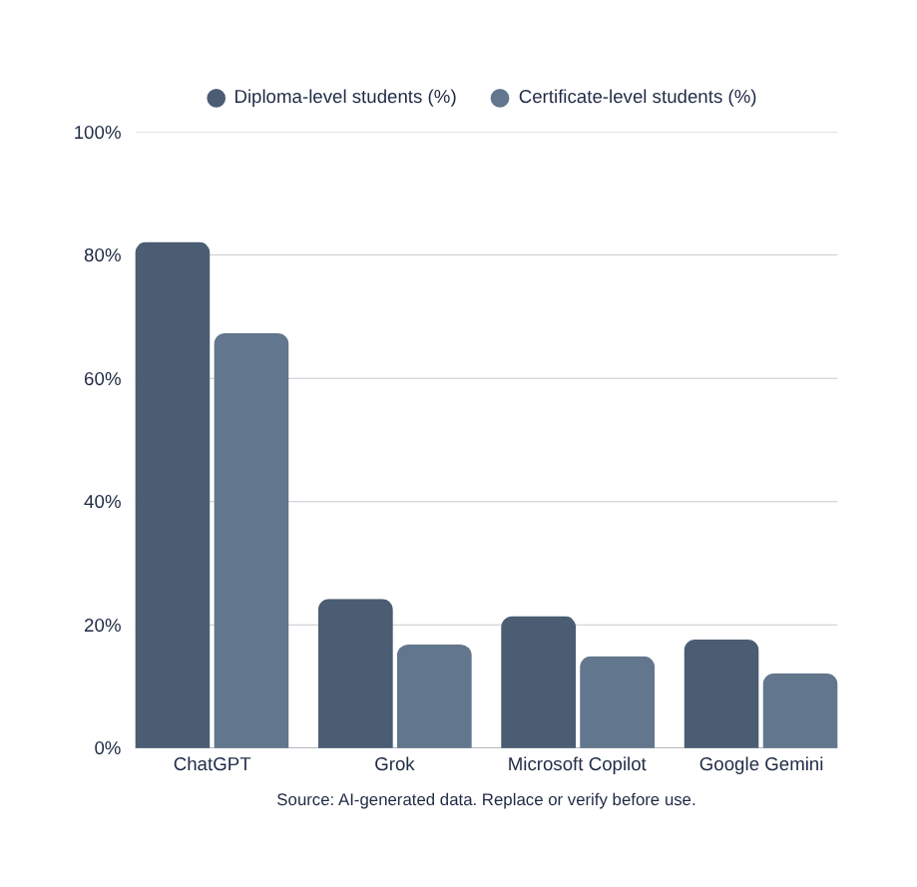
AI Usage Patterns Among Students
74.8% of TVET students use AI tools for academic tasks, with 61.2% submitting AI-generated content as original work.
Usage is significantly higher among diploma-level students (82.1%) compared to certificate-level students (67.3%), indicating deeper integration at advanced study levels.

Slide 64

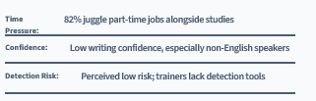
Motivations Behind AI Misuse
Students misuse AI due to multiple compounding factors. Economic pressures force many to work while studying, leaving insufficient time for assignments. Peer normalization creates a culture where AI submission is seen as acceptable, while competitive pressure drives students to seek any advantage available.

Slide 65

Impact on Graduate Quality
Employers across construction, ICT, and hospitality sectors report significant decline in graduate practical skills. A negative correlation (r = -0.47, p < 0.001) exists between AI misuse frequency and practical confidence levels.
Key Findings:
Heavy AI users rate theory 18% higher but practical skills lower
Graduates struggle with debugging code and reading technical drawings
Theoretical knowledge does not translate to workplace readiness

Slide 66

Institutional and Examination Challenges
01
No national AI policies or standardized AI literacy training in place
02
86.7% of trainers lack AI detection software or guidelines
Detection relies on unreliable stylistic inconsistency methods
03
04
KNEC reports rising exam irregularities; AI-assisted cheating documented

Slide 67

Ethical Opportunities
Constructive AI use cases demonstrate positive learning outcomes:
01
19.2% used AI for concept clarification
02
34% improvement in practical scores
03
Use intent differentiates ethical use
Ethical AI integration enhances learning without replacing critical thinking.

Slide 68

Policy and Curriculum Recommendations
Actionable steps for institutions, TVETA, and KNEC to address AI misuse while promoting ethical integration. These recommendations aim to balance innovation with academic integrity and workforce readiness.
Key Recommendations:
Develop AI Acceptable Use Policies with stakeholder input
Redesign assessments for AI-resistive outputs (practical demos, presentations)
Establish National AI Integration Framework and minimum literacy standards

Slide 69

Additional Recommendations
Key implementation priorities:
01
KNEC to update exam integrity protocols and reporting mechanisms
02
Integrate standalone AI literacy modules in diploma curricula co-developed with industry
03
Stakeholder collaboration for sustainable implementation across all TVET institutions
Coordinated action between TVETA, KNEC, institutions, and industry partners is essential for success.

Slide 70

Conclusion
TVET institutions educate 1.2 million learners annually, making them central to Kenya Vision 2030's workforce development goals.
AI misuse threatens economic transformation and sectoral productivity across construction, healthcare, and manufacturing. Urgent action is needed for ethical AI integration, comprehensive policies, and pedagogical innovation.
"Harnessing AI's potential requires scaffolding, not exclusion."

Slide 73
Skills Verification using Artificial Intelligence in TVET: A Proposed Framework of Enhancing Competency-based Assessment and Qualification Credibility in Kenya.
Author:
Sammy Kituyi Matanda
Ahmed Shahame Mwidani Technical Training Institute,
Email: matandason@gmail.com
Tel No: 0717658072

Slide 74
Background Information
Context of Study:
TVET's Role in Economic Growth: TVET systems are integral to the development of skilled human capital, crucial for economic growth, industrialization, and job creation (Republic of Kenya, 2007).
Competency-Based Education and Training (CBET): CBET has transformed how assessments are done in TVET institutions, from theoretical exams to the display of practical skills (Kenya National Qualifications Authority [KNQA], 2024).

Slide 75
Background Information
Key Challenges:
Inconsistent Assessment Practices: Assessment practices across TVET institutions are not standardized, leading to discrepancies in qualification credibility (Macheso et al., 2024).
Employer Distrust: Employers often question the validity of qualifications due to perceived subjectivity in the assessment process (Ngware et al., 2022).
Objective:
The study aims to explore the application of AI technologies to enhance competency verification and improve TVET qualifications' credibility (Sun & Tian, 2026).

Slide 76
Research Objectives
Primary Objective:
To develop a conceptual framework that integrates AI technologies to improve competency verification in Kenyan TVET institutions.
Specific Objectives:
Examine Current Challenges: Assess the challenges faced by Kenyan TVET institutions in competency-based assessment and qualification verification (Macheso et al., 2024; Maingi & Musyoka, 2025).
Assess AI Potential: Evaluate the applicability of emerging AI technologies (machine learning, computer vision) to improve assessment practices (Gao & Tan, 2025).
Propose an AI-Driven Framework: Design a framework that integrates AI-driven assessment systems, digital learner portfolios, and secure credentialing systems (Albaladejo-González et al., 2024).

Slide 77
Problem Statement
Key Issues:
Lack of Standardization: Competency assessment is inconsistent across institutions, leading to difficulties in qualification verification (Silaghi & Popescu, 2025).
Subjectivity in Assessment: Perceptions of bias and inconsistent criteria in assessing competencies (Maingi & Musyoka, 2025).
Employer Distrust: Employers question the validity of TVET qualifications due to unreliable assessment methods (Ngware et al., 2022).
Impact:
These issues contribute to low employability for TVET graduates, with employers less likely to trust qualifications issued by TVET institutions (Kimutai et al., 2025).

Slide 78
Resaerch Questions
What challenges do Kenyan TVET institutions face in competency-based assessment and qualification verification?
How can AI technologies improve the consistency and credibility of assessments in TVET?
How can an AI-driven framework be designed to integrate AI-driven assessment systems, digital portfolios, and secure credentialing?
What pilot studies and empirical testing are required to validate the proposed framework for wider implementation?

Slide 79
Literature
Overview of TVET and Competency-Based Assessment (CBA):
Role of TVET in Skills Development: TVET is a key driver of human capital development and economic growth, especially in developing economies like Kenya (Republic of Kenya, 2007).
Competency-Based Education and Training (CBET): CBET focuses on practical, skills-based learning and assessment, but its implementation has faced challenges such as lack of standardization, inconsistent assessment criteria, and employer distrust in qualifications (Maingi & Musyoka, 2025).

Slide 80
Literature
Challenges in TVET Assessment:
Inconsistent Assessment Practices: While CBET policies exist, their implementation is not uniform across institutions, leading to fragmented assessment practices (Silaghi & Popescu, 2025).
Lack of Trust in TVET Qualifications: Employers express concerns over the authenticity and reliability of TVET qualifications, partly due to the subjectivity in assessments and the absence of standardized systems for verifying competencies (Ngware et al., 2022).
Fragmented Digital Systems: Existing systems for competency verification are fragmented, and many TVET institutions lack integrated digital tools for tracking and verifying skills (Kimutai et al., 2025).

Slide 81
AI Technologies in Education
Machine Learning: Machine learning has been used in educational contexts for predictive analytics, personalized learning, and assessment scoring. It allows for data-driven decision-making and supports individualized learning paths (Chen et al., 2020).
Computer Vision: Computer vision is used for analyzing practical performance and automating the assessment of hands-on tasks, reducing assessor subjectivity (Kiarie, 2025).
Natural Language Processing (NLP): NLP can evaluate written responses, reflective assessments, and competency statements, providing deeper insights into learner progress (Albaladejo-González et al., 2024).
Blockchain for Secure Credentialing: Blockchain technology ensures that qualifications are tamper-proof and easily verifiable, addressing the problem of credential fraud in TVET (Sharples & Domingue, 2016).

Slide 82
Global AI Practices in TVET
AI in European TVET: Countries in Europe have started using AI for skill assessments in vocational training, focusing on automating practical assessments and validating skills through digital portfolios (Gao & Tan, 2025).
Machine Learning in Assessment: Studies in vocational training systems show that machine learning can significantly improve the scalability and fairness of assessments, reducing human bias (Yan et al., 2025).
Global Blockchain Initiatives: Blockchain technology is increasingly used in vocational education systems in Europe and Asia to provide tamper-proof records of learner competencies, improving employer trust in digital qualifications (Silaghi & Popescu, 2025).

Slide 83
AI Challenges in TVET
Barriers to AI Integration in TVET:
Infrastructure Constraints: TVET institutions in developing countries face challenges in adopting AI due to insufficient digital infrastructure, limited access to technology, and weak policy frameworks (Kimutai et al., 2025).
Digital Literacy: The lack of digital literacy among instructors and learners hinders the integration of AI tools in TVET settings, particularly in rural and under-resourced areas (Maingi & Musyoka, 2025).
Ethical Considerations: AI technologies in education need to be governed by ethical guidelines to prevent bias and ensure fairness in assessments (Binns et al., 2018).

Slide 84
Theoretical and Practical Contributions
Theoretical Contributions:
Expanding AI in Education: This study contributes to the growing body of knowledge by exploring the application of AI in vocational education systems, an area that has been underexplored (Williamson & Eynon, 2020).
AI-Driven Framework for TVET: It provides a conceptual framework for integrating AI technologies into the TVET system, which is critical for addressing competency verification challenges (Holmes et al., 2022).
Practical Contributions:
Improving TVET Assessment Practices: The framework proposes practical solutions to standardize competency assessments and improve the credibility of TVET qualifications.
Policy Implications: The findings offer policy recommendations for TVET regulators, institutions, and employers, highlighting how AI can enhance trust in TVET qualifications (Albaladejo-González et al., 2024).

Slide 85
Research Gap
Lack of AI Integration in TVET Assessment: While AI applications in education have been widely explored, there is a noticeable gap in the integration of AI technologies into competency-based assessment systems within TVET, especially in developing economies like Kenya (Gao & Tan, 2025).
Limited Research on AI for Vocational Training: Most AI research focuses on higher education or theoretical knowledge-based assessments, with limited studies applying AI to practical skill assessments in TVET (Sun & Tian, 2026).
Context-Specific Challenges: AI frameworks developed for global educational systems are often not tailored to the unique challenges of TVET systems in low-resource settings (Albaladejo-González et al., 2024). The absence of AI-driven solutions in the Kenyan TVET system represents a critical gap.
Fragmented Systems for Competency Verification: Although Kenya’s TVET policy framework mandates standardized assessments, there is a lack of integrated systems for competency verification, resulting in poor reliability and employer distrust (Silaghi & Popescu, 2025).

Slide 86
Methodology
Research Design: Conceptual Framework Development
Aim: Develop an AI-driven framework to enhance competency verification in Kenyan TVET institutions.
Approach: Systematic Literature Review (SLR)
Purpose: Identify AI applications in competency-based assessments and synthesize global practices.
Process: Followed PRISMA standards for a structured and rigorous review.

Slide 87
Methodology
Data Collection:
Databases: Scopus, Web of Science, IEEE Xplore, ERIC (2018–2025).
Inclusion Criteria: Peer-reviewed articles focused on AI and TVET.
Exclusion Criteria: Non-peer-reviewed sources or those irrelevant to vocational education.
Key Findings:
AI technologies like machine learning and computer vision enhance competency assessment.
AI can improve assessment fairness, reduce bias, and provide objective evaluations.
Blockchain for secure credentialing strengthens qualification verification.

Slide 88
Framework Design and Development
Framework Components:
AI-Based Competency Assessment Systems: Automated systems for scoring practical assessments, improving reliability and reducing subjectivity (Gao & Tan, 2025).
Digital Learner Portfolios: Secure, evidence-based portfolios for learners to showcase competencies (Al Idrus et al., 2024).
Automated Analytics Engines: Real-time analysis of learner performance and identification of skill gaps (Yan et al., 2025).
Secure Digital Credentialing: Blockchain-based systems for verifying qualifications and preventing fraud (Sharples & Domingue, 2016).
Interoperable Stakeholder Platforms: Systems that link TVET institutions, regulators, and employers to streamline competency verification (Alammary et al., 2019).

Slide 89
Framework Design and Development
Framework Design Process:
Step 1: Literature review to identify key components and challenges.
Step 2: Conceptualization of a framework that integrates these components into a cohesive system for improving assessment practices.
Step 3: Propose the AI-driven framework for adoption in Kenyan TVET institutions.

Slide 90
Validation and Future Work
Future Validation:
Stakeholder Consultation: Focus groups with trainers, employers, and regulators.
Pilot Testing: In urban and rural TVET institutions in Kenya.
Evaluation Metrics: Usability, fairness, reliability, and validity of the AI framework.
Future Research Directions:
Empirical Testing: To validate the framework’s feasibility and impact.
Algorithmic Fairness: Evaluate AI-driven assessments for fairness and transparency.

Slide 91
System Architecture
Layered architecture: Experience, Application, AI, Data, Integration, Security
Human-in-the-loop ensures accountability (Binns et al., 2018)
Offline capability addresses digital divide (Hilbert, 2020)
Interoperability supports national systems (Alammary et al., 2019)

Slide 92
High-Level System Architecture Overview
High-Level Overview:
Layered Architecture: A modular design consisting of six interdependent layers for seamless integration and scalability.
Core Goal: To standardize assessments, improve data traceability, and enhance employer trust in TVET qualifications.

Slide 93
High-Level System Architecture Overview
System Layers:
Experience Layer: User-facing interfaces for learners, assessors, administrators, and employers.
Application/Service Layer: Core logic for managing assessments, portfolios, and credentials.
AI Services Layer: AI-based support for automated scoring, predictive analytics, and competency assessment.
Data Layer: Storage and management of structured and unstructured data.
Integration/Interoperability Layer: Facilitates seamless communication between TVET institutions, regulatory bodies, and employers.
Security & Governance Layer: Ensures data protection, compliance, and ethical AI usage.

Slide 94
Experience Layer
Key Features:
Learner Portal: Provides learners access to their digital portfolios, assessment results, and credentials.
Assessor Portal: Enables assessors to manage assessments, review evidence, and validate competencies.
Admin Dashboard: Allows administrators to configure assessments, track progress, and generate reports.
Employer Verification Portal: Employers can verify the authenticity of digital credentials and assess learner competencies.
Mobile/Offline Evidence Capture App: Collects multimedia evidence of competencies in areas with limited connectivity.

Slide 95
Application/Service Layer
Core Services:
Assessment Management Service: Manages the creation, scheduling, and alignment of assessments to competency frameworks.
Digital Portfolio Service: Stores and links learner evidence such as videos, task completion logs, and audio recordings.
Competency & Standards Management: Defines and updates competency frameworks, performance criteria, and rubrics.
Analytics & Reporting Service: Generates insights and reports based on learner performance data, helping with decision-making.
Credential Issuance & Verification Service: Secures and verifies credentials using blockchain-based systems.
User & Access Management: Ensures appropriate user roles and permissions are assigned for system access.

Slide 96
AI Services Layer
AI-Driven Components:
Automated Scoring Systems: AI-based evaluation of practical skills using computer vision (e.g., for assessing carpentry or welding).
Predictive Analytics: Machine learning algorithms that predict learner performance and identify areas of improvement.
Natural Language Processing (NLP): Evaluates written assessments, reflective tasks, and competency statements.
Fairness Monitoring: A system to ensure AI assessments are free from bias, evaluating outcomes across different demographic groups.

Slide 97
Data Layer
Key Functions:
Structured and Unstructured Data Storage: Manages relational databases, object storage systems, and multimedia evidence.
Data Warehouse: For storing assessment data and learner performance metrics.
Audit Logs: Tracks all system activities, ensuring traceability and accountability.

Slide 98
Security and Governance Layer
Key Security Features:
Role-Based Access Control (RBAC): Ensures that only authorized users can access specific system components.
Data Encryption: Protects learner data and credentials from unauthorized access.
Audit Logs & Consent Management: Tracks all user interactions and ensures compliance with ethical standards.
AI Governance: Ethical oversight to ensure transparency and fairness in AI-driven decision-making.

Slide 99
Key Findings and Contributions
Findings:
AI can enhance assessment consistency, reduce subjectivity, and improve qualification verification.
AI-driven systems can automate evidence capture, scoring, and competency analysis.
Contributions:
Adds to the body of knowledge on AI in education and vocational training.
Offers a framework for improving trust in TVET qualifications in Kenya.

Slide 100
Limitations of the Study
Conceptual Framework:
The framework is conceptual and has not been empirically tested in real-world TVET settings.
Context-Specific:
The proposed framework is tailored specifically to Kenyan TVET institutions and may require adaptations for different regions or countries with distinct educational and technological landscapes.
Infrastructure Constraints:
The digital infrastructure in many TVET institutions, especially in rural areas, may not support the immediate implementation of the AI-driven framework due to limitations in technology access and internet connectivity (Kimutai et al., 2025).

Slide 101
Limitations of the Study
Digital Literacy:
Low levels of digital literacy among TVET trainers and learners, particularly in rural areas, may impact the successful adoption and use of AI tools (Maingi & Musyoka, 2025).
Ethical Concerns:
Bias in AI algorithms and ensuring fairness across different demographic groups within TVET institutions has not been fully addressed, which could affect the objectivity of AI assessments (Mehrabi et al., 2021).
Policy and Regulatory Framework:
The policy and regulatory framework for AI integration in education in Kenya is still in its infancy, and existing guidelines may not fully accommodate the scale of AI adoption proposed by this study (Republic of Kenya, 2025).

Slide 102
Recommendations
For TVET Regulators:
Adopt AI-Based Competency Verification: TVET regulators should promote the adoption of AI-driven assessment systems to standardize competency evaluations and improve the credibility of qualifications.
Create a National AI Strategy for TVET: Develop a national framework that supports the integration of AI technologies across TVET institutions, ensuring uniformity in implementation and ethical oversight (Republic of Kenya, 2025).
For TVET Institutions:
Capacity Building for Educators: Invest in training programs to enhance digital literacy among educators, equipping them with the skills to integrate AI into assessments (Maingi & Musyoka, 2025).

Slide 103
Recommendations
Infrastructure Improvement: Prioritize the development of digital infrastructure in TVET institutions, especially in rural areas, to enable the effective use of AI tools.
For AI Developers:
Context-Sensitive AI Tools: Collaborate with TVET institutions to design affordable, context-sensitive AI tools that meet the specific needs of vocational education, especially in developing economies like Kenya (Albaladejo-González et al., 2024).

Slide 104
Conclusion
This study proposes a conceptual AI-driven framework aimed at improving competency-based assessment and qualification verification in Kenya's TVET system.
The framework integrates AI technologies such as machine learning, computer vision, and blockchain to address challenges such as inconsistent assessments, subjectivity, and employer distrust in TVET qualifications.

Slide 105
Conclusion
Implications:
The framework has significant potential to enhance the transparency, reliability, and security of competency assessments, contributing to greater trust in TVET qualifications and improved graduate employability.
Policy and practice in TVET education must evolve to accommodate AI integration, and stakeholder collaboration is key to the successful implementation of these solutions.
Future Work:
Pilot testing the framework in Kenyan TVET institutions will be crucial to assess its effectiveness, and further empirical studies are needed to validate its impact on employer trust and graduate outcomes.

Slide 108


AIoT Pest Detection &
Smart Irrigation System
FarmAI — Empowering Kenyan Smallholder Farmers
Purity Kerubo, Argut Boaz, Anyange Mark Wisdom | EEE Dept, MUST | February 2026
Supervisors: Job Kerosi & Fiona Prema

Slide 109



National Qualifications Conference
2026
Problem Statement
The Challenge Facing Kenyan Smallholder Farmers
40%+
40%
KES Millions
of Kenya's population
depends on agriculture
global crop loss from
pests & disease (FAO 2021)
annual losses from
late/inaccurate diagnosis
Challenge 1: Delayed & Inaccurate Pest/Disease Diagnosis
Challenge 2: Inefficient Water & Soil Resource Management
Manual scouting is subjective, slow, and error-prone. By the time symptoms are visible, infestation is already advanced — leading to crop losses worth millions of KES and forced use of harmful chemical cocktails.
Without affordable monitoring tools, farmers over-irrigate or under-irrigate. Guesswork fertilization wastes money and pollutes soils — compounding food insecurity across rural Kenya.
© 2026 KNQA
FarmAI — AIoT Pest Detection & Smart Irrigation

Slide 110





National Qualifications Conference
2026
Current Solutions & Gaps
What Exists Today — And Why It Falls Short
Manual Scouting
Standalone Apps (Plantix)
Commercial Smart Irrigation
Academic IoT Prototypes
Subjective · Delayed · Requires trained staff · Unavailable at rural scale
No hardware · No soil monitoring · No irrigation automation · Needs constant internet
≥ KES 50,000+ · Complex setup · Not affordable for smallholders · No AI pest detection
Either pest-only OR irrigation-only · Not integrated · Rarely field-tested in Kenya
The Gap:
No affordable, integrated AIoT platform currently combines real-time pest detection + smart sensor-driven irrigation + AI advisory — specifically designed for Kenyan smallholder farmers.
© 2026 KNQA
FarmAI — AIoT Pest Detection & Smart Irrigation

Slide 111
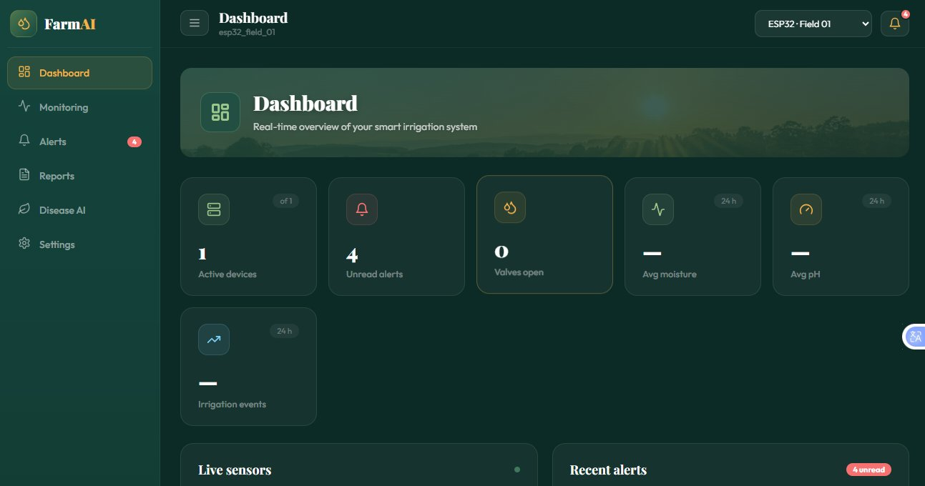


National Qualifications Conference
2026
Proposed Solution
FarmAI — An Integrated AIoT Smart Farming System
A low-cost prototype combining computer vision, IoT sensors, edge-cloud AI, and a farmer-friendly web dashboard into one seamless, solar-powered system.
APROX 30,000
Total hardware cost
accessible to smallholders
ESP32-CAM + CNN Model
Real-time leaf disease/pest classification via MobileNetV2. Hybrid edge-cloud ensures reliability without constant internet.
Smart Irrigation
Soil moisture & pH sensors drive automated solenoid valve irrigation. No more guesswork.
Cloud Dashboard + AI Advisory
Live alerts, pesticide recommendations, and local supplier contacts on any smartphone.
FarmAI Web Dashboard
© 2026 KNQA
FarmAI — AIoT Pest Detection & Smart Irrigation

Slide 112




National Qualifications Conference
2026
System Architecture
Four Integrated Layers — Modular & Hybrid Design
01
02
03
04
Field Layer (Hardware)
Edge Layer (Local AI)
Cloud Layer (Data & AI)
Farmer Platform (Dashboard)
ESP32-CAM · Soil Moisture Sensor · pH Sensor · Solenoid Valve & Relay · Solar Panel + Battery
ESP32 runs TensorFlow Lite CNN on-device. High-confidence detections resolved locally; low-confidence escalated to cloud.
Firebase / AWS IoT Core receives JSON sensor payloads. Complex CNN re-inference & AI advisory engine hosted here.
React/Vue.js responsive website — real-time gauges, disease alerts, pesticide recommendations, local supplier contacts.
© 2026 KNQA
FarmAI — AIoT Pest Detection & Smart Irrigation

Slide 113


National Qualifications Conference
2026
Key Features
What FarmAI Delivers
Real-Time Pest & Disease Detection
Automated Smart Irrigation
Live Farmer Dashboard
CNN classifies 10 plant disease classes (potato, tomato, pepper) from ESP32-CAM images with 85–90% target accuracy. Alerts within seconds.
Monitors soil moisture & pH continuously. Automatically opens/closes solenoid valve based on predefined thresholds — saving water, maximising crop health.
Real-time sensor gauges, historical trend graphs, disease alerts panel, and irrigation event logs — all on a mobile-friendly web interface.
AI Advisory Module
Solar-Powered & Low-Cost
Rule-based engine maps detected disease to safe, targeted pesticides and lists local Kenyan suppliers — reducing harmful chemical use.
Entire hardware setup powered by solar panel + rechargeable battery. Total BOM: KES 30,000 — accessible to smallholder farmers.
© 2026 KNQA
FarmAI — AIoT Pest Detection & Smart Irrigation

Slide 114
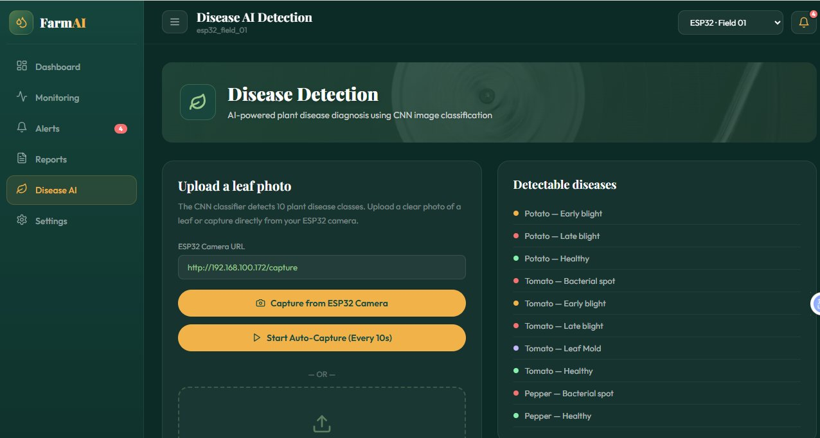
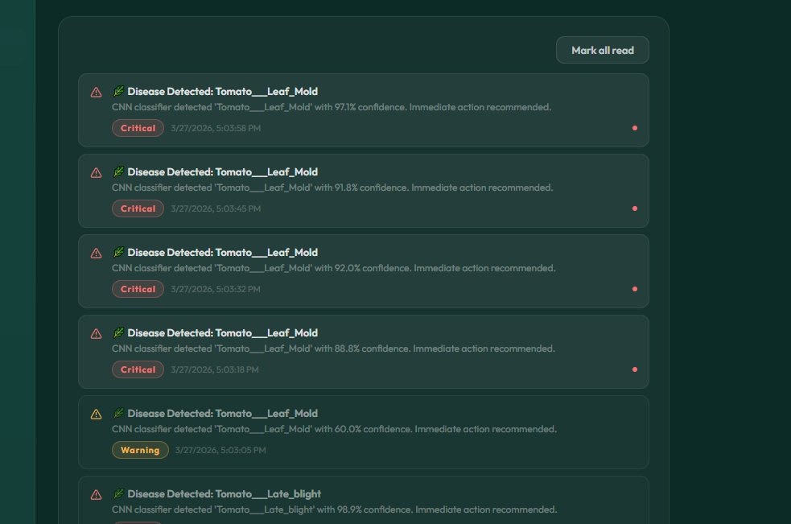
National Qualifications Conference
2026
Demo & Screenshots
FarmAI Web Dashboard — Live System Walkthrough
Step 1: Dashboard Overview
Step 2: Disease AI Detection
Step 3: Alerts & Advisory
Shows active device (ESP32 Field 01), 4 unread alerts, live moisture & pH readings, and 24-hour irrigation timeline.
Farmer captures leaf image via ESP32-CAM URL. CNN classifies against 10 disease classes. Auto-capture every 10 seconds.
Critical alerts for high-confidence detections (e.g., Tomato Leaf Mold 97.1%). AI Advisory shows safe fungicides & local supplier contacts.
© 2026 KNQA
FarmAI — AIoT Pest Detection & Smart Irrigation

Slide 115

National Qualifications Conference
2026
Technology Stack
Technologies Powering FarmAI
Hardware & Firmware
AI / Machine Learning
Cloud & Backend
Frontend Dashboard
ESP32 Microcontroller
ESP32-CAM Module
Capacitive Soil Moisture Sensor
pH Sensor · Solenoid Valve + Relay
Solar Panel + 12V Battery
Arduino IDE / PlatformIO · C++
TensorFlow Lite (on-device CNN)
Wi-Fi JSON data transmission
Convolutional Neural Network
MobileNetV2 / Custom CNN
Trained in TensorFlow / PyTorch
PlantVillage Dataset + local Meru tomato images
Converted to TFLite for edge deployment
85–90% target accuracy
10 disease classes classified
Hybrid edge-cloud inference
Firebase Realtime Database
AWS IoT Core
Rule-based AI Advisory Engine
REST API for dashboard data
React.js / Vue.js
HTML5 + CSS3 + JavaScript
Responsive mobile-friendly design
Real-time data polling
Chart.js for sensor trend graphs
© 2026 KNQA
FarmAI — AIoT Pest Detection & Smart Irrigation

Slide 116

National Qualifications Conference
2026
Use Case & Scenario
A Day in the Life of a FarmAI Farmer — Meru Region, Kenya
MORNING
MIDDAY
AFTERNOON
Automated Overnight Report
Disease Alert Received
AI Advisory Action Taken
James opens FarmAI on his phone. Soil moisture dropped to 28% overnight. System already opened the irrigation valve at 2 AM and closed at 3 AM when moisture reached 65%.
FarmAI sends a push notification: "Critical — Tomato Leaf Mold detected, 97.1% confidence." The CNN flagged early blight symptoms from an auto-captured leaf image.
James taps the alert. AI Advisory recommends Chlorothalonil fungicide (low human hazard), lists 2 agro-dealers in Meru town, and explains dosage. James acts within hours — not days.
Without FarmAI: Disease identified 1–2 weeks later → significant crop damage.
With FarmAI: Early detection + immediate action = saved harvest. ✓
© 2026 KNQA
FarmAI — AIoT Pest Detection & Smart Irrigation

Slide 117
National Qualifications Conference
2026
Impact & Benefits
Why FarmAI Matters — Measured Impact
20–40%
30–50%
Safer
KES 30,000
avg annual crop loss (FAO)
water savings (IoT irrigation)
targeted pesticide use
total hardware BOM
Crop Loss Reduction
Water Savings
Chemical Safety
Accessibility
Early AI detection (85–90% CNN accuracy) intercepts disease before it spreads. Every week earlier = significantly less damage.
Sensor-driven automation eliminates over/under-watering vs. manual methods (Dhanaraju et al., 2023).
Targeted pesticide recommendations replace broad-spectrum cocktails — reducing farmer health risks and environmental runoff.
Solar-powered for off-grid farms. Dashboard accessible via any basic smartphone browser — no specialist training needed.
© 2026 KNQA
FarmAI — AIoT Pest Detection & Smart Irrigation

Slide 118
National Qualifications Conference
2026
Conclusion & Next Steps
Summary, Deliverables & Future Roadmap
Summary
Future Improvements
FarmAI is a low-cost, integrated AIoT smart farming prototype for Kenyan smallholder farmers — combining real-time CNN-powered disease detection, automated sensor-driven irrigation, cloud data logging, and AI advisory into one KES 30,000 solar-powered system.
Expand CNN to more Kenyan crops (maize, beans, millet)
Add NPK soil nutrient sensors for full fertility monitoring
Key Deliverables Targeting Completion
Functional ESP32-CAM + CNN pest/disease detector (85–90% accuracy)
Working automated irrigation with real-time sensor feedback
Deployed cloud database + live farmer web dashboard
Integrated prototype validated in greenhouse environment
SMS alert integration for farmers without smartphones
Pilot with 5–10 real smallholder farms in Meru County
© 2026 KNQA
FarmAI — AIoT Pest Detection & Smart Irrigation

Slide 119
Q & A
Thank you. Questions are welcome.
Purity Kerubo, Argut Boaz & Mark Wisdom | EEE Department, MUST | February 2026

