Slide 1
Day 2 Break our Room 2 (Pride 2)

Slide 2
From Recognition to Relevance:
The new landscape of qualifications in Kenya.
Nelson Barazah Onyango
Nyeri National Polytechnic nbaraza@thenyeripoly.ac.ke

Slide 3
The Problem
Fragmented System: Multiple awarding bodies (Universities, TVETs, informal trainers) operating in isolation.
Mistrust: Employers struggled to verify credentials.
Exclusion: 80% of the workforce (informal sector) had no formal recognition.
No Pathways: Learners could not move between vocational and higher education.

Slide 4
The Research
Objective: To examine emerging trends in Kenya’s qualifications awarding landscape.
Design: Mixed-methods (Qualitative + Quantitative).
Tools:
  Document Analysis (KNQF, RPL, CBC)
  Interviews (Trainers, Employers, Learners)
  Survey (250 respondents across sectors)
  Case Study (RPL for Welders at Nyeri National Polytechnic)

Slide 5
Awareness (Key Finding 1)
The Gap: Awareness of KNQF & RPL is uneven.
  Formal Institutions: 62% aware.
  Informal Sector Workers: Only 28% aware.
The Barrier: Many artisans fear that formal assessment will discredit their skills (RPL skepticism).

Slide 6
Inclusivity (Key Finding 2)
Success: RPL is helping marginalized groups (women in trades, refugees).
  74% of respondents believe RPL enhances inclusivity.
Challenges:
  Limited assessment centers (mostly urban).
  High certification costs.
  Language barriers.

Slide 7
Digital Transformation (Key Finding 3)
Demand: 68% of employers want digital (blockchain) verification to stop certificate fraud.
Reality: Only 12% of institutions have functional digital systems.
Barriers: Poor infrastructure, high costs, and lack of technical skills.

Slide 8
Employability (Key Finding 4)
Alignment: 82% of employers say KNQF & CBC have improved the link between education and job needs.
Impact: Competency-based training produces graduates with practical skills, reducing onboarding time.
Need: Stronger industry-academia collaboration is still required.

Slide 9
Recommendations for Policy Makers
Awareness: Launch national campaigns targeting rural/informal workers via radio.
Inclusivity: Establish mobile RPL assessment units in underserved counties.
Digital: Invest in blockchain credentialing and low-cost digital platforms.

Slide 10
Recommendations for Practice
For Institutions: Adopt flexible pathways and digital badges.
For Employers: Join curriculum design panels and use digital verification.
For Trainers: Focus on competency-based teaching (not just theory).
For Learners: Use RPL to formalize your skills and pursue micro-credentials.

Slide 11
Conclusion
Kenya is moving toward a competency-based, inclusive, and globally aligned system.
Awareness is growing, but gaps remain.
Technology offers a solution to fraud, but we need infrastructure.
Recommendation: This is a "marathon, not a sprint." Sustained investment and collaboration are the keys to success.

Slide 14


Beyond the KCSE Barrier:
Reimagining Recognition Pathways for Refugee Teachers
within Kenya's National Qualifications Framework

Slide 15

¹st National Qualifications Conference
2026
Presentation Overview
1
Context
Refugee teachers in Kenya's camp schools — who they are and what they face
2
The Problem
KCSE grade C plain as a structural exclusion mechanism — not a neutral quality filter
3
Evidence
Mixed-methods findings: survey of N=927 teachers across 74 schools (Garissa & Turkana)
4
The Solution
School-anchored RPL & Credit Accumulation and Transfer (CAT) pathway under KNQF
5
Recommendations
Concrete actions for KNQA, TSC, donors & regional partners
Duration: 20 minutes | Paper: Makhapila et al., APHRC 2025

Slide 16
2026
¹st National Qualifications Conference
The Refugee Education Context in Kenya
843,165
1,046
<0.2%
>92%
refugees & asylum-seekers
in Kenya (UNHCR, Mar 2025)
refugee teachers across
49 refugee-serving schools
hold TSC registration
(formal professional status)
on 1-year renewable
contracts — not permanent
Kenya hosts the world's oldest and largest refugee settlements — Kakuma (Turkana) and Dadaab (Garissa)
Refugee teachers sustain camp-based schooling under extraordinary conditions of resource poverty, trauma and instability
98.7% of refugee teachers employed by NGOs — not the Government of Kenya; none on Government pay scales
They remain structurally invisible in Kenya's formal policy frameworks — trapped by a single credential threshold: KCSE C plain

Slide 17
2026
¹st National Qualifications Conference
Theoretical Framing
Collins (1979) — Credentialist Theory
Bourdieu (1986) — Cultural Capital
Credential requirements function as social closure mechanisms
KCSE threshold excludes not due to lack of ability, but structural inaccessibility of the credential itself
Gatekeeping serves institutional interests — not quality assurance
Formal systems valorise academic capital produced in stable, well-resourced environments
Experiential and pedagogical capital of refugee teachers is systematically devalued
Recognition systems encode existing social hierarchies — not neutral competence measures
Key reframe: Credential exclusion is NOT a quality-assurance mechanism — it is a structural inequality of recognition

Slide 18
2026
¹st National Qualifications Conference
Methodology: Concurrent Mixed-Methods Study (2025)
QUANTITATIVE
QUALITATIVE
Survey of 927 teachers across 74 schools — Garissa & Turkana counties
536 refugee teachers + 397 national (host community) teachers
Composite indices: Stress (TSI, α=0.95), satisfaction, motivation, social-emotional well-being
Bivariate analyses, chi-square, t-tests, ANOVA, logistic regression
105 respondents: 18 in-depth interviews (IDIs) with teachers
12 key informant interviews (KIIs) with heads of institutions
9 KIIs with policy actors
66 teachers in 11 focus group discussions — Kakuma, Dadaab, Garissa, Turkana
Ethical approval: APHRC Institutional Review Board | Concurrent design — both strands integrated at interpretation stage

Slide 19
2026
¹st National Qualifications Conference
Finding 1: The Qualification Gap
Indicator | National Men | National Women | Refugee Men | Refugee Women
Secondary school only (highest attainment) | 3.1% | 0.0% | 60.4% | 72.2%
No recognised teaching qualification | <5% | <5% | 73.2% | 81.9%
TSC Registered (formal recognition) | 92.8% | 97.4% | 0.2% | 0.0%
This is not a marginal anomaly — it is a systemic condition.
92.8–97.4% of national teachers hold TSC registration. Among 536 refugee teachers surveyed, only ONE individual (0.2%) is TSC-registered. Zero refugee women hold TSC registration.

Slide 20
2026
¹st National Qualifications Conference
Finding 2: The Pay Structure of Exclusion
Contract Type
92.7% of refugee men & 88.9% of refugee women on 1-year renewable contracts
77% of national teachers on permanent contracts
Employer
98.7% of refugee teachers employed by NGOs — not Government of Kenya
Pay Gap
No refugee teacher earns KSH 30,000+/month
73.8% of national men earn ≥ KSH 30,000/month
"A trained teacher is earning 9,000… today it can only buy a sack of sugar or rice." — FGD, male teachers, Dadaab

Slide 21
2026
¹st National Qualifications Conference
Finding 3: The Resilience Paradox
OR = 1.48
OR = 0.68
4.76 vs 4.65
Elevated odds of HIGH STRESS
(p=0.02, refugee vs national)
LOWER odds of low satisfaction
(p=0.018)
Social-emotional well-being
(refugee vs national)
What this tells us:
Refugee teachers face significantly higher stress odds (OR=1.48) — yet paradoxically report higher social-emotional well-being than national teachers (4.76 vs 4.65). This is consistent with post-traumatic growth research (Tedeschi & Calhoun, 2004): teaching community becomes a source of identity and meaning when formal systems offer neither.
The system is wasting this resilience — teachers who want to professionalise are being structurally blocked.

Slide 22
2026
¹st National Qualifications Conference
Finding 4: Career Stagnation & Structural Distress
Non-Recognition
→
No DTE Access
→
No TSC Registration
→
No Pay Progression
→
Distress & Attrition
"Stagnation in one job group… is very painful."
— FGD, male teachers, Dadaab
"I was stagnant… for 17 good years… Imagine from C1, 17 good years."
— FGD, female teachers, Dadaab
"I cried… I got depressed… I even got admitted to the hospital."
— FGD, female teachers, Garissa
Career stagnation degrades teaching quality — harming the 47,000 children enrolled in these schools

Slide 23
2026
¹st National Qualifications Conference
Three Profiles of Exclusion
Profile 01
Profile 02
Profile 03
The Form 4 Holder
The ECDE Gap
The Unrecognised Trained Teacher
The largest group. Taught for years with KCSE grades below C plain — reflecting camp learning conditions, not potential.
77% of refugee women | 63% of refugee men
Grades reflect a broken environment — not their teaching ability.
Women disproportionately staff pre-primary classrooms.
Only 7% of refugee teachers hold ECDE qualification vs ~41% of national teachers.
Gendered assignment to ECDE roles without professional recognition or pay equity.
Formally trained in Somalia, South Sudan, DRC, Burundi, Ethiopia — excluded by administrative non-recognition.
NOT a competence gap — an administrative gap.
Needs a foreign qualification recognition sub-pathway under KNQF.
All three profiles are barred not by lack of competence, but by entry criteria designed without them in mind.

Slide 24
2026
¹st National Qualifications Conference
The Proposed Pathway: School-Anchored RPL & CAT
Policy foundation: Kenya's 2024 National Policy on Recognition of Prior Learning + KNQF CAT architecture
1. KNQA
→
2. Accredited Assessors
→
3. TTC Moderation
→
4. KNQA Credits
→
5. DTE Entry
Designates refugee teachers as priority RPL population
KNQA accredits RPL assessors partnered with TTCs
Panels align competencies to DTE entry standards
Formally awarded under KNQF → DTE admission
Via distance/blended — NO KCSE required
Key Features of the School-Anchored Model
Assessment IN the school
Classroom observation, lesson plans, professional dialogue — no travel to assessment centres required
Competency benchmarked to DTE standards
Same bar — different measurement instrument. Moderated by accredited TTCs
Portfolio-based evidence
Compiled with in-school support — accessible without presupposing institutional literacy
CAT credits bypass KCSE
Credits formally awarded under KNQF → DTE entry via distance/blended modalities

Slide 25
2026
¹st National Qualifications Conference
Gender-Responsive Design: A Structural Precondition
Gender-responsive design is not an add-on — it is structurally essential. Without it, any RPL pathway will replicate existing gender disparities.
Flexible Scheduling
Targeted Outreach: Form 4 Women
Assessments timed around caregiving responsibilities to remove structural attendance barriers
Specific campaigns reaching the 77% of refugee women with only Form 4 qualifications
Childcare During Assessments
ECDE-Specific Pathway
Provision of childcare at all assessment sessions — currently a critical gap
Outreach targeting the pre-primary staffing gap (7% vs 41% ECDE qualification rate)
Female Assessors Available
Holistic Portfolio Support
All female teacher assessments conducted by female assessors where requested
Recognition of multi-grade teaching, pastoral care, community liaison, and GBV support roles
Female refugee teachers face compounded burdens: caregiving, GBV risk, maternity discrimination — gender-blind RPL design fails them twice.

Slide 26
2026
¹st National Qualifications Conference
Regional Precedents & Cost-Benefit
UGANDA — UHEQF (Closest Precedent)
SOUTH AFRICA — SAQA (Scale & Quality Assurance)
RPL assessments conducted within school settings
Assessors trained locally; credits articulate directly to teacher education entry
ILO-supported pilots confirm school-anchored model is operationally feasible
Gazette notice model used to extend recognition without legislative change
Processed tens of thousands of RPL candidates at scale
Portfolio moderation, external verification, institutional accreditation — all transferable
Kenya's 2021 RPL Policy Framework explicitly cites SAQA as comparator
Evidence: RPL completers perform comparably to standard entry completers
Cost Model for Kenya: KSH 17,000–26,000 per candidate (≈ USD 130–200) | Covers assessor training, portfolio support, TTC partnership, KNQA registration | School-anchored model eliminates travel overhead — costs fall at scale
Shirika Plan 2025–2036
USD 943M — mandates
skills accreditation pathways

Slide 27
2026
¹st National Qualifications Conference
Discussion: What the Evidence Tells Us
The KCSE barrier is NOT a neutral quality filter
Resilience is being wasted
It is a credentialist gatekeeping mechanism that systematically excludes competent professionals from formal recognition. The threshold was never designed with their context in mind.
Refugee teachers' motivation (evidenced by paradoxically high social-emotional well-being) is being squandered by structural exclusion rather than channelled into professional development.
RPL does NOT lower the bar — it changes the instrument
TSC citizenship clause — a barrier with a precedented solution
Competency benchmarks drawn directly from DTE standards, moderated by accredited TTCs. Evidence from Uganda & South Africa: RPL completers perform comparably to standard entry completers.
Section 23(1) TSC Act requires Kenyan citizenship. Uganda's solution: gazette notice creating a refugee teacher registration category — no full legislative amendment needed.
~47,000 learners in refugee-serving schools — the quality of their education depends on this reform

Slide 28
2026
¹st National Qualifications Conference
Recommendations & Conclusion
1
KNQA + State Dept for Teacher Education
Commission RPL-CAT pilot in Kakuma & Dadaab within 18 months
2
Gender-Responsive Design
Female assessors, flexible scheduling, ECDE-targeted outreach — embedded from the outset
3
Profile 3 (Trained Teachers)
Foreign qualification recognition sub-pathway under KNQF for pre-displacement qualifications
4
Funding
Integrate RPL into UNHCR, World Bank & bilateral donor frameworks with explicit budget lines
5
TSC
Create refugee teacher registration category via gazette notice (address Section 23(1) TSC Act)
6
Regional Advocacy
Use pilot evidence to advance East African RPL framework under IGAD
The tools exist. The 2024 RPL Policy provides the framework. The Shirika Plan provides the mandate. The children in Kakuma and Dadaab deserve qualified teachers. What is required now is the will to act.

Slide 29
2026
¹st National Qualifications Conference
Authors & Acknowledgements
1
Lead Author: Erick Makhapila
Abdimalik Farah | Lydia Namatende-Sakwa | Kebede Endale | Moses Ngware | Francis Kiroro | Patricia Wekulo
African Population and Health Research Centre (APHRC), Nairobi, Kenya

Slide 31
Assessing a Decade of Competency-Based Education and Training (CBET) in Kenya: Implications for Industry Linkages and Employability Skills Development in TVET
Inganga Isaac and Masinde Anthony
info@kisiwanationalpoly.ac.ke

Slide 32
Introduction
Technical and Vocational Education and Training (TVET) plays a critical role in equipping individuals with practical skills required in the labor market.
Kenya has undertaken significant reforms in the Technical and Vocational Education and Training (TVET) sector through the adoption of Competency-Based Education and Training (CBET).
The reform aimed to align training with labor market demands, strengthen industry linkages, and equip graduates with practical competencies required for employability and lifelong learning (Mauki et al., 2020)

Slide 33
Introduction Cont’
Competency-based education is a design of teaching and learning that emphasizes the demonstration and application of specific competencies or skills by learners.
Despite the affordance of CBE in preparing learners for the challenges of the 21st century, its implementation in Africa continues to be more challenging.
TVET reforms have been prioritized to address unemployment and skills mismatch in the labour market.

Slide 34
Introduction Cont’
Training institutions are expected to strengthen collaboration with employers and ensure that graduates possess both technical and soft skills required for employment.
This study therefore examined the progress made in implementing CBET in Kenya over the past decade.
It also evaluated its implications for industry linkages and employability skills development.
The study also addressed various gaps by examining both the barriers to CBE implementation and the opportunities that can be leveraged to promote successful adoption.

Slide 35
Methodology
A mixed-methods research design was adopted, combining both quantitative and qualitative approaches.
The study was conducted between June 2025 and February 2026 in TVET institutions within Kenya, both public and private.
Data was collected from TVET institutions, trainers, students, and industry stakeholders.
Institutional variation provided a suitable basis for examining differences in CBE implementation.

Slide 36
Methodology
The sample size was determined using the formula provided by Fishers et al., (1998) for determining sample size from a population greater than 10,000.
Random sampling was used to select the participating institutions from a list of 497 institutions.
Questionnaires were used to gather quantitative data from trainees and trainers.
Interviews were conducted with industry partners and institutional administrators.

Slide 37
Methodology
Document analysis of national TVET policies and curriculum frameworks was also carried out.
Data was analyzed using descriptive statistics for quantitative data and thematic analysis for qualitative data.
Ethical considerations including informed consent and confidentiality were observed during the study.

Slide 38
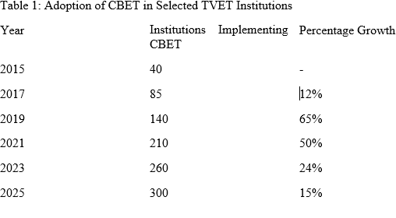
Results

Slide 39
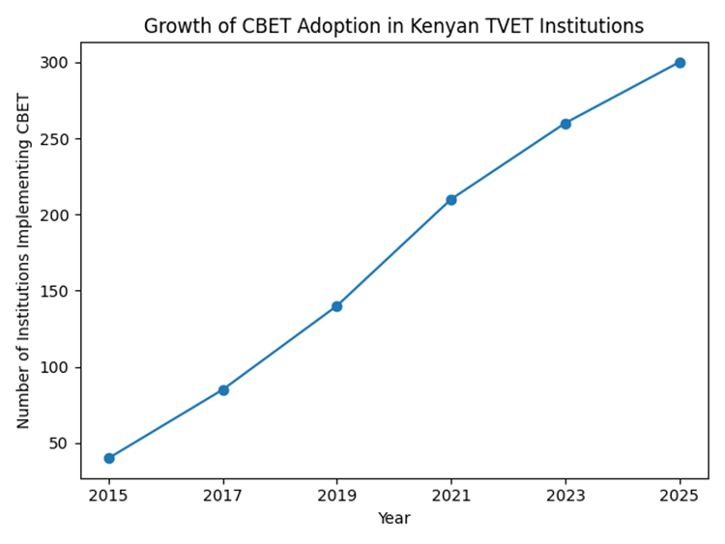
Results

Slide 40
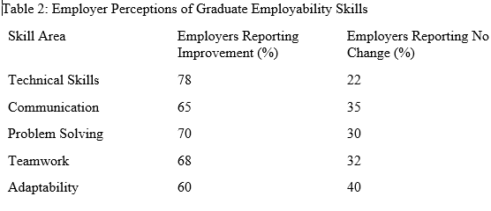
Results

Slide 41
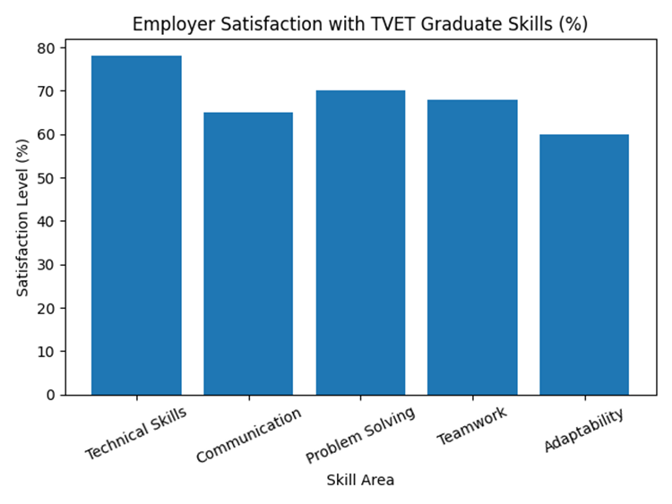
Results

Slide 42
Discussion
The findings suggest that CBET has contributed to improved practical training within TVET institutions.
Both groups sampled recognized the significance of CBET in developing students’ competencies for the world of work and the economic prosperity of the country.
Despite the positives of CBET in enhancing skills development, there are various systemic challenges noted.
Data analysis showed that trainers rarely use technology in their training due to lack of resources and limited teaching time allocated for lessons.

Slide 43
Discussion Cont’
Teaching in an overcrowded classroom, inadequate teaching and learning facilities or resources hinder a full implementation of CBE in technical education.
This cannot favour the learner in developing the necessary independent learning according to Chisi, (2018) and Marais, (2016).
The study results corroborate the claims of Tambwe (2017) that curriculum issues owing to overloading of the curriculum, and lack of support from the stakeholders affect the realization of competency-based practices in tertiary education.

Slide 44
Discussion Cont’
Inadequate resources and infrastructure emerged as the predominant barrier to CBE implementation.
However, the limited identification of research opportunities suggests that research culture may be underdeveloped in these training institutions.
The effectiveness of CBET is heavily dependent on strong partnerships between training institutions and industry.
Without adequate industrial attachment opportunities and employer involvement in curriculum development, CBET cannot fully achieve its objectives.

Slide 45
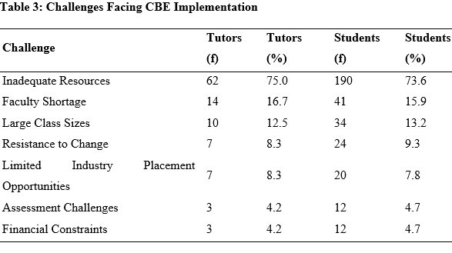
Challenges Facing CBE Implementation

Slide 46
Conclusion
The findings show that while CBET has improved practical training and competency development, significant gaps remain in industry collaboration and resource availability.
The findings reveal a complex implementation challenge characterized by significant systemic barriers alongside promising enabling factors.
Inadequate resources and infrastructure emerged as the predominant challenge, affecting approximately three-quarters of both trainers and students.

Slide 47
Cont’
Faculty shortages, large class sizes, limited placement opportunities, resistance to change, assessment challenges, and financial constraints constitute additional barriers impeding the transition to competency-based education.
However, government support through CBET policies and industry partnerships emerged as the most prominent facilitators.
The convergence in trainer and student perceptions across both challenges and opportunities evidenced by non-significant Chi-square test results indicates shared stakeholder experiences and suggests strong potential for collaborative reform initiatives.

Slide 48
Recommendation
The study recommends;
Strategic interventions addressing identified challenges and leveraging opportunities.
Significant investment in infrastructure, including laboratories, simulation centers, and ICT facilities, is critical to support practical training and align with CBE’s experiential focus.
Expanding faculty development programs to train tutors in SDL and portfolio-based assessments will enhance instructional quality, addressing gaps in pedagogical skills.

Slide 49
References
Government of Kenya TVET Act (2013). Technical and vocational education and training act, 2013. Nairobi: Government Printer.
Ige, W. B., Nkosi, Z. Z., & Adeniyi, O. V. (2024). Implementation of competency-based education for quality midwifery programmes in Africa: A scoping review. BMC Nursing, 23, 725. https://doi.org/10.1186/s12912-024-02333-w
Kabombwe, Y.M., & Mulenga, I.M. (2019). Implementation of competency-based curriculum by teachers in selected secondary schools in Lusaka district, Zambia. Yesterday and Today, (22), 19-41.
Kenya Institute of Curriculum Development. (2016). Basic Education Curriculum Framework. Kenya Institute of Curriculum Development. https://www.kicd.ac.ke/
Kenya National Qualifications Authority. (2020). Kenya national qualifications framework handbook. Nairobi.

Slide 50
References Cont’
Mauki, M. M., Kitur, J., Ireri, N. W., & Ngala, F. W. (2020). Competency-based curriculum implementation and the role of the universities in Kenya. Impact: Journal of Transformation, 3(1), 45-52.
Ministry of Education. (2023). Report of the Presidential Working Party on Education Reform. Government of Kenya. https://www.education.go.ke/
Muneja, M. S. (2015). Secondary school teachers’ implementation of the competency-based curriculum in the Arusha Region, Tanzania (Doctoral dissertation, University of South Africa).
Nursing Council of Kenya. (2025). Status of nursing and midwifery staffing at health facilities in Kenya. NCK Policy Brief. https://nckenya.go.ke/

Slide 52
FROM GRANT TO GROWTH:
Operationalizing the Tripartite TVET-Industry-Community
Nexus for Sustainable Skills Development and Employability
By:
Benard Ochieng Onyuka
Taita Taveta National Polytechnic

Slide 53
The Problem We Face
THE CHALLENGE WE FACE
2.3 MILLION Youth outside formal employment
50,000+University graduates released annually
TVET TARGET: 2 Million by 2027 Current: 700,000
Question: Are we creating graduates or economic creators?
Sources: Kenya News Agency (2026); Morendat Institute (2025)

Slide 54
Our Solution – The Tripartite Nexus Model
Government Policy
TVET Institution as Hub
INDUSTRY
Technology
Market
Expertise
COMMUNITY
Raw Materials
Labour
GRANTS
SITVES
YAW
GIZ
Seed
CO-CREATION
Curricula
Goods/Services
Enterprises
Revenue

Slide 55
The YAW Gemology Centre – A Living Model
TAITA TAVETA COUNTY
Gemstone Deposits
EXTRACTION
22 Trainees at Mining Site
Dual Tvet
VALUE ADDITION
5 Trainees in workshops
Cutting & Polishing
MARKET
Murangiri Gems Africa Ltd.
Expertise & Market
PUMA MINERS COOP
Registered & Located at TTNP
REVENUE SHARING
Puma Coop – Dividends
TTNP - Sales Value
Trainee - Stipend

Slide 56
Evidence This Model Works
EVIDENCE: SUCCESSFUL MODELS
PROPELA DUAL APPRENTICESHIP (Swisscontact) 75% workplace, 25% classroom
60+ private sector companies ------ (80% GRADUATE RETENTION) by host companies
NITA-accredited at KNQF Level 5 ------ Phase Two launched March 2026
JITUME DIGITAL HUBS -------- 400+ rural digital hubs nationwide
Kisiwa NP: 4,000+ trained Trainees earning Sh30,000-40,000 monthly
Some earning Sh115,000 WEEKLY as international tutors
Sources: KBC (2026); The Star (2026)

Slide 57
Who Benefits?
TRAINEES: Immediate income while learning; Practical employers value; Entrepreneurial mindset; Pathway to self-employment
TRAINERS: Professional development through industry exposure; Mentorship roles & alternative income
INSTITUTION (TTNP): Revenue from enterprises; Enhanced reputation & community ties
INDUSTRY (Murangiri Gems): Skilled labour pipeline; Innovation partnerships & goodwill
COMMUNITY (Puma Co-op): Market for raw materials Value addition returns & employment

Slide 58
Challenges We Must Address
POLICY & REGULATORY HURDLES
Mining regulations for student access
Cooperative governance requirements
Export regulations for gemstones
FINANCIAL MANAGEMENT
Transparent revenue sharing
Reinvestment vs. distribution decisions

Slide 59
Cont. Challenges We Must Address
SCALABILITY
Current: 27 gemology trainees (1% of students)
How to scale while maintaining quality?
MINDSET SHIFT
Trainers: educators → entrepreneur-supervisors
Students: passive learners → active owners

Slide 60
Policy Recommendation
POLICY RECOMMENDATIONS
FOR KNQA:
Formalize recognition of cooperative-based learning
Create credit transfer for workplace experience
FOR TVETA:
Develop accreditation for mining & gemology programmes
Create quality assurance for dual training
FOR MINISTRY OF EDUCATION:
Expand YAW & SITVES models nationally
Fund resource-based TVET (gemology, geothermal, tourism)

Slide 61
Policy Recommendation
FOR COUNTY GOVERNMENTS:
Integrate TVET cooperatives into economic planning
Extend 30% procurement to county level
FOR INDUSTRY:
Tax incentives for apprentice-hosting companies
Recognition programmes for industry champions

Slide 62
Conclusion – From Grant to Growth
Grant Projects (E.g SITVES, YAW, GIZ, EASTRIP etc.) are not ends in themselves
They are PILOTS FOR NATIONAL TRANSFORMATION
When TVET institutions become ECONOMIC HUBS:
→ JOBS, not just job seekers
→ REVENUE, not just budgets
→ INNOVATION, not just instruction
→ COMMUNITY WEALTH, not just individual skills
The goal: 2 MILLION TRAINEES by 2027
who are CREATORS, not just candidates

Slide 63
Cont.
ASANTE SANA

