Slide 1
Day 2 Break our Room 1 (Pride 1)

Slide 2
TITLE: ONE QUALIFICATION, ONE REGION: THE KNQF AS A CATALYST FOR REGIONAL INTEGRATION AND PROFESSIONAL PORTABILITY.
THEME: A DECADE OF TRANSFORMATION AND REIMAGINING QUALIFICATIONS IN KENYA.
SUBTHEME: NATIONAL QUALIFICATIONS FRAMEWORK AS A TOOL FOR INCLUSION AND REGIONAL INTEGRATION.
AUTHOR: KEN MUGAMBI KATHURIMA
PHONE NO: 0713746803
Email: kenmugambik@gmail.com
INSTITUTION: MITUNGUU NATIONAL POLYTECHNIC

Slide 3
Background & Context
Global shift toward competency-based education and training (CBET)
Increasing demand for cross-border recognition of qualifications
Fragmentation of qualifications systems in Africa limits mobility
Emergence of National Qualifications Frameworks (NQFs) as standardization tools
Kenyan Context:
Establishment of the Kenya National Qualifications Framework (KNQF)
Alignment with regional frameworks like:
  East African Qualifications Framework (EAQF)
  African Continental Qualifications Framework (ACQF)
Core Problem:
Limited professional portability and skills recognition across borders

Slide 4
The KNQF Framework Explained
KNQF: A unified system for classification, assessment, and recognition of qualifications
Key Components:
10-level framework (basic to doctoral levels)
Recognition of:
  Formal learning
  Non-formal learning
  Informal learning (RPL – Recognition of Prior Learning)
Functions:
Standardization of qualifications
Quality assurance and accreditation
Credit accumulation and transfer system (CATS)
Strategic Role:
Bridges education, training, and labor markets
Promotes lifelong learning pathways

Slide 5
KNQF and Regional Integration
Catalytic Role:
Harmonization of qualifications across East Africa
Supports mutual recognition agreements (MRAs)
Integration Benefits:
Facilitates labor mobility within EAC and Africa
Enhances regional economic cooperation
Supports AfCFTA goals (free movement of skilled labor)
Mechanisms:
Level comparability across countries
Competency benchmarking
Alignment with continental frameworks (ACQF)
Case Insight:
Comparable qualifications enable Kenyan professionals to work across borders without re-certification barriers

Slide 6
Inclusion & Professional Portability
Inclusion Dimensions:
Recognition of Prior Learning (RPL)
Access for marginalized and informal sector workers
Flexible learning pathways
Professional Portability:
Easier transition across:
  Regions
  Industries
  Education levels
Impact:
Increased employability
Skills visibility and transparency
Reduced duplication of training
Challenges:
Awareness gaps among stakeholders
Institutional capacity constraints
Need for stronger regional policy alignment

Slide 7
Conclusion & Recommendations
Key Takeaways:
KNQF is a strategic enabler of integration and inclusion
Strengthens Kenya’s role in regional and continental skills ecosystems
Recommendations:
Strengthen regional collaboration (EAC, AU)
Scale up RPL implementation
Increase stakeholder awareness and capacity building
Digitize qualifications frameworks for transparency
Promote industry–education partnerships
Closing Statement:
“One Qualification, One Region” is achievable through harmonized frameworks like KNQF, unlocking mobility, inclusion, and shared prosperity.
                THANK YOU

Slide 10


Transforming Qualifications
and Skills Recognition in Kenya
The Role of the Kenya National Qualifications Framework in
Advancing Quality and Employability
Authors
Mr. Kevin Ernest
Ms Colleta Awino
KNQA 1st National Qualifications Conference 2026
Presentation aligned to the accepted abstract and moderation feedback
Notes:
Hello everyone. My name is Kevin Ernest, and I am presenting this study on transforming qualifications and skills recognition in Kenya through the Kenya National Qualifications Framework. This presentation focuses on how KNQF, particularly through Recognition of Prior Learning, can help address the long-standing recognition gap affecting workers who acquire skills outside formal education. The study is especially relevant in Kenya because many skilled workers, particularly in the informal sector, remain excluded from formal certification, career progression, and better employment opportunities.”

Slide 11

Abstract
Aim and method
Core findings
The study examines how the KNQF and RPL support recognition of skills gained through non-formal and informal learning in Kenya.
A descriptive mixed-methods design combined surveys, interviews, FGDs, and document analysis across 100 stakeholders.
KNQF awareness was 75%, but strong knowledge was lower at 45%.
RPL awareness reached 57%, yet only 30% had used it.
Formal-sector respondents were significantly more likely to use RPL than informal-sector respondents (χ² = 10.25, p = 0.03), and vocational training was associated with higher RPL utilization (F = 4.78, p = 0.02).
Abstract focus
The study moves beyond a descriptive account of KNQF within TVET by providing empirical evidence on who is excluded from RPL, why non-formal learning remains difficult to modularize and assess, and what changes are needed for recognition to translate into employability gains.
Source: Ernest & Awino (2026).
Notes:
This research focuses on examining the impact of the Kenya National Qualifications Framework in increasing recognition of non-formal learning in the Kenyan TVET sector. Particularly, the research seeks to find out how the KNQF has improved the quality assurance process, the RPL program, and employability in the country. This study used both quantitative surveys and qualitative interviews to examine how the KNQF and the RPL program have helped in addressing the issue of skills recognition in the formal and informal sectors. From the study's descriptive analysis, it was discovered that 75% of the surveyed respondents had an idea about the KNQF whereas 45% had a proper knowledge about the framework. In addition, 57% were familiar with the RPL program, but just 30% of the respondents had ever accessed the program. From the findings, the Chi-square test showed a significant difference between sector type and RPL utilization in that people from the formal sector were more likely to use RPL compared to people from the informal sector (χ² = 10.25, p= 0.03). Moreover, ANOVA test results indicated a significant difference in RPL utilization scores by education level (F = 4.78, p= 0.02), with vocational training being more likely to participate in the program than other educational levels. The study shows that the introduction of the KNQF program in the country has contributed significantly in making the qualification system much transparent and standardized. However, the utilization of RPL still remains problematic especially among informal sector employees due to the lack of awareness about the program as well as lack of infrastructure among others. Therefore, it is advisable to develop a standardized RPL tool, engage employers in order to increase the rate of participation, and raise awareness in order to promote accessibility.

Slide 12
Background and problem statement
Why this matters
Core problem
National qualifications frameworks improve transparency, comparability, and mobility across education and employment systems.
In Kenya, many workers develop skills through apprenticeships, work experience, and other non-formal pathways.
Recognition of Prior Learning (RPL) is intended to convert those competencies into formally recognized qualifications.
The study describes a persistent recognition gap between skills people possess and qualifications they can formally present.
Implementation barriers include low awareness, weak assessment infrastructure, limited modularization, and weak stakeholder coordination.
This gap constrains employability, educational progression, and social inclusion—especially in the informal sector.
80%
Estimated share of Kenya's workforce in the informal sector
Implication: many workers acquire real competencies outside formal schooling, but those competencies are still under-recognized in qualification and recruitment systems.
(Coles et al., 2010; KNBS, 2022; KNQA, 2018; UNESCO, 2020; World Bank, 2019)
Notes:
The background to this study is that national qualifications frameworks have increasingly become important in improving transparency, comparability, and mobility in education and labour markets. In Kenya, this issue is particularly important because a large share of the workforce gains skills through apprenticeships, work experience, and other non-formal pathways. However, these skills are often not formally recognized. That creates what this study calls the recognition gap, which is the difference between the competencies people actually possess and the qualifications they can formally present. The core problem is therefore not lack of skills, but lack of credible recognition systems, especially for informal sector workers.”

Slide 13
Study objectives and contribution
General objective
Examine how the KNQF facilitates inclusive recognition of skills acquired through non-formal and informal pathways, and how this affects employability and lifelong learning in Kenya.
1. Policy and institutions
2. Awareness and access
Analyse the policy and institutional framework guiding KNQF implementation and skills recognition.
Assess awareness, accessibility, and use of RPL among trainees, trainers, and employers.
3. Pathway integration
4. Barriers and strategies
Examine how non-formal learning, modularization, and competency-based approaches connect to qualification pathways.
What this study adds: empirical evidence from Kenya on awareness, use, sector disparities, and the operational conditions required to integrate non-formal learning into qualification pathways.
Research focus: policy framework, stakeholder awareness, pathway integration, and implementation barriers.
(KNQA, 2018; UNESCO, 2020)

Slide 14
Methodology
Mixed
n = 100
4 tools
Triangulated
Descriptive mixed-methods design
Total study participants
Questionnaires, interviews, FGDs, document analysis
Quantitative + qualitative evidence
Sampling
Sample composition
Data collection
Analysis
Stratified and purposive sampling were used to capture stakeholders directly involved in or affected by KNQF and RPL implementation.
50 informal sector workers
30 educators/trainers
20 employers
Structured questionnaires measured awareness and utilization. Semi-structured interviews and FGDs captured stakeholder experiences and barriers.
Descriptive statistics, chi-square, ANOVA, and qualitative content analysis.
1
2
3
4
Design
Participants
Evidence
Interpretation
Source: study design and field data (Ernest & Awino, 2026).
Notes:
The study adopted a descriptive mixed-methods design because the issue required both numerical evidence and stakeholder experiences. The sample size was 100 participants, including informal sector workers, educators or trainers, and employers. Data was collected through questionnaires, semi-structured interviews, focus group discussions, and document analysis. Quantitative data was analysed using descriptive statistics as well as inferential tools such as chi-square and ANOVA. Qualitative data was analysed through content analysis and triangulated with the survey findings to improve reliability and depth.”

Slide 15
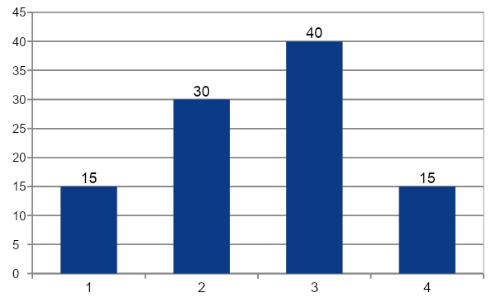

Respondent profile
Age distribution
Employment sector
60% / 40%
25%
40%
100
Male / Female split
Vocational training background
Largest age group: 35–44 years
Total respondents represented
Source: study survey data, n = 100 (Ernest & Awino, 2026).
Notes:
The participants were diverse in age, gender, employment sector, and level of education. Most respondents were aged between 25 and 44 years, which reflects an active working-age population. In terms of employment, the largest group came from the informal sector, followed by the formal sector, with a smaller group not employed. This respondent profile was important because it allowed the study to compare how different groups experience awareness and access to KNQF and RPL

Slide 16
Awareness and access to KNQF and RPL
What the pattern suggests
80
75%
Awareness is higher than actual utilization. Stakeholders may know the framework exists, but many still lack practical knowledge or access to the process.
60
57%
45%
40
Informal sector perspective
30%
One interview excerpt in the paper illustrates the gap: a respondent had heard about KNQF but did not know how it applied to their own skills.
20
0
Interpretation
KNQF aware
Strong KNQF knowledge
RPL aware
RPL used
The main issue is not only awareness creation but also actionable guidance, system access, and user-facing support.
Source: study survey/interview data (Ernest & Awino, 2026).
Notes:
One of the key findings is that awareness is higher than actual utilization. Seventy-five percent of respondents had heard of KNQF, but only 45 percent had a strong understanding of it. Similarly, 57 percent were aware of RPL, but only 30 percent had ever used it. This means that policy visibility does not automatically translate into practical access or uptake. The findings suggest that many people may know the terms KNQF and RPL, but they do not fully understand how these systems apply to their own skills, careers, or learning pathways

Slide 17
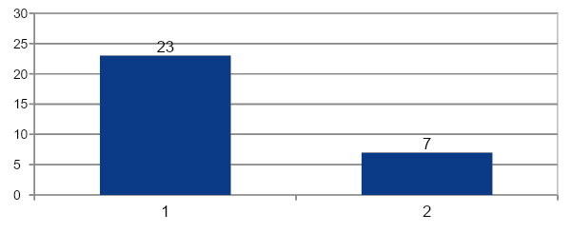
RPL utilization differs sharply by sector
Chi-square result
Meaning of the finding
χ² = 10.25, p = 0.03
Formal sector respondents were much more likely to report using RPL than respondents in the informal sector.
Formal sector workers likely have better access to information, institutional support, and employer familiarity with the RPL process.
Informal sector workers face the strongest recognition gap despite being a major target group for RPL policy.
This pattern strengthens the case for targeted outreach and decentralized service delivery.
Source: chi-square analysis of study data (Ernest & Awino, 2026).
Notes:
The chi-square test showed a significant relationship between sector type and RPL utilization, with a chi-square value of 10.25 and a p-value of 0.03. This means that formal sector workers were significantly more likely to use RPL than informal sector workers. In practical terms, this suggests that access to information, institutional support, and employer familiarity are stronger in the formal sector.

Slide 18
Employability and education-level findings
Perception gap
80
Most respondents believe RPL can improve employability, but employer buy-in remains limited. That weakens the labor-market value of recognition.
72%
60
40
ANOVA result: F = 4.78, p = 0.02
30%
20
Interpretation used in the paper
0
RPL improves employability
Employer support in recruitment
RPL-related utilization scores differed by education level, with vocational training associated with stronger participation than lower education levels.
Implication: vocational institutions can serve as practical entry points for scaling RPL.
Source: survey findings and ANOVA analysis (Ernest & Awino, 2026).
Notes:
The study examined perceptions of employability and differences by education level. 72 percent, believed that RPL can improve employability by recognizing skills gained through non-formal learning. However, employer support for using RPL in recruitment was much lower, at only 30 percent. In addition, ANOVA results showed a significant difference in RPL utilization by education level, with an F-value of 4.78 and a p-value of 0.02. Participants with vocational training were more likely to use RPL than those with primary or secondary education only. This suggests that vocational pathways may be better positioned to connect existing skills with formal recognition mechanisms.

Slide 19
Deeper analysis: non-formal learning modules
Competency capture
Level alignment
1
Skills gained through apprenticeships and work experience are real, but they are not consistently broken into clearly assessable competency units.
2
Non-formal learning is still unevenly mapped to KNQF levels, which weakens progression into formal qualifications and structured training pathways.
Assessment evidence
Labour-market signaling
3
RPL uptake remains low because standardized assessment tools, assessor capacity, and evidence systems are not yet strong enough to validate learning consistently.
4
Even where skills exist, weak employer recognition reduces the payoff from certification; assessment credibility and employability value must therefore move together.
(Coles et al., 2010; TVETA, 2020; UNESCO, 2020; World Bank, 2019)
Notes:
The study found that the challenge is not only awareness, but also the weak structuring of non-formal learning into assessable and portable units. First, competency capture remains inconsistent, meaning that skills gained through work and apprenticeships are not always broken into clearly measurable competencies. Second, level alignment is still weak, so it is difficult to map non-formal skills onto qualification levels within KNQF. Third, assessment tools and institutional coordination remain underdeveloped. My argument here is that KNQF will be more effective when non-formal learning is modularized, competency-based, and linked to credible RPL assessment pathways rather than treated only as a broad policy ambition

Slide 20
Conclusions and recommendations
Conclusions
Recommendations
KNQF has improved transparency and standardization in Kenya's qualification system.
RPL remains underutilized, with especially low uptake among informal sector workers.
Utilization is shaped by awareness, institutional support, employer recognition, and access to assessment systems.
Raise awareness through targeted campaigns aimed at informal sector workers and employers.
Develop standardized RPL assessment tools and clearer operational pathways.
Engage employers so that non-formal and RPL-certified skills gain labor-market value.
Expand access using mobile and digital RPL services, especially in remote areas.
Overall message: the framework exists, but effective recognition depends on practical system access, credible assessment, and real employer acceptance.
(Ernest & Awino, 2026; TVETA, 2020; World Bank, 2019)
Notes:
The study found that KNQF has already improved transparency and standardization in Kenya’s qualifications system, but RPL remains underutilized. The main barriers are limited awareness, weak assessment infrastructure, low employer recognition, and poor accessibility, especially for informal sector workers. Based on these findings, the study recommends four key actions: first, targeted awareness campaigns; second, development of standardized RPL assessment tools; third, stronger employer engagement; and fourth, more accessible delivery models such as mobile and digital RPL services. The overall message is that the framework already exists, but its success depends on whether people can actually access and trust the recognition process.

Slide 21
References
Becker, G. S. (1993). Human capital: A theoretical and empirical analysis with special reference to education (3rd ed.). University of Chicago Press.
Bjørnåvold, J. (2000). Making learning visible: Identification, assessment, and recognition of non-formal learning in Europe. Bernan Associates.
Coles, M., Oates, T., & European Training Foundation. (2010). European qualifications frameworks and learning pathways. Office for Official Publications of the European Communities.
Ernest, K., & Awino, C. (2026). Transforming qualifications and skills recognition in Kenya: The role of the Kenya National Qualifications Framework in advancing quality and employability [Conference presentation]. 1st National Qualifications Conference 2026, Nairobi, Kenya.
References formatted in APA style and compiled from the paper bibliography.

Slide 22
References (cont.)
Kenya National Bureau of Statistics. (2022). Economic survey 2022. KNBS.
Kenya National Qualifications Authority. (2018). Kenya National Qualifications Framework policy. KNQA.
Schultz, T. W. (1961). Investment in human capital. American Economic Review, 51(1), 1-17.
Technical and Vocational Education and Training Authority. (2020). Annual report 2019/2020. TVETA.
UNESCO. (2020). Education for sustainable development goals: Learning objectives. UNESCO Publishing.
World Bank. (2019). Kenya skills development report: Improving employability and productivity. World Bank.
References formatted in APA style and compiled from the paper bibliography.

Slide 23


&
Thank you
Questions and discussion

Slide 25
LEVERAGING THE KENYA NATIONAL QUALIFICATIONS FRAMEWORK FOR PARA-INTERNAL STAKEHOLDER INCLUSION AND REGIONAL EMPLOYABILITY
By Christopher S. Khisa (PhD)

Slide 26
Para-Internal Stakeholder/Publics
Introduction
Para-internal stakeholders are the outsourced service providers, interns, contractors, and informal agents.
In modern-day fluid organizational ecosystems, these service providers make up to 40 percent of the workforce in the Kenyan public and private sectors.
These important but usually unrecognized groups of workers, are the salient frontline customer care soldiers in Banks, International Institutions, Government, parastatals, among others.

Slide 27
Para-Internal Stakeholder/Publics…/2
These agents cut across conventional internal-external lines and permeate everyday operations, such as the National Social Security Fund-NSSF, the outsourcing of security services, IT maintenance, and Haba Haba mobilizing savings, which brings 2.8 million informal providers into contact with formal employees.
However, their systematic lack of inclusion in skills development programs creates silos of hierarchy, friction in miscommunication, and productivity gaps annually.

Slide 28
Para-Internal Stakeholder/Publics…/3
According to Freeman (1984), the presence of such oversights in stakeholder models causes disengagement costs of up to trillions of dollars, which is why innovative inclusion frameworks are critically needed worldwide.
The Kenya National Qualifications Framework (KNQF), as enforced in Act No. 22 of 2014, can be considered a revolutionary response.
This presents a comprehensive 10-level, outcomes-based system that includes formal education, Technical Vocational Education and Training (TVET), with special focus on standardized qualification, Recognition of Prior Learning (RPL) and lifelong learning.

Slide 29
Para-Internal Stakeholder/Publics…/4
Para-internals are theoretically based on the Public Relations (PR) theory, and are also redefined as neither internal nor external, but are an important part of the customer-focused operations and corporate image (Kent &Taylor, 2002).
Empirically, Kenyan parastatals outsource 62% of non-core work for cost efficiencies.
The KNQF 2024 RPL guidance mandates assessor-led portfolios, interviews, and demonstrations with industry reports indicating that 53.7% of the alignment is being achieved through Industry Awarding Committees (IACs).

Slide 30
Objectives
To explore how KNQF facilitates the inclusion of para-internal stakeholders.
To evaluate how KNQF bridges communication gaps between internal teams and outsourced service providers (Para-internal Stakeholders).
To recommend actionable strategies for leveraging the principles of KNQF to enhance qualifications mobility.

Slide 31
Literature Review
Conceptual Boundaries
Para-internal stakeholders are an intermediate group, who are neither outsiders nor insiders by traditional dichotomies in organizational theory, and include outsourced service providers, interns, contractors, and informal agents, such as in the NSSF Haba Haba savings scheme.
In PR literature, they are re-conceptualized as a type of boundary-spanner or an enabling public, which is necessary to relational equity and image-building, being customer-focused with an estimated contribution of global performance at 1.5 trillion annually (Kent & Taylor, 2002).

Slide 32
PR and Stakeholder Evolution
The origin of the stakeholder theory dates back to the managerial model proposed by Freeman (1984), focusing on strategic salience but with the siloing of actors based on proximity, which does not include any para-internals in the creation of value.
This is then developed by public relations theory, which is based on dialogic paradigms and where mutual adaptation and symmetry are seen as the remedies to asymmetry (Kent and Taylor, 2002).
Para-internals become channels of compassion and candor; the cost of their de-engagement undermines corporate image, reputation and results in relational costs.

Slide 33
KNQF Architecture and Employability Nexus
Inclusion of Para-Internal Stakeholders/Publics
KNQF focuses on standardized qualifications, making it inclusive as it promotes the standardization of skills and competencies that recognize contributions regardless of the route of acquisition, whether formal, non-formal, or informal.
This standardization guarantees para-internal stakeholders (such as the Haba Haba agents of NSSF- organized group leaders in the informal sector) formal validation, which increases the employability with portable credentials acceptable by employers in the region.
Recognition of Prior Learning (RPL) system is especially important as it allows organizations to evaluate and certify previous experiences through evidence-based procedures, empowering these actors and aligning practices with KNQF standards for inclusive cultures (KNQA, 2024a).

Slide 34
Bridging Communication Gaps
The KNQF systems, specifically RPL and credit accumulation systems, enhance communication in organizations by providing a common, standardized language of competencies that can cross the traditional internal-external boundaries.
KNQF allows internal departments and outsourced providers to align their communication expectations.
This model leads to empathy through humanizing para-internal stakeholders, as validated boundary-spanners, but not peripheral actors; RPL assessments validate experiential learning, raising inferred empathy scores.
Secondary PR-stakeholder analysis in NSSF contexts demonstrates reduced turnover and "us-versus-them" dynamics.

Slide 35
Regional Dimensions and EAC Harmonization
The KNQF is an example of integrating the EAC, and is strategically aligned with Annex VI of the EAC Common Market Protocol.
The protocol provides that qualifications should be mutually recognized, standards harmonized, and barriers to free movement of labor, services, and skills between Partner States should be removed (EAC, 2011).
Inter-University Council of East Africa (IUCEA) designed the East African Qualifications Framework of Higher Education (EAQFHE) which organises higher education cycles (equivalents of level 6-10) through learning outcomes in knowledge, skills and competencies, allowing people to have confidence in standards and to transfer credit (IUCEA, n.d.).

Slide 36
Theoretical Framework
The theoretical framework of this research is based upon the Public Relations (PR) theory, assuming that para-internal stakeholders or publics are not entirely internal or external but are important to customer-focused activities and corporate image (Brunner, 2019).
These para-internal stakeholders, the outsourced service providers, interns, and contractors, have a special status in organizations.
They provide quality insights and expertise that can improve service provision and organizational image.
Nonetheless, contemporary stakeholder models don’t consider these stakeholders, resulting in disengagement and miscommunication.

Slide 37
Methodology
The paper is based on a desk-based mixed-methods research design, which focuses more on qualitative depth through thematic content analysis with quantitative validation by meta-aggregates.
It incorporates trend projections to critically investigate the role of KNQF in the inclusion of para-internal stakeholders using the NSSF as a representative example.
The research took place in the period between February and March 2026.
It entailed systematic sourcing of 52 secondary documents covering 2022-2025 and curated by a multi-stage protocol.

Slide 38
Empirical Support
Inclusion criteria gave priority to peer-reviewed theses and articles, official reports and guidelines (KNQA 2024 RPL, NSSF CSP 2023-2027), EAC harmonization reports, and meta-metrics that have empirical proxies.
Pre-2019 sources that were not relevant to RPL, primary data not aggregated, non-empirical opinions, paywalled and unverifiable sources, or tangents like pure financial NSSF analysis without skills were excluded.
The data synthesis was done iteratively in which the qualitative data (NVivo-inspired themes; empathy, transparency and governance) were coded into policy texts and NSSF disclosures; the quantitative meta-analysis projections; the triangulation was minimized by including primary sources. This provided evidence-based results of the KNQF bridging efficacy without the ethical fieldwork burdens.

Slide 39
The Case of NSSF
Drawing exclusively from secondary sources, this section explains why KNQF processes, RPL and credit accumulation close the internal-external divides of NSSF, creating empathy, transparency, and collaborative governance.
These processes have positively contributed to a positive culture that has seen NSSF achieve greater stakeholder engagement.
This performance is demonstrated in the NSSF Corporate Strategic Plan 2023-2027, which focuses on member-centricity, innovation, and collaboration.

Slide 40
RPL as Divide-Bridger
The RPL framework of Kenya National Qualifications Authority (KNQA) formalizes experiential skills acquired through non-formal or informal means by rigorous assessment procedures (portfolios, interviews, workplace observations, and demonstrations), allowing para-internal stakeholders to accrue credits against the KNQF.
These standards were formulated in consultation with other regulators, such as the National Industrial Training Authority (NITA) and TVET agencies.
It supported the alignment with the 10-level outcomes-based framework of KNQF to facilitate lifelong learning and equity by certifying competencies regardless of the acquisition route (KNQA, 2024a).

Slide 41
Conclusion and Recommendations
This paper has highlighted the transformative power of the KNQF in weaving para-internal stakeholders, those vital yet often overlooked outsourced service providers, interns, and informal agents, into the fabric of organizational life, particularly through concrete case studies such as the National Social Security Fund (NSSF).
To maximize on this, organizations are encouraged to promote RPL accreditation of para-internal stakeholders by integrating portfolio assessments into standard business practices.
Policymakers should focus on awareness campaigns by KNQA and digital MIS expansions for effective tracking, and to establish EAC-wide reciprocity agreements to increase mobility.
Parastatals such as NSSF are encouraged to lead agent-network and educators to introduce dialogic values to TVET curricula.

Slide 44
Towards a National Framework for Credit Accumulation and Transfer in Kenya’s TVET System: Case Study of Sustainable Agriculture for Rural Development
Authors: Charles Kibeu, Monicah Wambui Wahome, David Macharia Mwangi
Date: 16th April 2026
Notes:
This presentation explores challenges in implementing Credit Accumulation and Transfer within Kenya’s TVET system. Using a case study of the Sustainable Agriculture for Rural Development program (SARD), we examine duplication of learning and inefficiencies in progression. The study proposes a structured framework aligned with national qualifications objectives to enhance lifelong learning, improve mobility, and ensure efficient training pathways.

Slide 45
Table of Contents
Current Situation
Background & Context
Problem Statement
Objectives
Methodology
Case Study Overview
Evidence of Duplication
Credit Analysis
Key Findings
Policy Gaps
Proposed Framework
Conclusion & Recommendations
Future Outlook

Slide 46
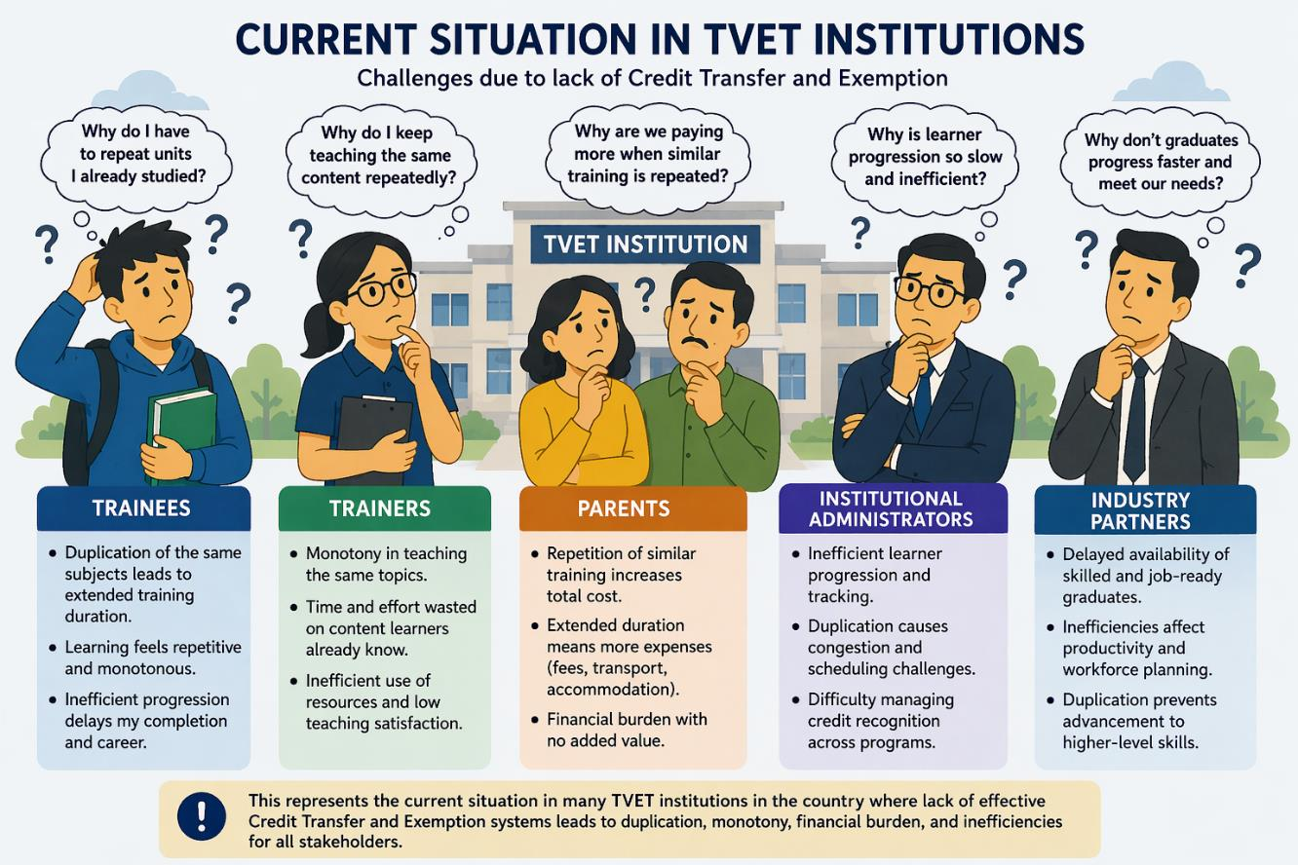
Introduction
Notes:
This image represents the current situation within many TVET institutions in Kenya. Stakeholders—including trainees, trainers, parents, institutional administrators, and industry partners—often face confusion regarding credit transfer, duplication of learning, and unclear progression pathways. The absence of structured Credit Accumulation and Transfer mechanisms leads to uncertainty, inefficiency, and frustration across the entire training ecosystem.

Slide 47
Background & Context-KNQA Role
Established under KNQF Act No. 22 of 2014
Oversees national qualifications framework implementation
Ensures quality assurance and accreditation
Facilitates articulation and classification of qualifications
Promotes mobility across qualification levels
Notes:
The Kenya National Qualifications Authority (KNQA), established under the KNQF Act of 2014, plays a central role in regulating qualifications. It ensures quality assurance, accreditation, and classification of learning outcomes. Importantly, it promotes learner mobility across levels. However, while the framework exists, operationalization of credit transfer mechanisms remains limited in practice, especially within TVET institutions.

Slide 48
…Cont’d Background & Context-KCATS
KCATS monitors and records learner achievement
Supports comparability and transferability of learning
Enhances student mobility across institutions
Facilitates entry, re-entry, and exit pathways
Enables vertical, horizontal, and diagonal mobility
Notes:
The Kenya Credit Accumulation and Transfer System (KCATS) is designed to support lifelong learning by tracking learner progress and enabling credit transfer. It enhances comparability and allows movement across institutions and levels. Despite its design, implementation challenges persist, particularly in modularized TVET programs where duplication of competencies and unclear credit mapping hinder effective learner progression.

Slide 49
Problem Statement
Absence of clear CAT implementation guidelines
Duplication of units across levels i.e. Level 5 and Level 6
Unclear duration for progressing trainees
Increased financial burden on parents and guardians
Inefficient learner progression pathways
Notes:
The study identifies key challenges affecting TVET progression. There is no clear operational framework for Credit Accumulation and Transfer, resulting in duplication of learning units between Level 5 and Level 6. This creates uncertainty in training duration, increases costs for families, and slows progression. These inefficiencies undermine the objectives of lifelong learning and skills development.

Slide 50
Objectives
Examine challenges in credit transfer within TVET
Analyze duplication between levels e.g. Level 5 and Level 6
Assess impact on training duration and cost
Explore stakeholder experiences and perspectives
Propose structured Credit Accumulation and Transfer framework
Notes:
The study aims to examine challenges in credit transfer within TVET programs. It analyses duplication between qualification levels and evaluates its impact on duration and cost. Stakeholder perspectives are explored to understand practical implications. Ultimately, the study proposes a structured framework to enhance credit transfer, reduce inefficiencies, and strengthen lifelong learning pathways.

Slide 51
Methodology
Qualitative case study research design
Focus on SARD program in TVET institution
Curriculum documents analyzed
Stakeholder perspectives collected
Thematic analysis applied to findings
Notes:
A qualitative case study approach was adopted to examine the SARD program. Curriculum documents were analyzed to identify duplication of competencies. Stakeholder perspectives—including trainees, trainers, parents, and administrators—were incorporated to provide practical insights. Thematic analysis was used to interpret findings, ensuring a comprehensive understanding of challenges affecting credit transfer and learner progression.

Slide 52
Case Study Overview
Level 5 Cycle 1: Trainees admitted between Sept 2023–May 2024
Level 5 Cycle 2: Trainees admitted between Sept 2024–Jan 2025
Level 6 Cycle 3: Trainees admitted between May 2025–Present
Cycle 3 encompasses a modular system across all levels
Core units shared across all levels at the start of the module
Notes:
The case study focuses on SARD trainees transitioning across cycles. In this case study, Cycle 1 and 2 represent Level 5, while Cycle 3 represents Level 6 under a modular system. Although Cycle 2 has fewer basic units, both cycles 1&2 share similar competencies. Modularization means all trainees initially study the same units (mostly core units),some of which were already done in previous levels contributing to duplication when progressing between levels.

Slide 53
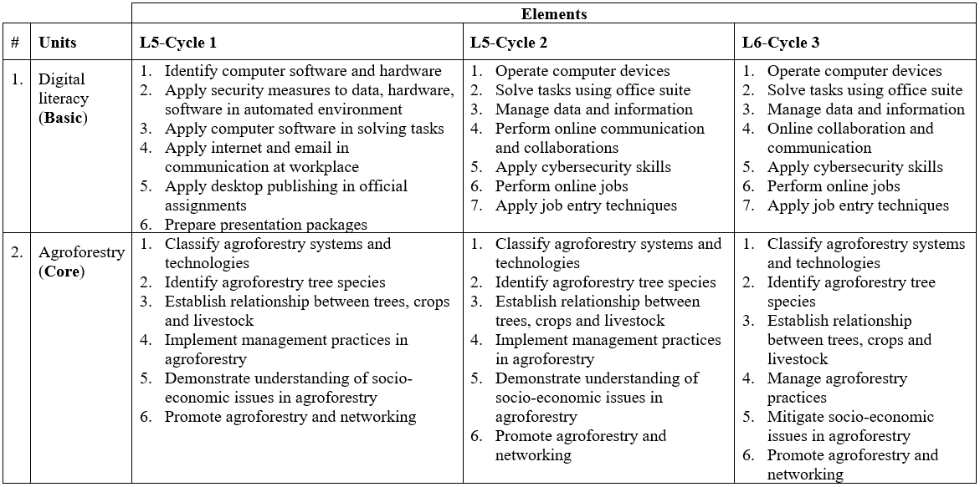
Evidence of Major Duplication
Notes:
Digital literacy shows partial duplication, where Level 5 Cycle 2 and Level 6 Cycle 3 contain identical elements, indicating no progression in competencies. In contrast, agroforestry exhibits complete duplication across Level 5 Cycles 1 and 2 and Level 6 Cycle 3, with nearly identical elements and only minor wording differences, suggesting redundancy and limited advancement in learning outcomes across all levels.

Slide 54
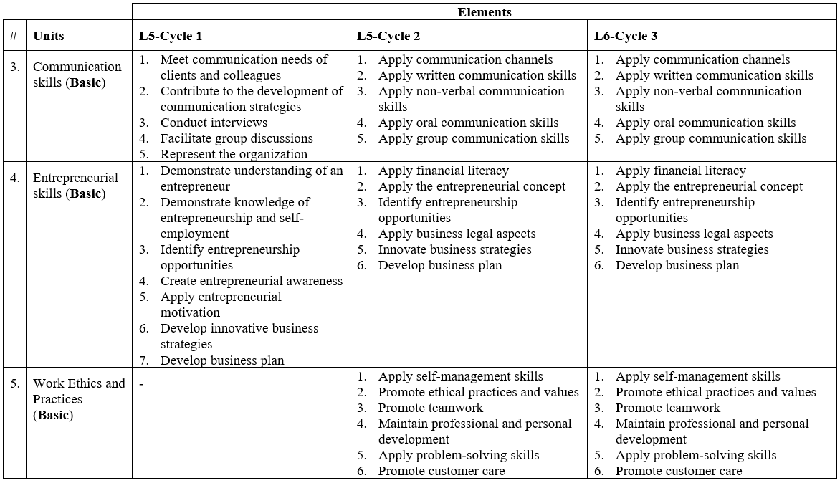
…Cont’d Evidence of Major Duplication
Notes:
Communication skills, entrepreneurial skills, and work ethics and practices demonstrate significant duplication across levels. Level 5 Cycle 2 and Level 6 Cycle 3 contain identical elements, indicating no progression in competencies. Level 5 Cycle 1 shows only minor overlap with Level 6 Cycle 3, while work ethics is not learned in Level 5 Cycle 1. This pattern highlights redundancy, limited skill advancement, and inefficiencies in curriculum progression across levels.

Slide 55
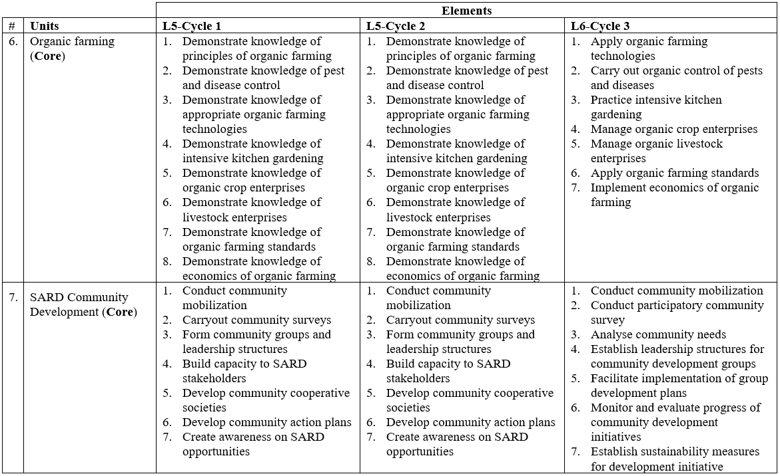
…Cont’d Evidence of Minor Duplication
Notes:
Organic farming and SARD Community Development exhibit minor duplication between Level 5 Cycles 1 and 2 and Level 6 Cycle 3, reflecting some progression from knowledge to application. However, overlapping elements remain evident. To strengthen competency advancement, Level 6 elements should be redesigned to fully eliminate duplication and emphasize higher-level skills, ensuring clear differentiation and progressive learning across all qualification levels.

Slide 56
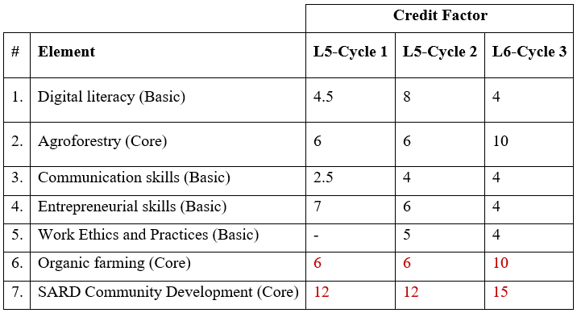
Credit Analysis
Notes:
The credit analysis reveals inconsistencies in credit allocation across levels. Some units have reduced credit values at higher levels despite increased complexity, while others increase disproportionately. This mismatch highlights the absence of standardized credit mapping. Without clear alignment, credit transfer becomes difficult, further complicating progression pathways for trainees. However, organic farming and SARD Community Development shows increased credit values at higher levels due to increased complexity and hence other units of competencies should adopt a similar approach to avoid duplication of content especially for the core units of competencies.

Slide 57
Key Findings
Duplication leads to extended training duration
Increased financial burden on parents and guardians
Monotony from repeated learning experiences
Inefficiency in learner progression pathways
Weak alignment with lifelong learning principles
Notes:
The findings indicate that duplication significantly affects training efficiency. Trainees spend more time completing programs, increasing costs for families. Repetition leads to monotony and reduced motivation. These inefficiencies contradict lifelong learning principles, which emphasize flexibility and progression. Without proper credit transfer mechanisms, the system fails to support effective skills development.

Slide 58
Policy Gaps
No fully operational CAT framework in practice
Limited standardization of credit mapping
Weak implementation of KNQF regulations
Inconsistent application across institutions
Limited stakeholder awareness of CAT processes
Notes:
Although regulations exist, practical implementation remains limited. The KNQF provides provisions for credit transfer, including credit definitions and transfer limits. However, institutions lack clear operational guidelines. This results in inconsistent application and limited awareness among stakeholders. Without standardized procedures, the intended benefits of credit accumulation and transfer are not fully realized.

Slide 59
Proposed Framework
Develop accessible national CAT guideline documents
Standardize credit mapping across all TVET programs
Enable transfers: sectorial, institutional, program, and level
Clarify rules: For instance 49% transfer, notional hours, mobility
Establish clear guidelines for future training cycles
Notes:
The proposed framework emphasizes accessibility and standardization. Public guidelines should clearly outline credit transfer rules for all stakeholders. Credit mapping must be harmonized across programs. Transfer pathways should include sectorial and institutional mobility. Clear rules—such as the 49% limit and notional hours—must be simplified. Future cycles should also be guided by structured policies.

Slide 60
Conclusion & Recommendations
Develop and implement national CAT operational guidelines
Eliminate duplication through curriculum alignment
Enhance stakeholder awareness and training
We commend KNQA for advancing lifelong learning agenda
Encourage access to detailed CAT implementation guidelines
Notes:
In conclusion, addressing credit transfer challenges is critical for strengthening lifelong learning in Kenya. We commend the Kenya National Qualifications Authority for organizing this conference and prioritizing CAT discussions through its sub-theme 4: Lifelong Learning-Recognition of Prior Learning, Credit Accumulation and Transfer and Recognition of Qualifications. Continued efforts, including initiatives by TVET CDACC, are commendable especially on inviting stakeholders to address this concerns on Credit Transfer and Exemption. However, stakeholders require clear, accessible guidelines to effectively plan and implement credit transfer mechanisms.

Slide 61
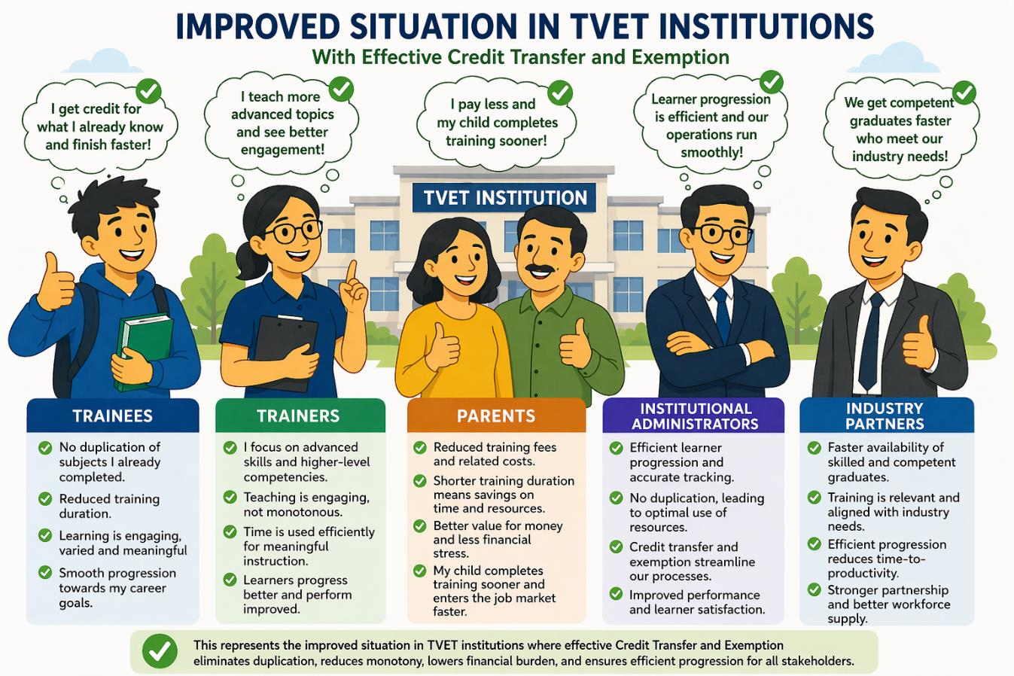
Future Outlook
Notes:
This image represents the desired future state of TVET in Kenya. With clear Credit Accumulation and Transfer frameworks, all stakeholders—trainees, trainers, parents, institutions, and industry—can confidently navigate progression pathways. Transparency and structured guidelines will eliminate confusion, enhance efficiency, and promote lifelong learning, ensuring a more responsive and inclusive qualifications system.

Slide 64
INTEGER PROGRAMMING MODEL FOR
Micro-Credential Stackability
Optimising Progression Efficiency within the
Kenya National Qualifications Framework
Saina Philiph Kipkosgei
Academic Officer, Sensei Institute of Technology | PhD Candidate, University of Eldoret
Conference Theme: Lifelong Learning Pathways and Recognition • Sub-theme: Micro-Credentials and Modularisation
sainamailbox@gmail.com • +254 746 059 188

Slide 65
ROADMAP
Presentation Overview
01
The Problem
06
Model Validation
Ad-hoc stacking, credit redundancy & efficiency gaps in KNQF
MAPE = 4.9%; hold-out cohort 2023
02
Research Objectives
07
Results & Efficiency Gains
Three operationally distinct, sequenced aims
28.4% ICT, 22.7% Eng., 19.3% Business savings
03
Literature & Theory
08
Sensitivity Analysis
IP in education; competency mapping; KNQF context
Scheduling load, credit caps, prerequisite depth
04
BIP Model Formulation
09
Policy Recommendations
Decision variables, objective function, 5 constraint sets
MCSOT, floor-and-flex, scheduling standards
05
Data & Calibration
147 units across 3 institutions; Delphi α = 0.60

Slide 66
INTRODUCTION
Micro-Credentials and Stackability in Kenya
Micro-credentials are short, focused learning achievements attesting to specific assessed competencies — central to lifelong learning, workforce upskilling, and qualification pathway flexibility within the KNQF.
What are Micro-Credentials?
Stackability Defined
KNQF Regulatory Basis
Records of assessed learning outcomes from short learning experiences, subject to quality assurance standards (European Commission, 2022)
Structured accumulation of discrete credentials toward full qualification recognition — sequential, parallel, branching, or modular clustering configurations
KNQA Credit Accumulation and Transfer Policy (2019): 1 credit = 40 notional hours; up to 50% credit transfer from prior micro-credentials permitted
Four Stackability Configurations (DESE, 2020)
Sequential (linear prerequisites) | Parallel (concurrent independent) | Branching (conditional electives) | Modular Clustering (thematic groups)

Slide 67
PROBLEM STATEMENT
The Efficiency Gap in KNQF Micro-Credential Stacking
12/92
+2.8 sem
0.6–2.6 sem
Institutions with Formal
Stacking Integration
Excess Completion
(Engineering Level 7)
Excess Completion
(Range, all sectors)
Core Problem: The absence of a formal optimisation framework for sequencing credential stacks leads to credit redundancy, prerequisite violations, and inflated time-to-qualification outcomes.
Heuristic / Ad-Hoc Sequencing
Prerequisite Violations
Learners and planners rely on intuition — generating credit redundancy and missed competencies
Unresolved sequencing conflicts delay programme completion, especially in engineering
No Predictive Tool
African Context Gap
No framework predicts optimal durations or validates coverage before deployment
No prior study has validated a BIP model for KNQF micro-credential sequencing
Unquantified Redundancy
KNQA Review Finding (2023)
18–27% content overlap in ICT programmes (Mwangi et al., 2022) — unmanaged
Only 13% of surveyed institutions had formally integrated micro-credential stacking

Slide 68
RESEARCH OBJECTIVES
Objective 1 · Model Development & Calibration
Develop and empirically calibrate a BIP model that determines optimal micro-credential stacking sequences satisfying KNQF credit thresholds, prerequisite dependency, competency coverage, and scheduling feasibility in ICT, Engineering, and Business Studies.
Objective 2 · Efficiency Quantification
Quantify pathway efficiency gains — reductions in time-to-qualification and competency redundancy — achieved by IP-optimal stacking relative to traditional linear delivery, benchmarked against cohort completion records (2019–2023).
Objective 3 · Policy Sensitivity Analysis
Assess the robustness and policy sensitivity of optimal solutions to variations in institutional credit caps, scheduling load constraints, and prerequisite depth structures, and derive evidence-based KNQF policy recommendations.
Objectives form a logical progression: development → validation → policy application.

Slide 69
LITERATURE REVIEW
Literature and Theoretical Framework
IP in Education (International)
Birbil et al. (2016): 17–23% scheduling gains (Turkey)
Kucukakin & Aras (2019): 14.8% fewer hours, MAPE ~6.1% (vocational BIP)
Lara, Liern & Perez-Gladish (2021): 18.3% redundancy reduction (Mexico)
IP in Africa
Oladele & Adeodun (2018): 12.4% duration reduction via goal programming (Nigeria) — but no prerequisite chain or stackable micro-credential modelling
KNQF Competency Alignment
Wambua & Muasya (2021): significant Level ≤6 misalignment in engineering
Mwangi et al. (2022): 18–27% content overlap in Kenyan ICT programmes
Three theoretical pillars: Set-Covering Theory (competency coverage) + Network Scheduling (DAG prerequisite chains) + Multi-Objective Optimisation (weighted objective function)

Slide 70
METHODOLOGY
Data Sources, Sampling and Dataset
147
2,360
3
4–7
Micro-Credential Units
Learner Observations
(calibration)
Institutions
(3 sectors)
KNQF Levels
Covered
Institutions: Strathmore University (ICT) | Technical University of Kenya (Engineering) | KCA University (Business Studies)
Sector | Units | Total Credits | Mean Credits (SD) | Mean Duration (SD) | Comp. Clusters (K) | Prereq. Depth
ICT (Strathmore) | 54 | 638 | 11.8 (2.4) | 7.4 wks (2.1) | 9 | 2.3
Engineering (TUKe) | 51 | 594 | 11.6 (2.1) | 8.9 wks (2.6) | 8 | 2.8
Business Studies (KCA) | 42 | 487 | 11.6 (1.8) | 6.8 wks (1.9) | 7 | 1.9
Overall | 147 | 1,719 | 11.7 (2.2) | 7.7 wks (2.3) | 24 | 2.4

Slide 71
METHODOLOGY — BIP MODEL FORMULATION
Binary Integer Programme: Core Structure
Decision Variable: xᵢ ∈ {0,1} — 1 if unit i selected in optimal stack; 0 otherwise
C1
Credit Threshold
Cmin ≤ Σ crᵢ xᵢ ≤ Cmax
Objective Function
C2
Prerequisite Chain
Minimise Z = α · T + (1-α) · R
xᵢ ≤ xⱼ ∀ j ∈ P(i)
T = Σᵢ tᵢ xᵢ (total completion time)
R = Σᵢ Σⱼ cᵢⱼ yᵢⱼ (competency redundancy — Jaccard)
α = 0.60 (Delphi-calibrated; Kendall's W = 0.74)
C3
Competency Coverage
Σᵢ aₖᵢ xᵢ ≥ 1 ∀ k = 1…K
C4
Scheduling Feasibility
Σᵢ∈Sₛ xᵢ ≤ Mₛ ∀ semester s
C5
Binary Integrality
xᵢ ∈ {0,1} ∀ i

Slide 72
METHODOLOGY
Objective Function: Calibration and Redundancy Measure
Completion Time Component (T)
Competency Redundancy Component (R)
T = Σᵢ tᵢ xᵢ
tᵢ = mean completion duration (weeks) for unit i, estimated from institutional cohort records (2019–2022 training set). Engineering mean: 8.9 wks; ICT: 7.4 wks; Business: 6.8 wks.
R = Σᵢ Σⱼ cᵢⱼ yᵢⱼ
cᵢⱼ = Jaccard similarity: |Aᵢ ∩ Aⱼ| / |Aᵢ ∪ Aⱼ|
McCormick linearisation applied to bilinear yᵢⱼ = xᵢ · xⱼ
Mean cᵢⱼ across all sectors: 0.188 (SD = 0.10)
Delphi Weight Calibration (α = 0.60)
14 curriculum designers · 2-round structured Delphi · Kendall's W = 0.74, p < 0.001 → α = 0.60 (time efficiency slightly prioritised over redundancy minimisation)
McCormick Linearisation ensures BIP solvability without quadratic extension:
yᵢⱼ ≤ xᵢ · yᵢⱼ ≤ xⱼ · yᵢⱼ ≥ xᵢ + xⱼ − 1 · yᵢⱼ ≥ 0

Slide 73
METHODOLOGY
Five Constraint Sets — KNQF Alignment
C1 — Credit Threshold
Cmin ≤ Σ crᵢ xᵢ ≤ Cmax
Level 4: 60–80 cr | Level 5: 120–160 cr | Level 6: 240–300 cr | Level 7: 360–420 cr (KNQA Credit Framework, 2021)
C2 — Prerequisite Dependency
xᵢ ≤ xⱼ for all j ∈ P(i)
Models credentials as a directed acyclic graph (DAG). All prerequisites of a selected unit must also be selected. Mean chain depth: 2.4 across sectors (Engineering: 2.8)
C3 — Competency Coverage
Σᵢ aₖᵢ xᵢ ≥ 1 for all k
The stack must cover all K required competency clusters. aₖᵢ from KNQA Competency Standards (2022) and institutional programme descriptors. Full coverage achieved in all 12 instances.
C4 — Scheduling Feasibility
Σᵢ∈Sₛ xᵢ ≤ Mₛ for all s
Within each semester s, concurrent units cannot exceed institutional load limit Mₛ. Baseline Mₛ = 3; most sensitive parameter (shadow price 0.063).
C5 — Binary Integrality
xᵢ ∈ {0,1}
Each credential unit is either included (1) or excluded (0) from the optimal stack. No partial or fractional inclusion permitted.

Slide 74
METHODOLOGY
Implementation, Validation Design and Benchmarks
Software Implementation
Validation Split
Python 3.11 + PuLP v2.7.0 modelling library
CBC branch-and-bound MILP solver
12 instances (3 sectors × 4 KNQF levels)
Solution time: 0.3–4.7 seconds per instance
Training set: cohorts 2019–2022 (n = 1,888)
Hold-out set: cohort 2023 (n = 472)
Parameters tᵢ and cᵢⱼ estimated on training data only
Model applied to hold-out — no data leakage
Benchmark Comparisons
Traditional Linear Model (TLM)
Greedy Heuristic Model (GHM)
BIP Optimal (This Study)
All credits delivered sequentially in fixed institutional sequence — no stackability flexibility. Defines the upper bound of inefficiency. By definition equals prescribed duration.
Iteratively selects the micro-credential unit with highest credit-per-week ratio until credit threshold is met. Myopic: ignores downstream prerequisite and coverage implications of early selections.
Global optimisation across all 5 constraint sets simultaneously. Overcomes myopic failure of GHM by anticipating downstream prerequisite and coverage implications.

Slide 75
DATA
KNQF Credit Thresholds and Unit Distribution by Level
All 147 micro-credential units are distributed across KNQF Levels 4–7. Level 6 (Diploma) is the primary site of micro-credential innovation in Kenya.
KNQF Level | Descriptor | C_min | C_max | ICT Units | Eng. Units | Bus. Units | Total
Level 4 | Certificate / Artisan | 60 | 80 | 8 | 7 | 9 | 24
Level 5 | Higher Certificate | 120 | 160 | 14 | 13 | 11 | 38
Level 6 | Diploma | 240 | 300 | 17 | 16 | 13 | 46
Level 7 | Bachelor Degree | 360 | 420 | 15 | 15 | 9 | 39
Observed Completion Excess — Ad-Hoc Modular vs. Prescribed Duration
ICT Level 7
Engineering Level 7
Business Level 7
12 sem prescribed → 13.7 sem observed → +1.7 sem excess
12 sem prescribed → 14.8 sem observed → +2.8 sem excess ⚠
12 sem prescribed → 13.2 sem observed → +1.2 sem excess

Slide 76
DATA
Competency Overlap Matrix (Jaccard) — ICT Level 6 Sample
Values ≥ 0.40 indicate high content overlap. The BIP redundancy objective penalises concurrent inclusion of high-overlap unit pairs, preferring the unit with broader competency coverage per credit-week.
 | MC-06-01 (Data Struct.) | MC-06-02 (Programming) | MC-06-03 (Database) | MC-06-04 (Data Eng.) | MC-06-05 (Web Dev.) | MC-06-06 (Net. Sec.) | MC-06-07 (Cybersec.) | MC-06-08 (Cloud Sec.) | MC-06-09 (UX Design)
MC-06-01 (Data Struct.) | 1.00 | 0.42 | 0.18 | 0.09 | 0.31 | 0.07 | 0.12 | 0.05 | 0.22
MC-06-02 (Programming) | 0.42 | 1.00 | 0.29 | 0.14 | 0.38 | 0.11 | 0.08 | 0.17 | 0.27
MC-06-03 (Database) | 0.18 | 0.29 | 1.00 | 0.47 | 0.21 | 0.33 | 0.19 | 0.24 | 0.16
MC-06-04 (Data Eng.) | 0.09 | 0.14 | 0.47 | 1.00 | 0.12 | 0.55 | 0.28 | 0.31 | 0.08
MC-06-05 (Web Dev.) | 0.31 | 0.38 | 0.21 | 0.12 | 1.00 | 0.16 | 0.09 | 0.13 | 0.44
MC-06-06 (Net. Sec.) | 0.07 | 0.11 | 0.33 | 0.55 | 0.16 | 1.00 | 0.41 | 0.37 | 0.09
MC-06-07 (Cybersec.) | 0.12 | 0.08 | 0.19 | 0.28 | 0.09 | 0.41 | 1.00 | 0.52 | 0.14
MC-06-08 (Cloud Sec.) | 0.05 | 0.17 | 0.24 | 0.31 | 0.13 | 0.37 | 0.52 | 1.00 | 0.11
MC-06-09 (UX Design) | 0.22 | 0.27 | 0.16 | 0.08 | 0.44 | 0.09 | 0.14 | 0.11 | 1.00
RED = Jaccard ≥ 0.40 (high overlap). Pairs: MC-01/02 (0.42), MC-03/04 (0.47), MC-04/06 (0.55), MC-07/08 (0.52), MC-05/09 (0.44)

Slide 77
RESULTS — VALIDATION
Model Validation: Predicted vs. Observed Duration
0.34 sem
4.9%
0.41 sem
Mean Absolute Error
MAPE (Overall)
RMSE
Hold-out validation set: n = 575 learner-qualification observations (2023 cohort). Parameters estimated exclusively from 2019–2022 training data — no data leakage.
Sector | Level | Observed (sem) | Predicted (sem) | Abs. Error (sem) | MAPE (%)
ICT | Level 5 | 4.8 | 3.6 | 0.28 | 5.8%
ICT | Level 6 | 9.4 | 6.8 | 0.31 | 4.6%
ICT | Level 7 | 13.7 | 9.9 | 0.42 | 4.2%
Engineering | Level 5 | 5.1 | 4.0 | 0.36 | 7.2%
Engineering | Level 6 | 10.2 | 7.9 | 0.29 | 3.7%
Engineering | Level 7 | 14.8 | 11.4 | 0.38 | 3.3%
Business Studies | Level 5 | 4.6 | 3.7 | 0.27 | 7.3%
Business Studies | Level 6 | 9.1 | 7.4 | 0.34 | 4.6%
Business Studies | Level 7 | 13.2 | 10.7 | 0.41 | 3.8%
Overall Mean | — | 9.4 | 7.3 | 0.34 | 4.9%

Slide 78
RESULTS — OBJECTIVE 1
BIP Optimal Stack Composition by Sector and Level
All 12 instances solved to proven optimality. Full competency coverage achieved in all instances — efficiency gains do not compromise qualification integrity.
Sector & Level | Avail. | Selected | Util. Rate | Credits | Duration (sem) | Coverage | Z
ICT — Level 5 | 22 | 10 | 45.5% | 124 | 2.5 | 9/9 | 0.312
ICT — Level 6 | 32 | 18 | 56.3% | 246 | 4.9 | 9/9 | 0.389
ICT — Level 7 | 54 | 30 | 55.6% | 378 | 8.7 | 9/9 | 0.441
Engineering — Level 5 | 20 | 11 | 55.0% | 128 | 3.1 | 8/8 | 0.354
Engineering — Level 6 | 31 | 19 | 61.3% | 252 | 6.1 | 8/8 | 0.412
Engineering — Level 7 | 51 | 33 | 64.7% | 372 | 10.7 | 8/8 | 0.479
Business — Level 5 | 18 | 9 | 50.0% | 122 | 3.0 | 7/7 | 0.301
Business — Level 6 | 28 | 16 | 57.1% | 242 | 5.6 | 7/7 | 0.348
Business — Level 7 | 42 | 28 | 66.7% | 368 | 9.8 | 7/7 | 0.403
14 high-efficiency pathway configurations identified — replicable stacking templates for KNQF programme design.

Slide 79
RESULTS — OBJECTIVE 2
Pathway Efficiency Gains vs. Traditional and Heuristic Baselines
Primary empirical finding: BIP achieves mean completion duration reductions of 27.0% (ICT), 22.4% (Engineering), and 19.1% (Business) versus Traditional Linear Model.
Sector & Level | TLM (sem) | GHM (sem) | BIP (sem) | vs TLM | vs GHM | Red. Reduction
ICT — Level 5 | 4.8 | 4.2 | 3.6 | 25.0% | 14.3% | 22.4%
ICT — Level 6 | 9.4 | 8.4 | 6.8 | 27.7% | 19.0% | 28.6%
ICT — Level 7 | 13.7 | 11.9 | 9.9 | 27.7% | 16.8% | 33.9%
Engineering — Level 5 | 5.1 | 4.7 | 4.0 | 21.6% | 14.9% | 20.2%
Engineering — Level 6 | 10.2 | 9.2 | 7.9 | 22.5% | 14.1% | 23.6%
Engineering — Level 7 | 14.8 | 13.2 | 11.4 | 23.0% | 13.6% | 24.6%
Business — Level 5 | 4.6 | 4.3 | 3.7 | 19.6% | 14.0% | 17.8%
Business — Level 6 | 9.1 | 8.2 | 7.4 | 18.7% | 9.8% | 19.4%
Business — Level 7 | 13.2 | 11.8 | 10.7 | 19.0% | 9.3% | 23.2%
Overall Mean | 9.9 | 8.9 | 7.2 | 22.5% | 13.9% | 23.7%

Slide 80
RESULTS — OBJECTIVE 2
Efficiency Gains: BIP vs. Baselines — Visual Comparison
BIP consistently achieves shortest durations. GHM falls 13.9 percentage points below BIP — confirming the value of global optimisation over myopic heuristics.

Slide 81
RESULTS
Financial Value of Efficiency Gains
1.4 sem
KES 37,520
KES 44,660
Mean Semester Savings
per Learner
Fee Saving
per Learner
Total Estimated Saving
per Learner
Cost Calculation (Auditable and Verifiable)
Institutional fees: KES 26,800/semester (published schedules, 2023–24) → Fee saving: 1.4 × KES 26,800 = KES 37,520
Opportunity cost: KNBS (2023) average monthly earnings = KES 38,400 → KES 5,100/semester → Opp. cost saving: 1.4 × KES 5,100 = KES 7,140
Total: KES 37,520 + KES 7,140 = KES 44,660 per learner per qualification cycle
System-Level Annual Efficiency Value
KES 105.4 million / year
KES 2.4–3.8 million
Aggregated across 2,360 learners in calibration cohort
Estimated implementation cost per institution (CUE, 2024)

Slide 82
RESULTS — OBJECTIVE 3
Sensitivity Analysis: Key Parameter Variations
Systematic parametric variation of credit caps, scheduling load, and prerequisite depth. LP relaxation shadow prices identify most policy-sensitive constraints.
Parameter Variation | ΔT ICT | ΔT Eng. | ΔT Bus. | ΔZ | Binding Constraint | Shadow Price
Credit cap −20% (tightened) | +10.8% | +9.4% | +7.9% | +0.071 | Credit threshold | 0.041
Credit cap +20% (loosened) | −5.9% | −4.8% | −4.3% | −0.031 | Comp. coverage | 0.028
Load Mₛ = 2 (restrictive) | +18.4% | +21.3% | +13.7% | +0.148 | Scheduling ⚠ | 0.063
Load Mₛ = 3 (baseline) | — | — | — | — | — | —
Load Mₛ = 4 (flexible) | −9.6% | −11.2% | −7.4% | −0.082 | Prereq. chain | 0.047
Load Mₛ = 5 (most flexible) | −13.8% | −16.4% | −10.2% | −0.119 | Prereq. chain | 0.047
Prereq. depth +1 (deeper) | +15.2% | +21.7% | +10.8% | +0.114 | Prereq. chain ⚠ | 0.061
Prereq. depth −1 (shallower) | −8.7% | −11.9% | −7.1% | −0.064 | Comp. coverage | 0.028
Alpha = 0.40 (redundancy) | +7.4% | +6.8% | +5.3% | −0.017 | Credit threshold | 0.038
Alpha = 0.80 (time focus) | −3.8% | −3.3% | −2.7% | +0.029 | Credit threshold | 0.041

Slide 83
SENSITIVITY ANALYSIS
Three Policy-Critical Sensitivity Findings
1
Scheduling Load (Mₛ) — Highest Leverage
Shadow price = 0.063 (highest in table). Moving from Mₛ=2 to Mₛ=5 cuts duration by 10.2–16.4%. Scheduling policy is the primary institutional variable for realising micro-credential efficiency gains.
Policy action: KNQA accreditation standards should require minimum concurrent load of 3–4 units per semester for Level 5–7 programmes.
2
Prerequisite Depth — Engineering Disproportionate Impact
Engineering completion time rises 21.7% per added prerequisite level (vs. 15.2% ICT, 10.8% Business). Engineering shadow price on prerequisite chain = 0.061 — highest across sectors.
Policy action: EBK should commission prerequisite audit distinguishing competency-driven from administratively-inherited prerequisites.
3
Asymmetric Credit Cap Sensitivity — Floor is Binding
Tightening credit cap (−20%) distorts duration more (+7.9–10.8%) than loosening (+20%) reduces it (4.3–5.9%). The floor constraint (Cmin) is more regularly binding than ceiling (Cmax).
Policy action: 'Floor-and-flex' model — maintain current Cmin as binding standard; allow flexibility above to Cmax ceiling.

Slide 84
DISCUSSION
Discussion: Model Performance and Methodological Contribution
BIP achieves MAPE = 4.9% — exceeding the 6.1% benchmark of Kucukakin & Aras (2019), consistent with the 4.2–5.8% range of Lara et al. (2021). Methodologically competitive with international state of the art.
McCormick Linearisation
Structured Delphi (α = 0.60)
Bilinear redundancy term linearised prior to BIP solver pass — enabling MIP solvability without quadratic extension (no commercial solver required)
Kendall's W = 0.74, p < 0.001 — most rigorous weighting calibration in the KNQF curriculum optimisation literature to date
Three-Way Benchmark Design
Full Competency Coverage
TLM vs. GHM vs. BIP — definitively isolates the value of global optimisation: GHM falls 13.9pp below BIP, confirming myopic failure of heuristic approaches
Achieved in all 12 instances — directly addressing the primary institutional concern: optimisation for efficiency does not compromise qualification integrity
Computational Tractability
Computational Tractability
0.3–4.7 seconds per instance on standard hardware — deployable as web-accessible national planning tool at near-zero marginal cost
0.3–4.7 seconds per instance on standard hardware — deployable as web-accessible national planning tool at near-zero marginal cost

Slide 85
DISCUSSION
Why Do Efficiency Gains Differ Across Sectors?
ICT — Highest Gain (27.0%)
K = 9 competency clusters (broadest)
38.9% prerequisite-free units (largest solution space)
Highest substitutable high-overlap unit pairs (Jaccard range 0.07–0.52)
Engineering — Intermediate (22.4%)
Deepest prerequisite chains (depth 2.8) constrain flexibility
Highest scheduling sensitivity — most gains unlockable through Mₛ reform
Prerequisite rationalisation could close gap with ICT
Business — Modest (19.1%)
Already lower excess duration (0.6–1.2 sem vs. 2.8 sem engineering)
Lowest Jaccard overlap (0.162) — smaller redundancy reduction space
Current modular structure already relatively efficient

Slide 86
POLICY IMPLICATIONS — RECOMMENDATIONS
Four Evidence-Based Policy Recommendations
P1 · Scheduling Policy Standard
P2 · Engineering Prerequisite Audit
KNQA should require minimum concurrent load of 3–4 micro-credential units/semester for KNQF Level 5–7 accreditation. Highest-leverage parameter (shadow price 0.063). Primarily logistical — not resource-intensive.
EBK should commission systematic prerequisite review distinguishing competency-driven from administratively-inherited prerequisites. BIP model provides computational test: prerequisite relaxation does not compromise competency coverage.
P3 · National MCSOT Tool
P4 · 'Floor-and-Flex' Credit Policy
KNQA + CUE + TVETA should commission a web-accessible Micro-Credential Stacking Optimisation Tool. Open-source PuLP/CBC solver: near-zero software cost. Max solution time 4.7 sec confirms real-time deployment feasibility.
Maintain Cmin as binding regulatory floor. Allow institutions flexibility to exceed floor up to Cmax ceiling. Asymmetric sensitivity confirms that policy flexibility should extend primarily above the floor, not below it.

Slide 87
POLICY RECOMMENDATIONS
Sector-Differentiated Investment Priorities
Sector-differentiated efficiency gains should directly inform KNQA investment allocation in micro-credential ecosystem development (P5).
ICT (27.0% gain)
Maintain and expand competency cluster breadth (currently K=9 — broadest across sectors)
Increase prerequisite-free unit proportion (currently 38.9%)
Focus on high-overlap unit substitution — most Jaccard pairs above 0.40
Priority: curriculum breadth and variety over depth
Engineering (22.4% gain)
Priority intervention: prerequisite rationalisation with EBK
Increase scheduling flexibility (Mₛ), currently most constrained sector
Deepest chains (2.8) offer largest restructuring gains
If chains reduced to ICT levels, efficiency could approach 27%
Business Studies (19.1% gain)
Current modular structure already relatively well-designed
Incremental gains from competency overlap reduction (Jaccard = 0.162 — lowest)
Scheduling flexibility improvements yield smaller but real gains
Lower priority relative to engineering and ICT for resource allocation

Slide 88
CONCLUSION
First Validated BIP Framework for KNQF Micro-Credential Stackability
MAPE = 4.9%
Model achieves international benchmark accuracy — validated on 2023 hold-out cohort
1.4 sem saved / learner
Mean saving: ICT 1.6 sem · Engineering 1.3 sem · Business 1.0 sem · KES 44,660 per learner
23.7% redundancy drop
Competency overlap reduced across all 12 sector-level model instances
Mₛ is Key Policy Lever
Scheduling load limit: highest shadow price (0.063); most accessible institutional reform
14 stacking pathways
High-efficiency templates directly applicable by KNQF curriculum planners
MCSOT recommended
Deployable at near-zero cost on open-source PuLP/CBC; max 4.7 sec solution time
By formalising micro-credential pathways through integer optimisation, this study advances analytical precision in modular curriculum planning and strengthens flexible lifelong learning systems within Kenya's national qualifications landscape.
sainamailbox@gmail.com • Saina Philiph Kipkosgei • University of Eldoret

